Slide 1

Trade Radar
Thoughts
Trades & Fades
James & Will, Astor Ridge
Feb 17th
Bespoke Trading Strategies
& Modelling

Slide 2
The week ahead:
Just some features that are worth looking out for in a volatile environment
Next two slides are 91 calendar days change vs the average
  On yield
  On swap

Slide 3
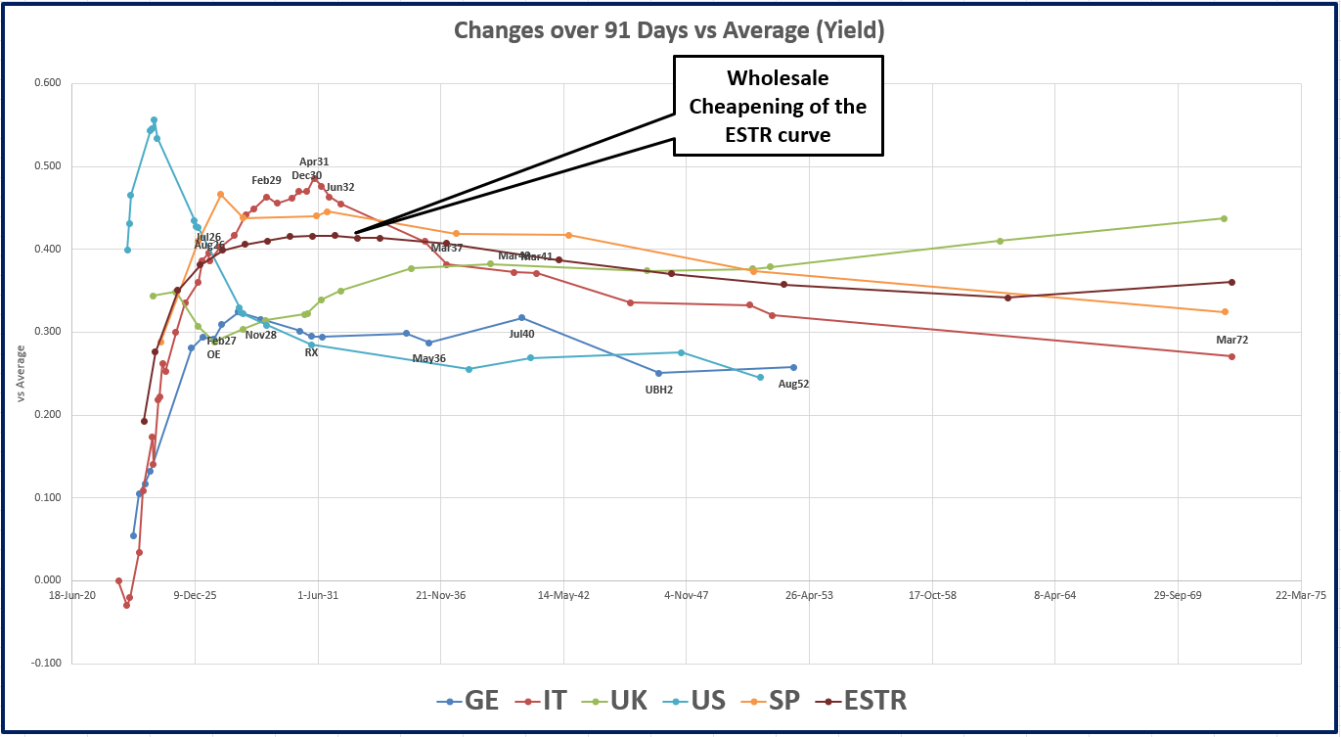
Yield Changes over the last 90 days

Slide 4
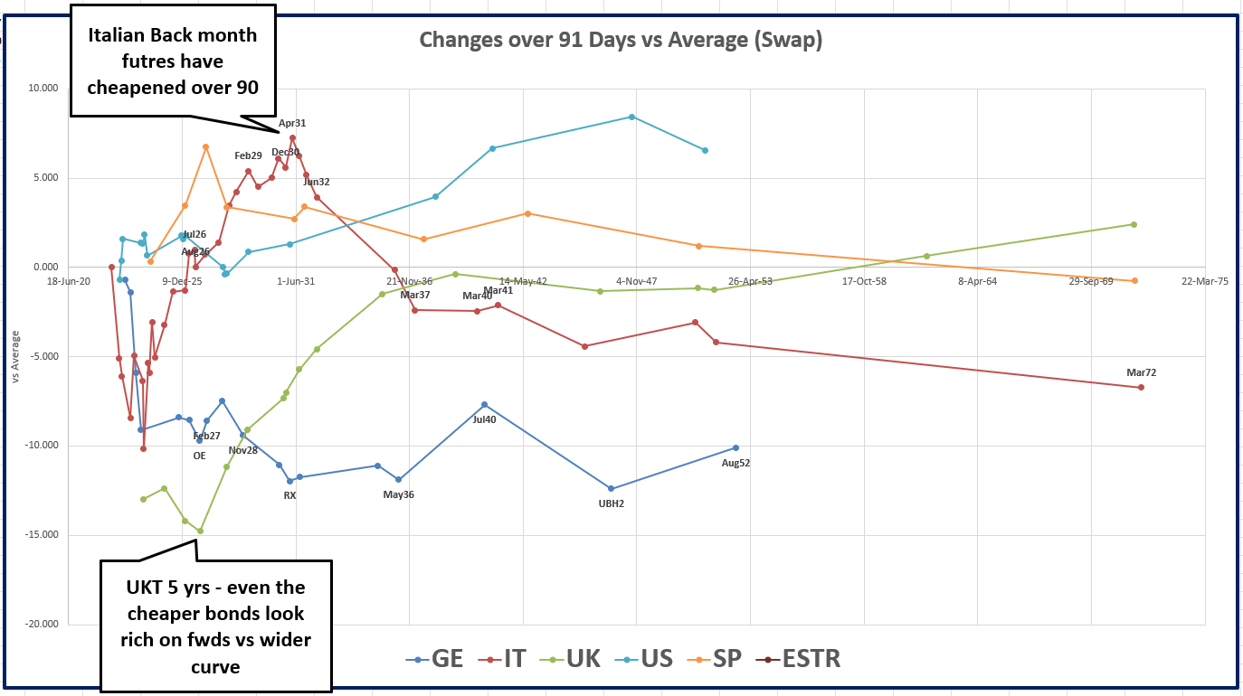

Slide 5
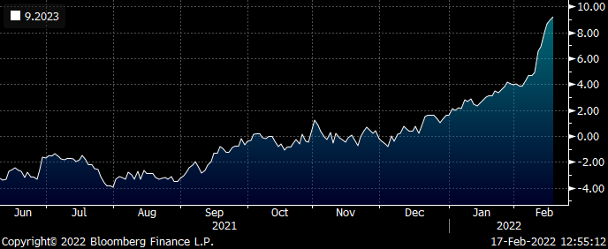
Italy: long back month IK CTD vs jul28 & Dec31
Btps…
-jul28 / +apr31 (or back months) / -dec31
Weighting: .4 / 2 / 1.6
Small entry here 20% (risk)
Target entry: +10.5bp (based on forwards)
Rationale: apr31 is an oversold back month CTD, low coupon bond that has been driven into the curve by credit selling and roll prep. On forwards at the higher lvl we see it as value
200 * (yield[BTPS 0.9 04/01/31 Govt]-0.2*yield[BTPS 0.5 07/15/28 Govt]-0.8*yield[BTPS 0.95 12/01/31 Govt])

Slide 6
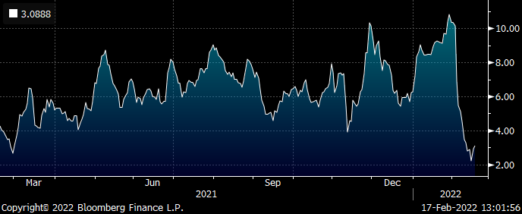
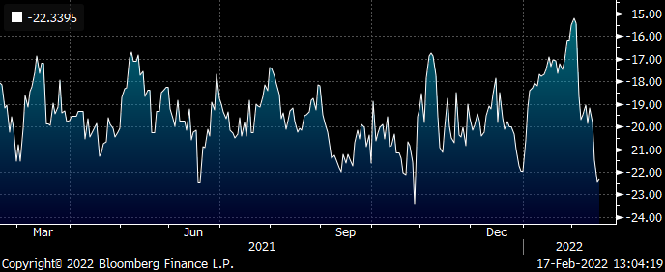
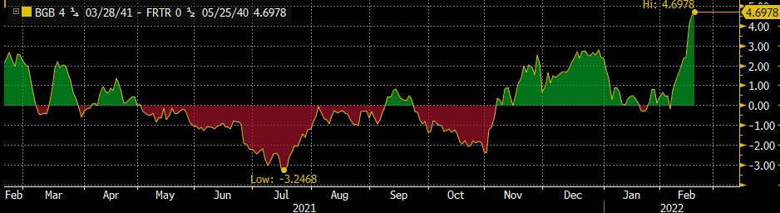
Sell France 20y vs OATA & 30y
Generally we’re looking for short ends to bounce but see long ends as overly optimistic in the ability to contain inflation
Therefore we want to fade the flattening and have steepeners – one nice fade is to sell 20y belly vs wings
Graphs show using the old 30y – we prefer to use the newer frtr 53 for more value
Again, smalls here and decent @ <2bp – expecting more curvature than history reveals
See graph vs Yields & Vs swap
Also anomaly Frtr 40 into HC BGB 41 – for pro PEPP and Carry
Vs yield
Vs swap

Slide 7
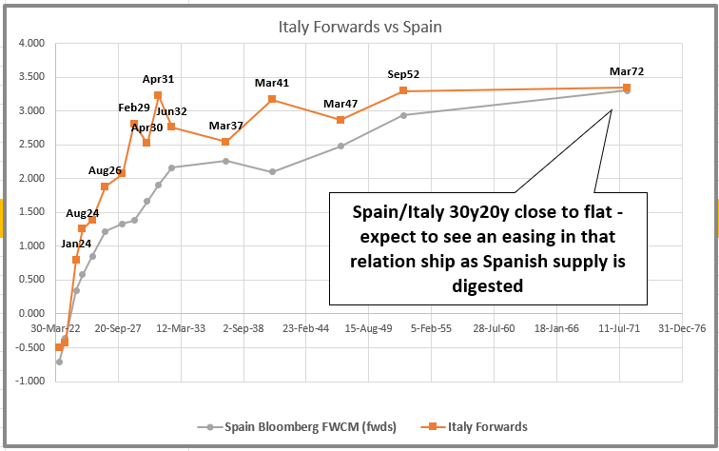
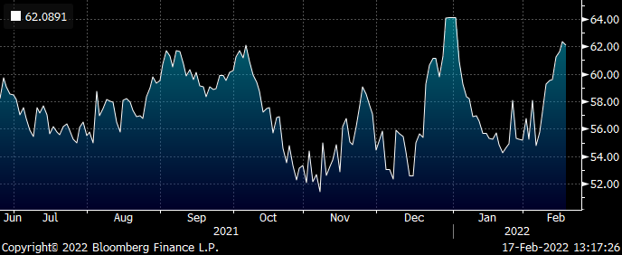
Spain 10s50s flattener vs Italy 10s50s steepener
Call for bonds and details…
30y20y spain almost flat to 30y20y Italy has flattened in the back end
Yes it should flatten – but no forwards should go lower then issuers in a much better shape
Our expression is the 10s50s box: Spain/Italy

Slide 8
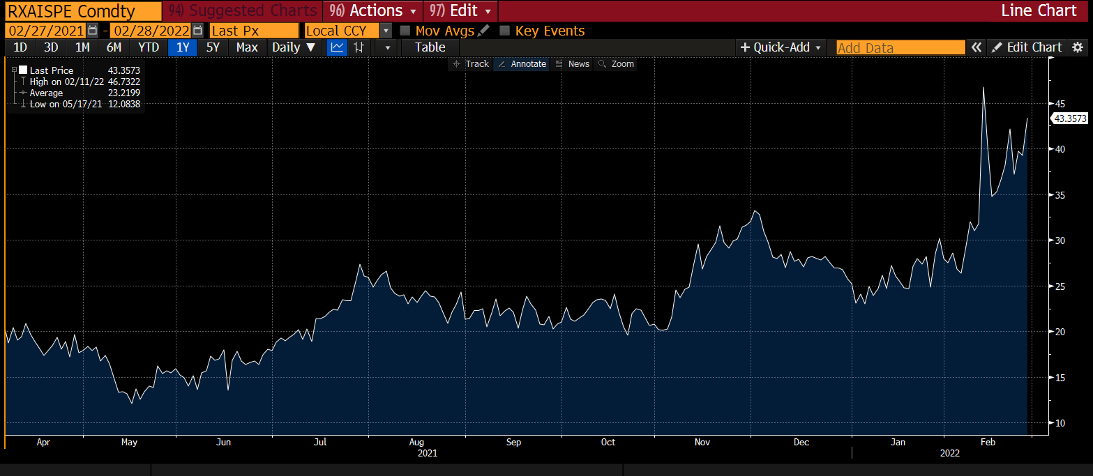
Germany announces increased defence spending: German invoice spreads look vulnerable
Core and Semi Core invoice spreads widened
Although regression may off lite to us about the future, certainly historically German invoice spreads look rich

Slide 9
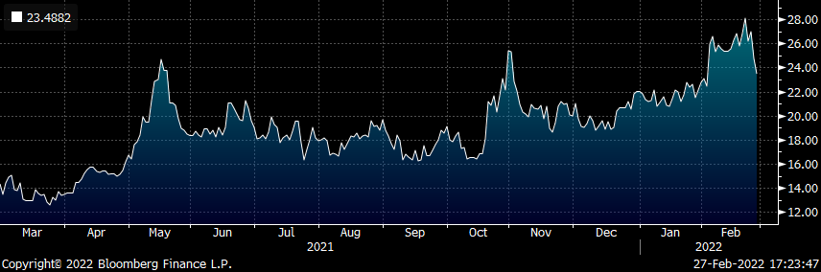
Regressing French Invoice spreads vs Germany – France got to cheap levels
Long end French supply on Thursday may be a good chance to get French inv spreads vs Germany. On regression
OATISPE – 60% RXAISPE = look for the highs again in this one up until Wednesday?

Slide 10
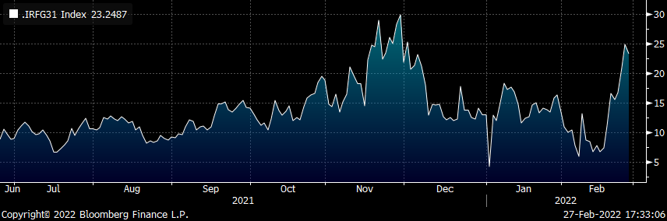
Some specific countries got too cheap to France – looking at those farthest from continental Europe: Ireland
Ireland on a regressed basis vs France and Spain looks ok..
Take Ireland vs France and then rotate, by buying back France next Wednesday ahead of supply
To leave us with…
Ireland vs Spain and Germany
(+2.00*yield[IRISH 0 10/18/31 Govt ]-1.00 * yield[DBR 0 02/15/31 Govt]-1.00 * yield[SPGB 0.5 10/31/31 Govt])*100

Slide 11
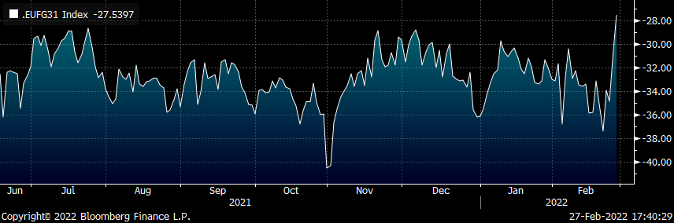
EU 4y supply on Monday: containment of spread risk just difficult in EU – requires even more leverage in wideners
Being long EU AND Bunds vs short short France seems the only way to have contained EU risk during the last year of supply
Consider long 1 unit of EU and 0.9 units of Germany to be short 1.9 units of France
10y tenor graph to the right, pictured…
The real issue here is our struggle to contain the cheapening drift in EU bonds as spreads widen
Am not sure I love EU bonds here – the issuance entity doesn’t feel determined and hence robust – but I’d be taking back shorts if I had any

Slide 12
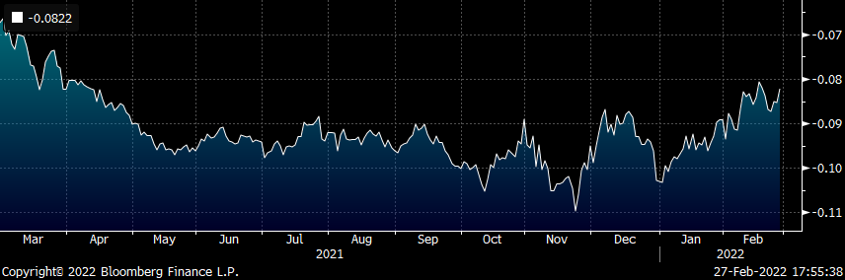
German Green August 30 tap Wednesday:
German Green 2030 trade with a 3% delta vs the CTD to RXM2 (June RX))
I see the bond 4.5bp rich to the same maturity regular Dbr
In terms of greeniums, I like them all at -3bp but in this environment I want -2.5. I just don’t care if it doesn’t get there
On that basis – I’d buy the issuance vs RXM2, if this index gets over -6.5bp. Street may be short or they may just hang around…
((YIELD[ZO291992 Corp] - 1.03 * YIELD[DBR 0 02/15/31 Corp]))

Slide 13
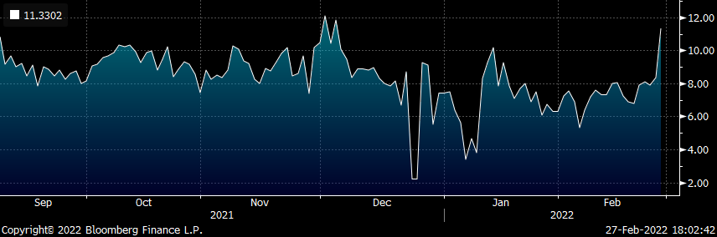
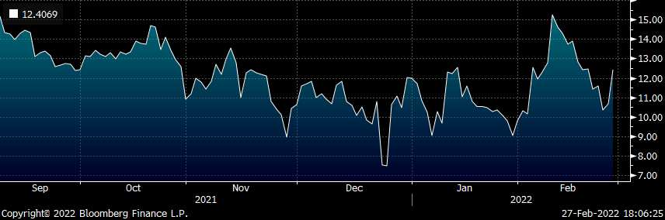
Spain 42 on Thursday
(+2.00*yield[SPGB 1 07/30/42 Govt ]-0.70 * yield[SPGB 0.5 10/31/31 Govt]-1.30 * yield[SPGB 1 10/31/50 Govt])*100
On fly vs 10y and 30y…
0.7 / 2 / 1.3
On box 10s20s Spain vs France it looks unimpressive
On straight regression vs 30y bond looks like it could cheapen 4bp – stand back and let it happen…. Maybe short some French 20y vs OATM2
100 * ((YIELD[SPGB 1 07/30/42 Corp] - YIELD[SPGB 0.5 10/31/31 Corp]) + -0.9 * (YIELD[FRTR 0.5 05/25/40 Corp] - YIELD[FRTR 1.5 05/25/31 Corp]))

Slide 14
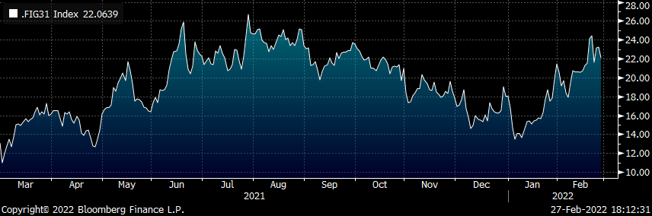
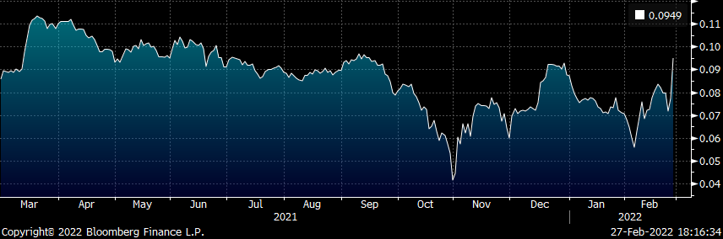
French Longs on Thursday
10y 2032
30y 2053
And old high coupon 3.25 45
All other things being equal I need France 10s30s 5 steeper to get excited
( +2.0 * YIELD[FRTR 1.5 05/25/31 Corp] - 1.6 * YIELD[DBR 0 02/15/31 Corp] - 0.4 * YIELD[BTPS 1.65 12/01/30 Corp]) * 100
As a credit France seems to have support vs IK and RX about 2/3 bp from here – I would tentatively have some there
The HC 45 look interesting – cheap bond when I re-invest all cash-flows at the right rate
Vs selling Frtr May40 – which I hate, they’re +9.5bp
@ > + 10.5bp I think they look good – needs to trade with a 2% delta long

Slide 15
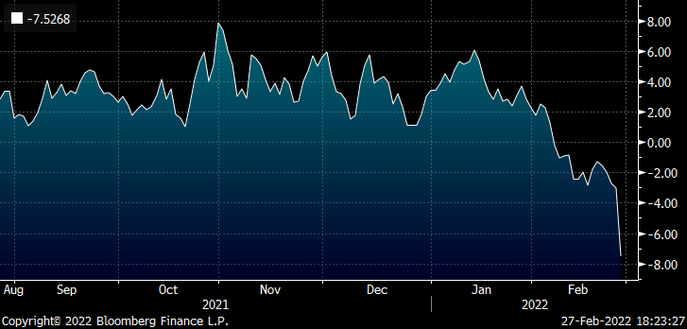
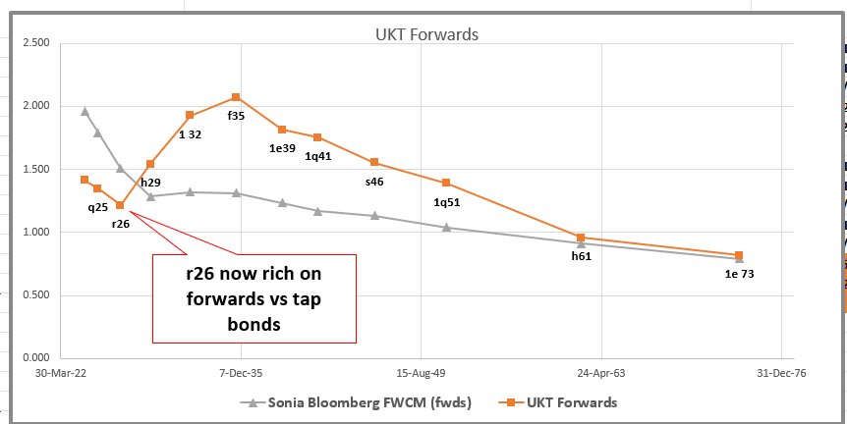
UKT q25 supply on Wednesday
Love ‘em as a wing to short 5yrs which got rich on forwards end of last week
UKT +q25 –r26 +h29
Weights: +1.3 / -2 / +0.7
If you wanna spice it up by selling anomalous bonds… be my guest
(+2.00*yield[UKT 0.375 10/22/26 Govt ]-1.30 * yield[UKT 0.25 01/31/25 Govt]-0.70 * yield[UKT 0.5 01/31/29 Govt])*100

Slide 16

UK: 14-16 Dowgate Hill, London ec4r 2su
US: 60 Rumson rd, rumson, nj 07760
Office: +44 (0) 203 -143 - 4178
Mobile: +44 (0) 7540-117705
Email: james.rice@astorridge.com
Website: www.astorridge.com
This marketing was prepared by James Rice, a consultant with Astor Ridge. It is not appropriate to characterize this e-mail as independent investment research as referred to in MiFID and that it should be treated as a marketing communication even if it contains a trade recommendation. A history of marketing materials and research reports can be provided upon request in compliance with the European Commission’s Market Abuse Regulation. Astor Ridge takes no proprietary trading risk, has no market making facilities, and has no position in any security we discuss in this e-mail. The views in this e-mail are those of the author(s) and are subject to change, and Astor Ridge has no obligation to update its opinions or the information in this publication. If this e-mail contains opinions or recommendations, those opinions or recommendations reflect solely and exclusively those of the author, and such opinions were prepared independently of any other interests, including those of Astor Ridge and/or its affiliates. This publication does not constitute personal investment advice or take into account the individual financial circumstances or objectives of the those who receive it. The securities discussed herein may not be suitable for all investors. Astor Ridge recommends that investors independently evaluate each issuer, security or instrument discussed herein, and consult any independent advisors they believe necessary. The value of, and income from, any investment may fluctuate from day to day as a result of changes in relevant economic markets (including changes in market liquidity). The information herein is not intended to predict actual results, which may differ substantially from those reflected. Past performance is not necessarily indicative of future results.
You should not use or disclose to any other person the contents of this e-mail or its attachments (if any), nor take copies. This e-mail is not a representation or warranty and is not intended nor should it be taken to create any legal relations, contractual or otherwise. This e-mail and any files transmitted with it are confidential, may be legally privileged, and are for the sole use of the intended recipient. Copyright in this e-mail and any accompanying document created by Astor Ridge LLP is owned by Astor Ridge LLP.
Astor Ridge LLP is regulated by the Financial Conduct Authority (FCA): Registration Number 579287
Astor Ridge LLP is Registered in England and Wales with Companies House: Registration Number OC372185
Astor Ridge NA LLP is a member of FINRA/SIPC: CRD Number 282626
Astor Ridge NA LLP is a member of the National Futures Association (NFA): Firm ID Number 0499303
Astor Ridge NA LLP is Registered in England and Wales with Companies House: Registration Number OC401796
James Rice

