Slide 1
TECHNICAL SWAPS IDEAS : DAVID SANSOM AND I have been working on utilising TECHNICALS on SWAP ideas and here are 3 we have found. The USFS 10-20 was advocated a while ago and its picking up momentum.
Here are 3 very technical interpretations of various swap ideas which myself and David Sansom have been working on. All have decent dislocations and thus the stops are cheap on all.
TRADE 1 USFS 10-20 WHAT NEXT : **STILL TIME TO RELOAD or ADD as we HEAD LOWER AGAIN.**
This continues to work well, moving lower again in a similar style to the move lower in bond yields.
Above all this is a long term trade hence don’t be afraid to sell new LOWS.
This chart corelates well with the outright yield charts which ALSO predict a move LOWER.
My BIG worry is that if equities fail then yields plummet and the RE ENTRY is missed.
Trade 2 EU 2-10
A simple chart highlighting a hit of a trend line from 2008 and RSI last seem in September 2014. Sadly this has breached the trend line but for those who still believe the RSI dislocation then a stop sub the 50% ret 69.500 might suit.
Trade 3 EU HICP ZC swaps
Again a simple chart and significant historical history well worth a look as it is complimented by NUMEROUS technical factors. We have built a BASE but subsequent PERFORMANCE is poor.
**Speak to David Sansom re any trade discussion on this idea, NEW OR ADDING. **

Slide 2
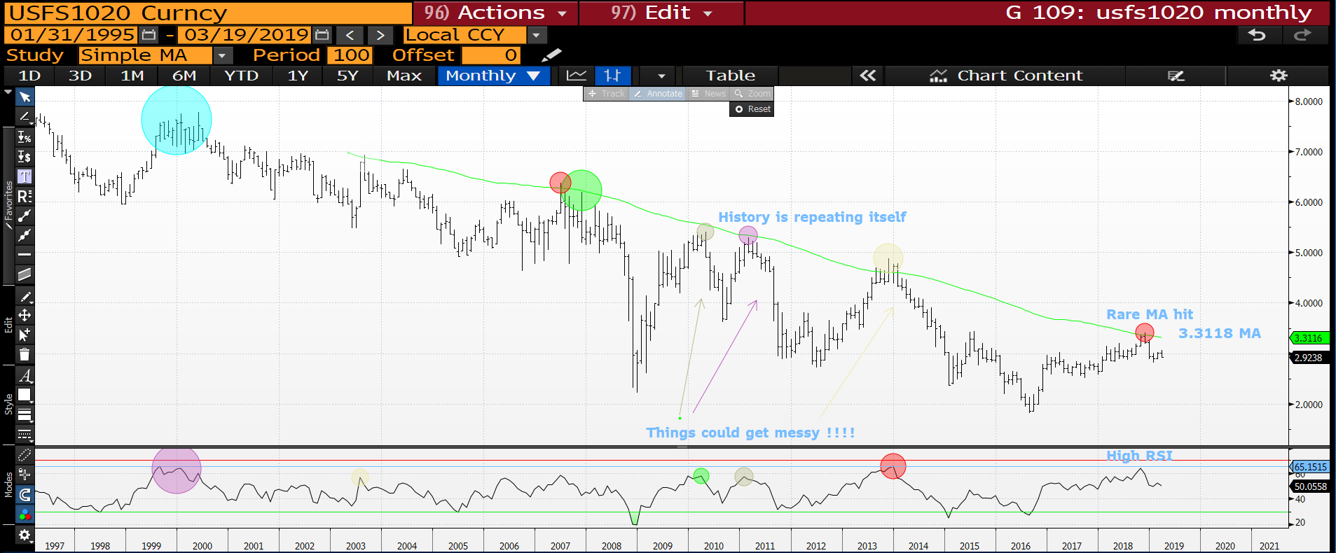
USFS 1020 monthly : The long-term view hasn’t changed given the moving average failure, RSI extension and inability to rally. The latest bounce has failed to achieve any major level breaches, we are now heading lower! Hopefully momentum picks up.

Slide 3
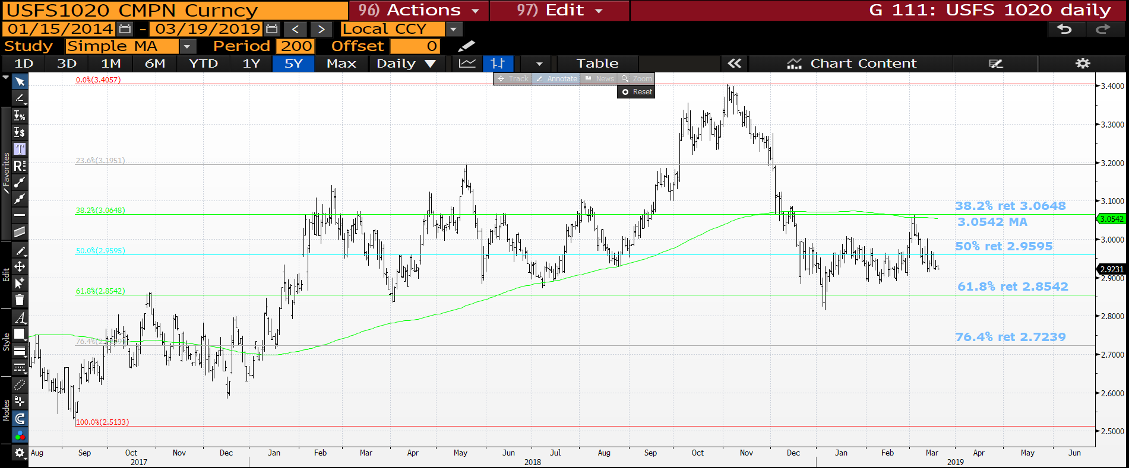
USFS 1020 daily : The moving average is a distant memory and now we are FAILING the
50% ret 2.9595. This is one of the weakens bounces and any new low will open the flood gates. The upside pierce recently helps the call lower no end.

Slide 4
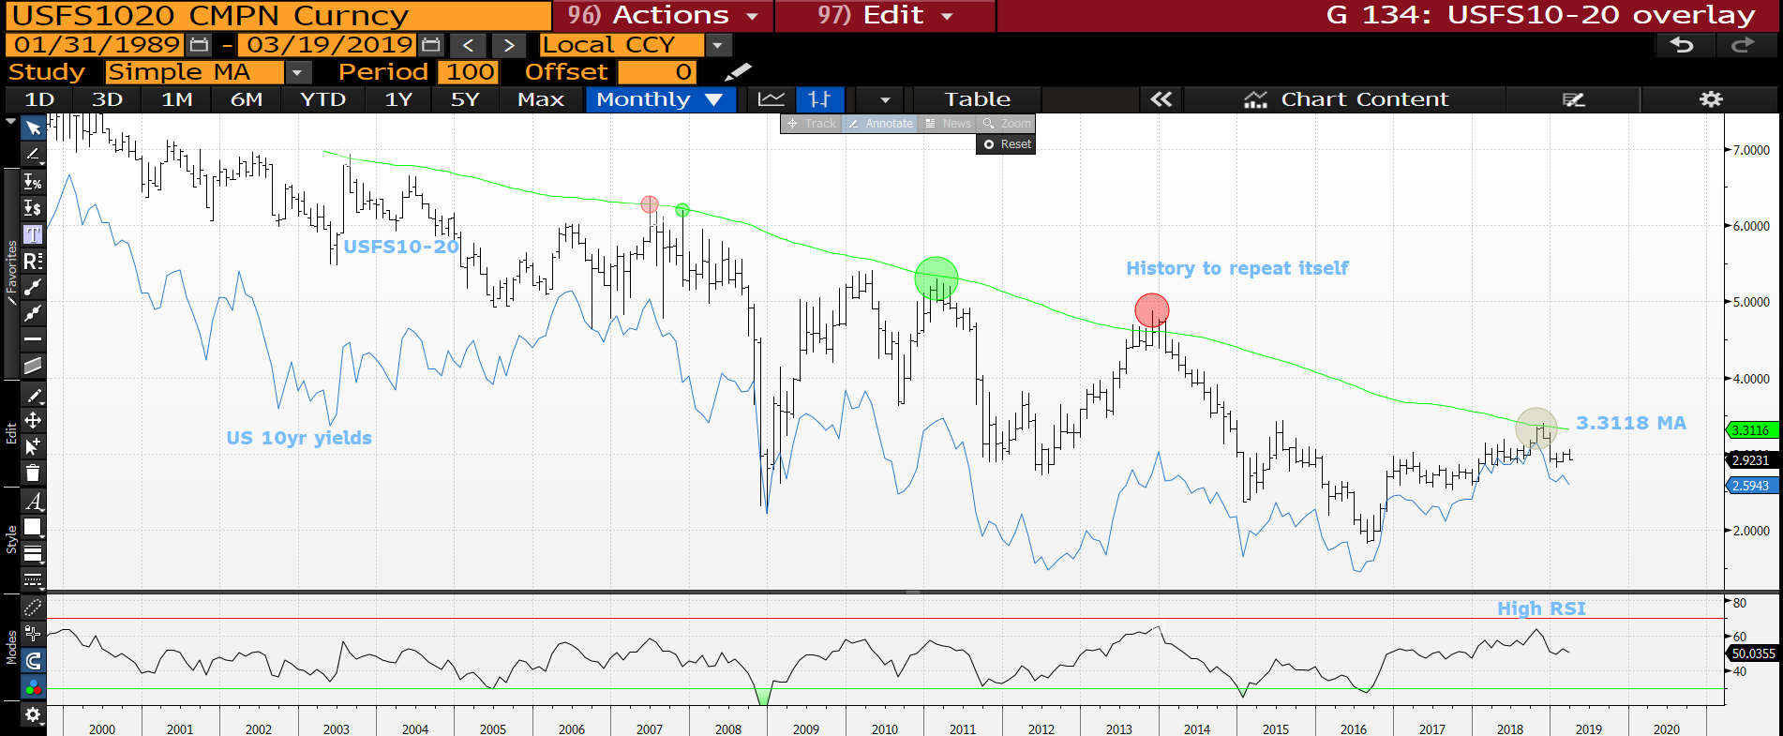
USFS 1020-US 10yr yield overlay monthly : A pretty neat representation of the current correlation between US 10yr yield and the USFS 10-20. Both seem to have EVERY reason to head lower over the longer-term. The speed of the drop might be the alarming factor.

Slide 5
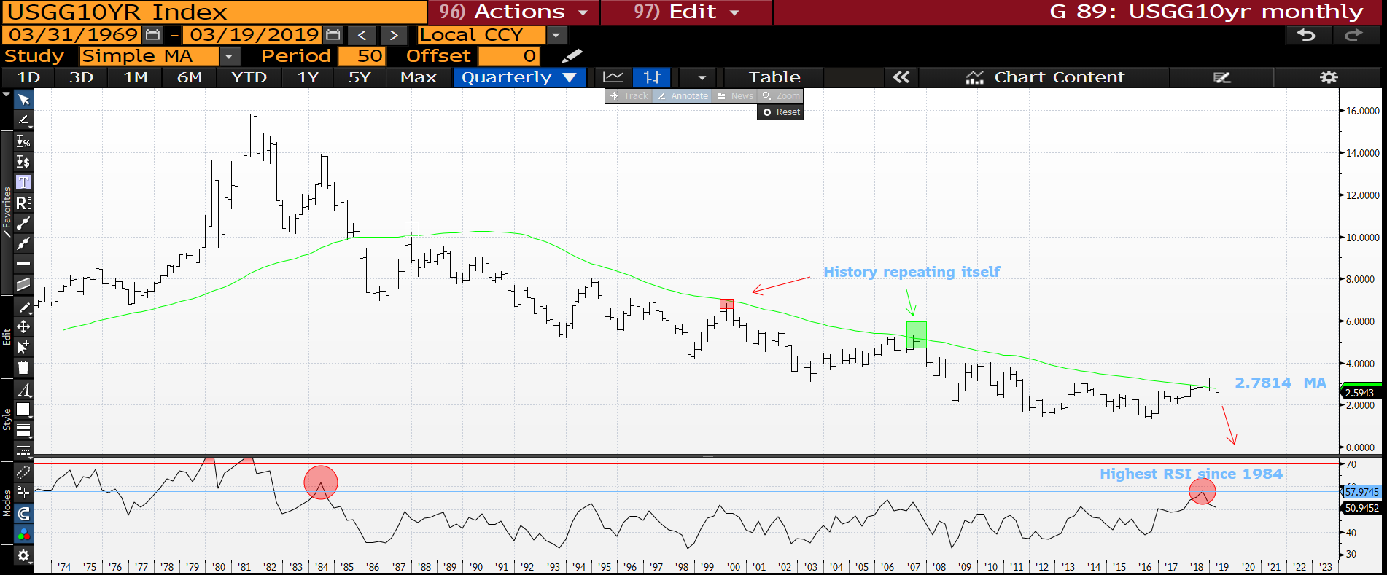
US 10yr yield quarterly : Hopefully this highlights the correlation with the USFS10-20 as this chart too has a NEW YEAR low. We are also sub the 2.7823 moving average with a nice 1984 RSI extension. Yields could see a savage drop.

Slide 6
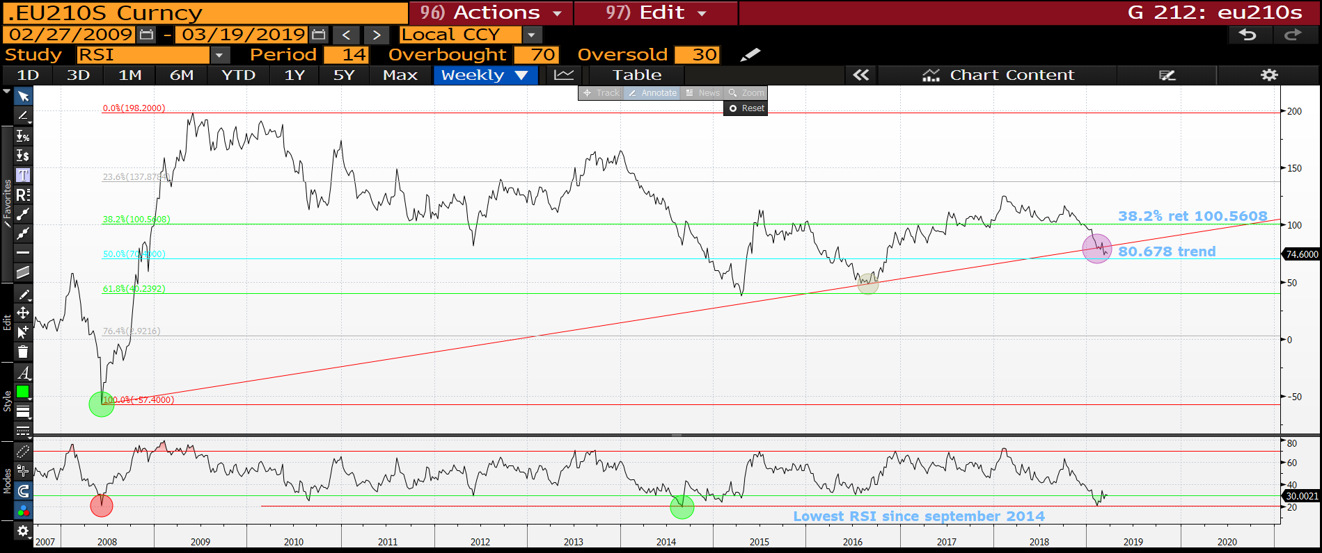
EU 2-10 Swaps weekly : This has sadly breached the 2008 trend line but the RSI remains very dislocated for those who still believe the RSI, stops below the 50% ret 69.500.

Slide 7
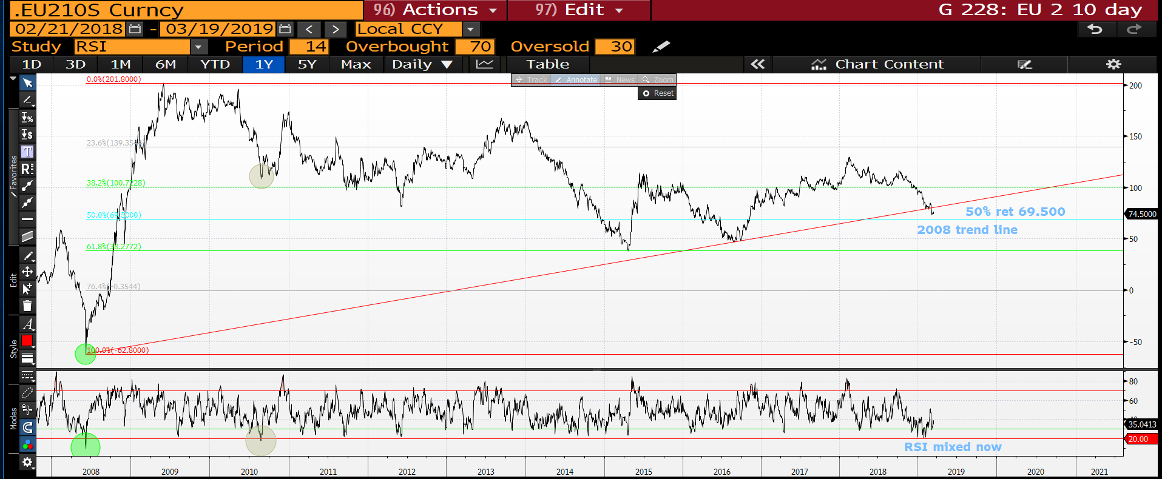
EU 2-10 swaps daily : The RSI is now mixed on the daily as the trendline is breached, as mentioned all stops sub the 50% ret 69.500 if people believe in the weekly RSI.

Slide 8
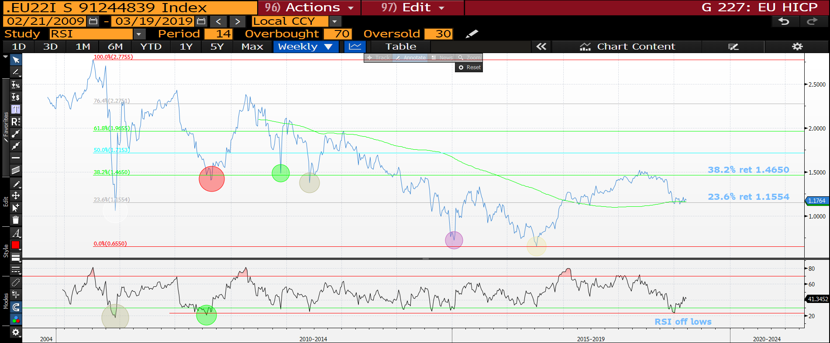
EU HICP ZC 2y2y fwd weekly : We persist in HOLDING the multi year 23.6% 1.1554 retracement but bounce has been minimal, this presents a problem as the RSI is now off its lows.

Slide 9
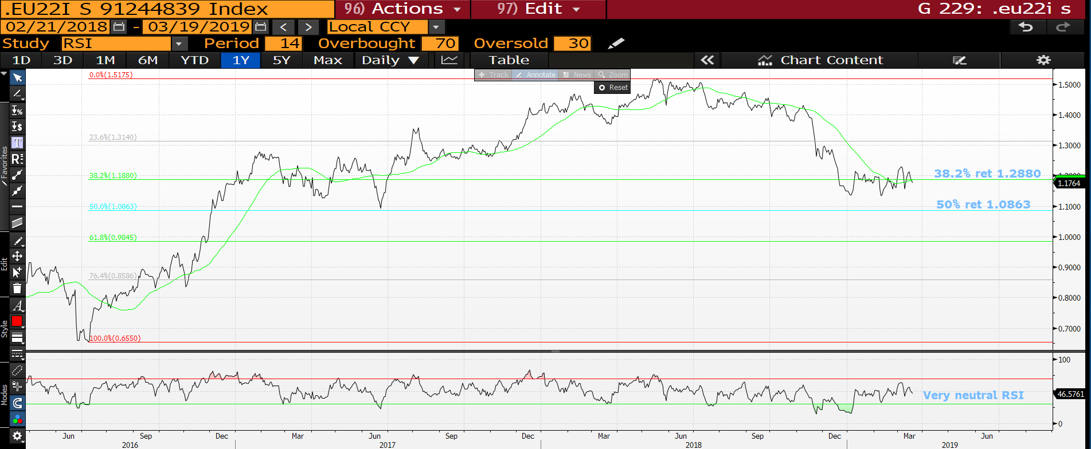
EU HICP ZC 2y2y fwd daily : We are holding the 38.2% ret 1.2880 but with minimal bounce! We need to start bouncing soon.

Slide 10


