Slide 1
USFS 10-20 WHAT NEXT : Am sure many REAL MONEY accounts will run this idea given its RARITY valve.
For those taking profits at the SOLID 200 day moving average, here are some RE ENTRY points!
Above all this is a long term trade hence don’t be afraid to sell new LOWS. We do need to erode some of the latest daily over extension (page 6).
Overall this chart corelates well with the outright yield charts which ALSO predict a move LOWER.
This weeks NON FARM could be a nasty catalyst, a big dilemma for many if we approach it at yield lows.
My BIG worry is that if equities fail then yields plummet and the RE ENTRY is missed. Therefore finding the bounce on this strategy might require a “SCALE IN” BUT significant ADD when 3.0648 failure confirmed. The STOP on any scale in could be just above the 61.8% ret 3.2744 on page 6.
This will be a big trade as it 100% endorses the YIELD LOWER call.

Slide 2
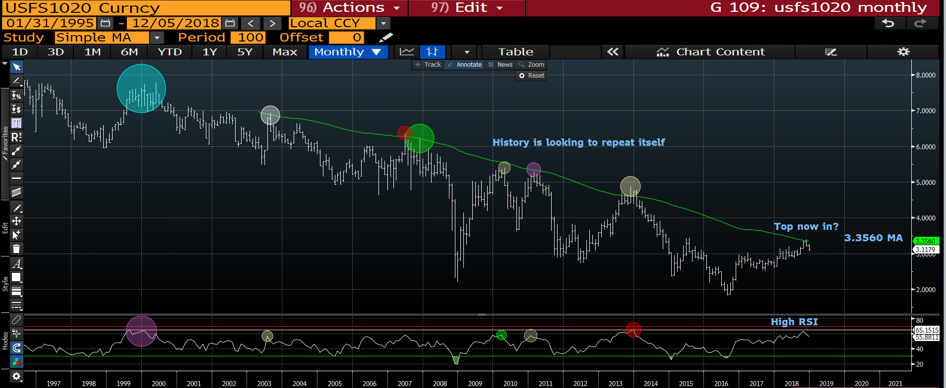
USFS 1020 monthly : If we can agree a major TOP IS IN then this head happily lower during 2019. Its been a nice 100 period moving average rejection and the RSI is as high as 2014!

Slide 3
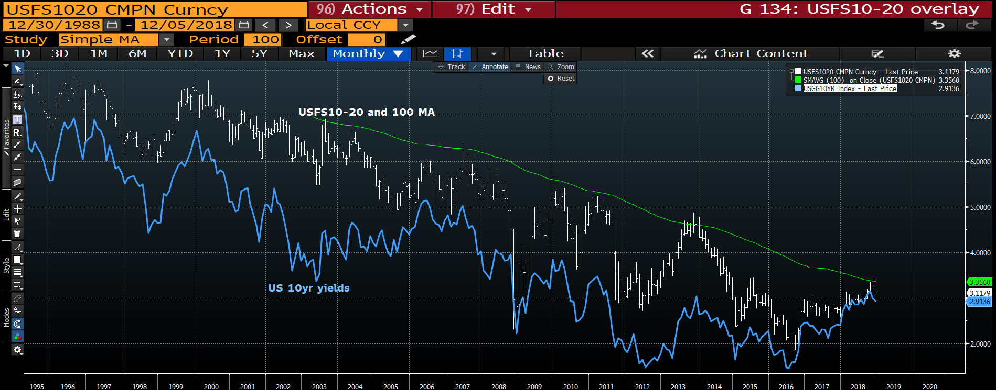
USFS 1020-US 10yr yield overlay monthly : A pretty neat representation of the current correlation between US 10yr yield and the USFS 10-20. Both seem to have EVERY reason to head lower.

Slide 4
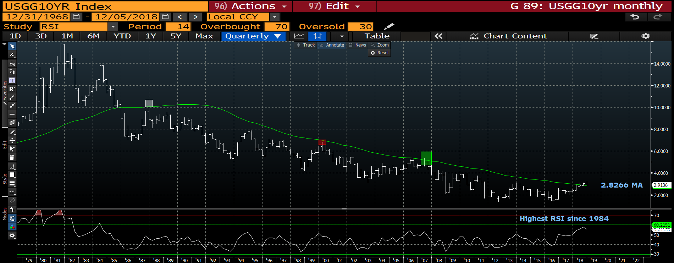
US 10yr yield quarterly : This highlights a massive problem, the RSI has only JUST rolled over and is of 1984 proportions! We have a major reversal-BAR on the quarter but a breach of the 2.8266 moving average will be the KILLER blow. Thus plenty going on here.

Slide 5
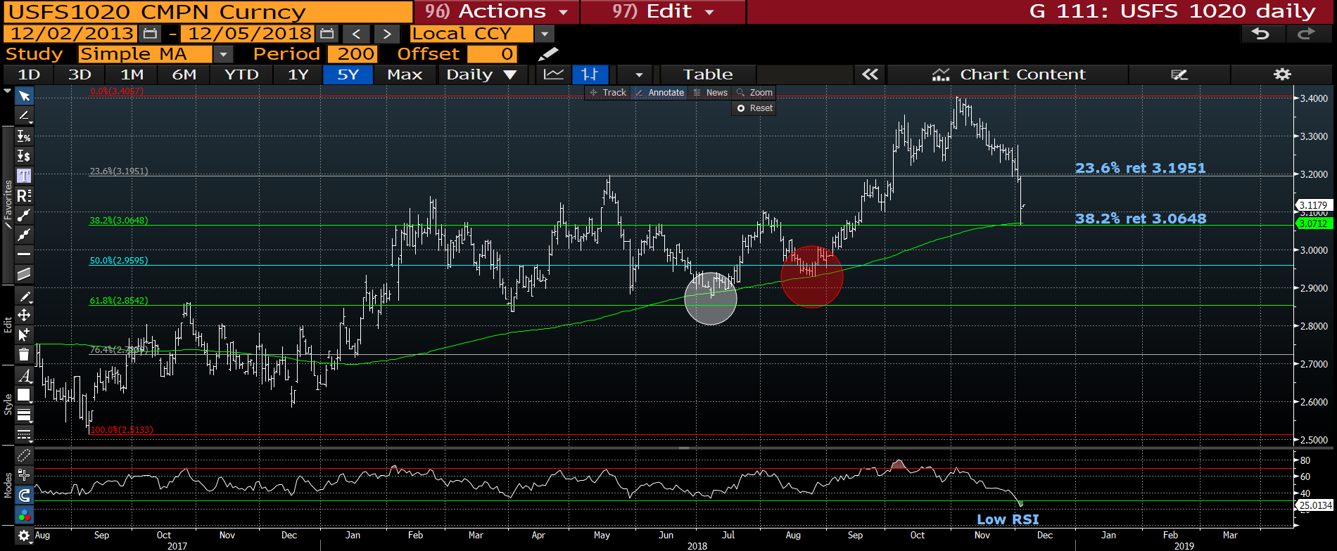
USFS 1020 daily : We have had a perfect HIT of the 200 day 3.0712 so this tells me TECHNICALLY, levels should work. The natural draw is the 23.6% ret 3.1951.
This chart also highlights SELL ANY breach of the 38.2% ret 3.0648 if the RSI recovers its over extension.

Slide 6
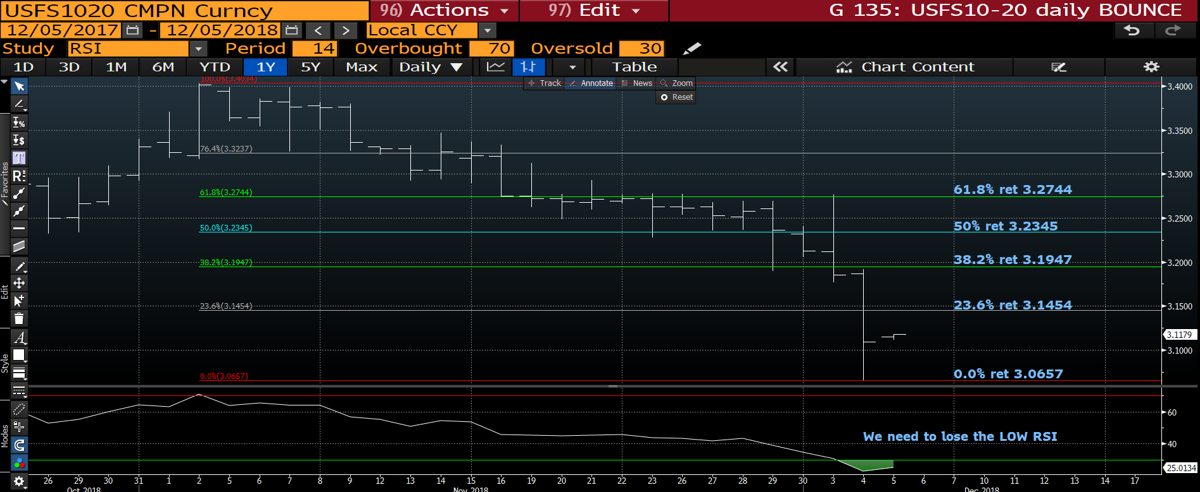
USFS 1020 daily : We did over step the mark with yesterdays range BUT finding the RE ENTRY isn’t going to be easy. There are a selection of levels to try, I think starting from the
38.2% ret 3.1947 up to the 61.8% ret 3.2744. The RSI needs to be watched like a HAWK to assess when it might suddenly ROLL LOWER.

Slide 7
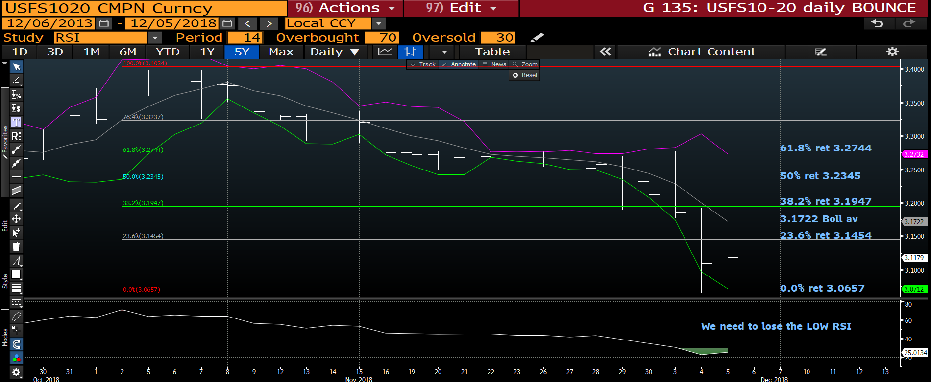
USFS 1020 daily : Another possible failure point can be the bollinger average 3.1722, but in this case I think the RSI needs more room to erode its over extension.

Slide 8


