Slide 1
MULTI ASSET UPDATE : PRE NON FARM The big movers have been stocks and bonds with significantly more room to “GO” on both. The only issue ahead of NON FARM is the oversold nature of the DAILY YIELD RSI’s.
The EURO continues to remain heavy and sub 1.1500 furthers the negative outlook.
**Trade idea BUY Euro Dec 11100.00 puts @15 ticks, and ADD below 1.1301 NOW 0.5.
EM BONDS continue to do well and many USD crosses well on the way to major drops. The USD INR short is starting to develop as a sizeable top has been confirmed. USD TRY and USD ZAR about to stretch their legs.
EQUITIES
These have worryingly broken many MAJOR levels and the US is close to COMPLETE reversal confirmation.
**Trade idea BUY DAX DEC 11300-11200 put spread 33.0 ticks and ADD sub 11400. NOW 75.5**
CORE BONDS : Bonds are now back in the limelight given the MONTHLY REVERSAL. All longer duration charts have many RSI’s at 1984, 1982 extremes. We just need to eradicate some of the DAILY RSI dislocations!
US CURVES continue to steepen in the back end and show little signs of giving up the BULL STEEPENER bias, that said this whole yield-curve directional view NEEDS discussion. The STEEPENING continues.
Positions :
**Buy US 2-30 entry 36.418 now 39.196**
**Buy US 10-30 entry 14.426 now 26.050**

Slide 2
FX UPDATE
Topics PAGES
CORE FX 03-10
USD EM (Opportunities) 11-17
Stocks 18-26
Bonds 27-36
US Curves 37-45
Oil 46-47

Slide 3
FX UPDATE
FX UPDATE :
EURO : A VERY sideways performance given focus for many has been ELSEWHERE i.e. stocks and bonds. Overall we remain negative whilst sub 1.1500 and a breach 1.1241 50% ret, we FREE FALL.
EUR GBP I have long favoured a short in this and ACTIONED a short recently, it has a long way to go. I would prefer it to REFLECT a weak EURO performance overall not a DIFFERENT rate of change on a EURO rally with GBP. This could be the STAR trade for the YEAR END.
USD EM This really is starting to stretch its legs now and REAL MONEY is long EM and am sure
poised to ADD as confidence builds.
USD INR has now confirmed its long-term top.

Slide 4
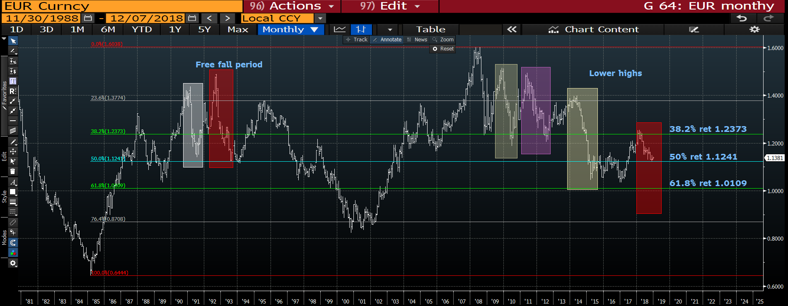
EUR USD quarterly : We continue to trade sideways but a breach the multi year 50% ret 1.1241 WILL HELP ALOT.

Slide 5
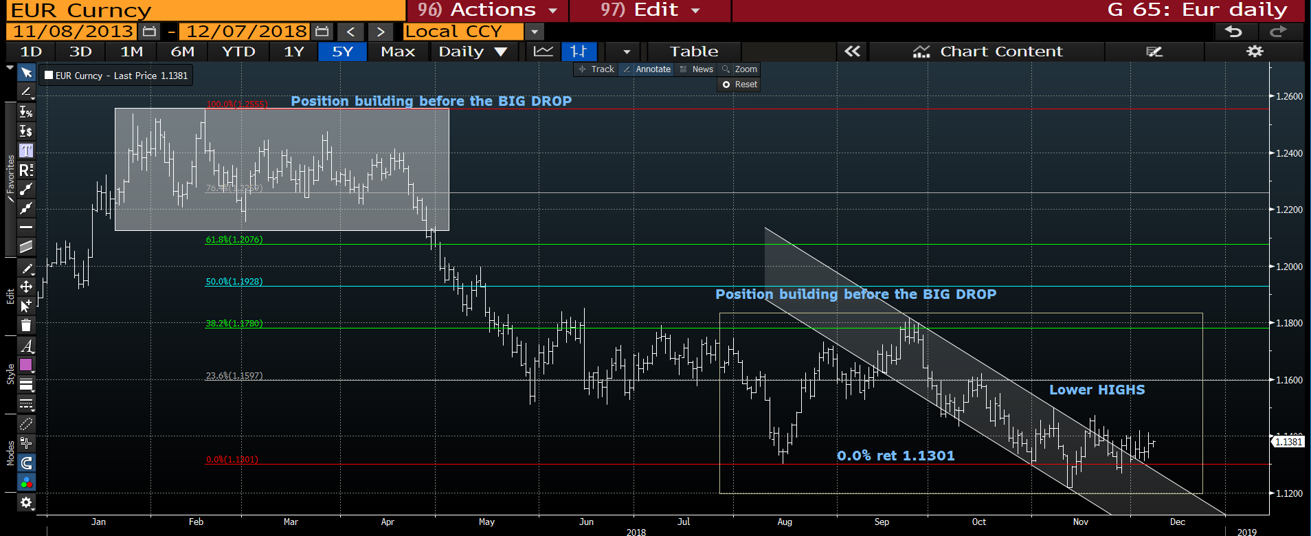
EUR USD daily : A very sideways period of late but whilst sub the 1.1500 high all remains negative.

Slide 6
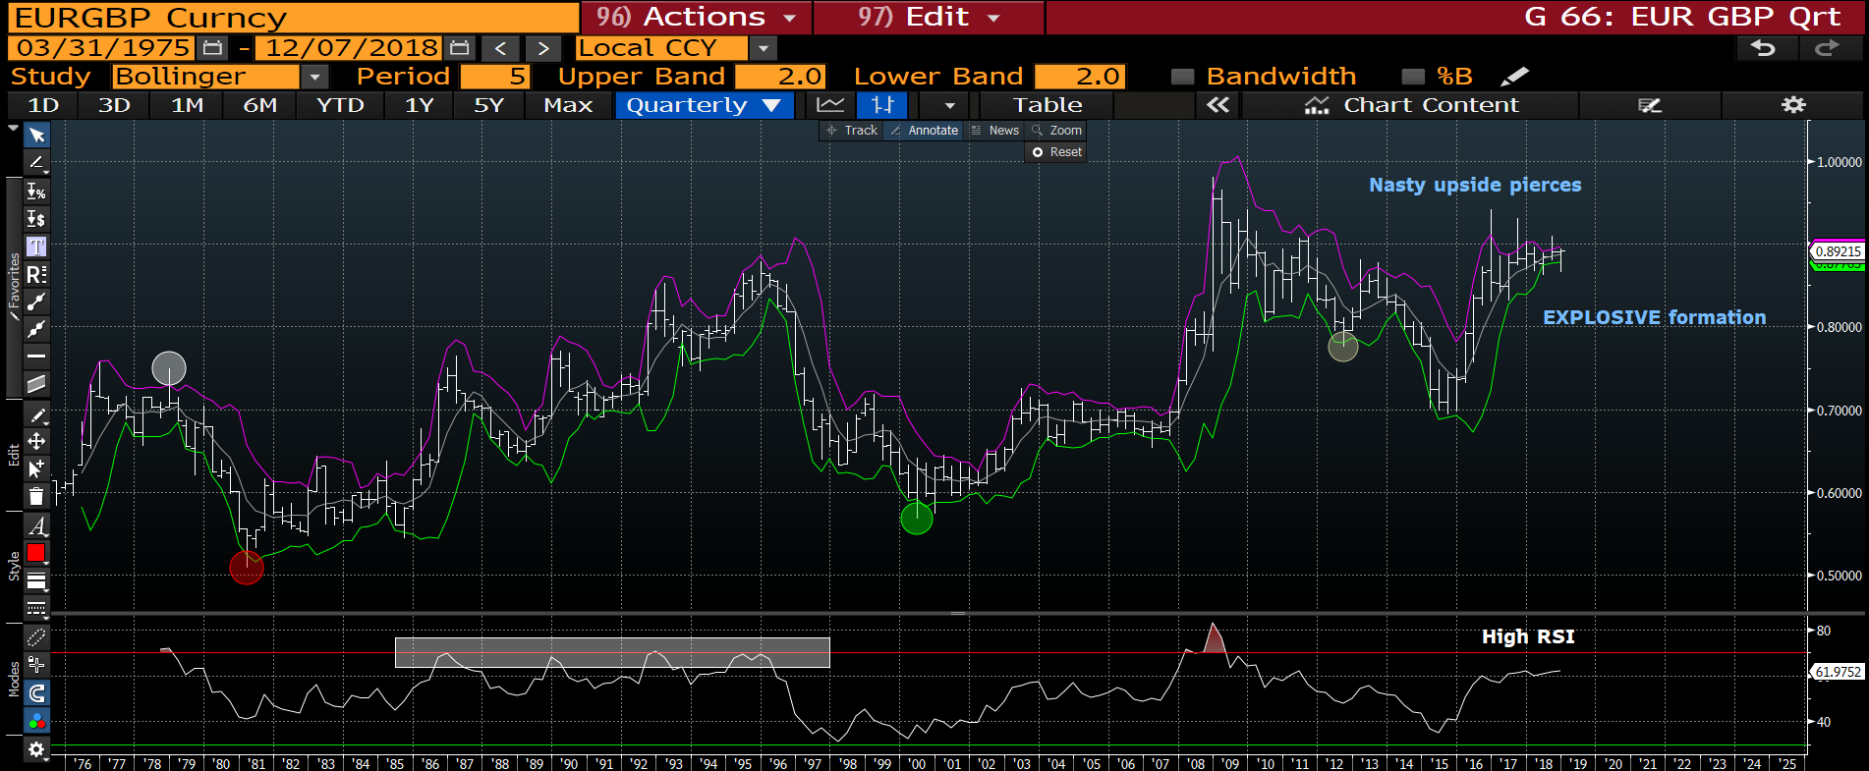
EUR GBP quarterly : This is shaping up to be a VERY BEARISH long-term formation. The MAGNITUDE of upside pierces are extremely rare.

Slide 7
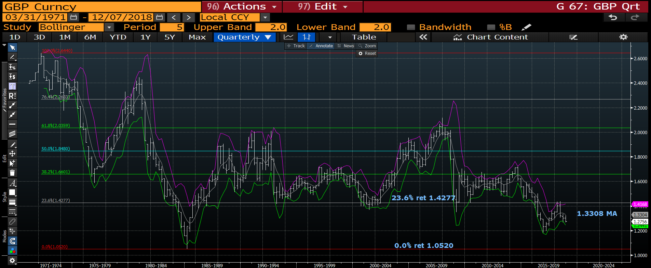
Cable Quarterly : No real outright trade here, we remain between the bollingers and it would be better to represent it via the EUR GBP idea. The overall bias remains lower while we are sub the 1.3308 trend friend bollinger average.

Slide 8
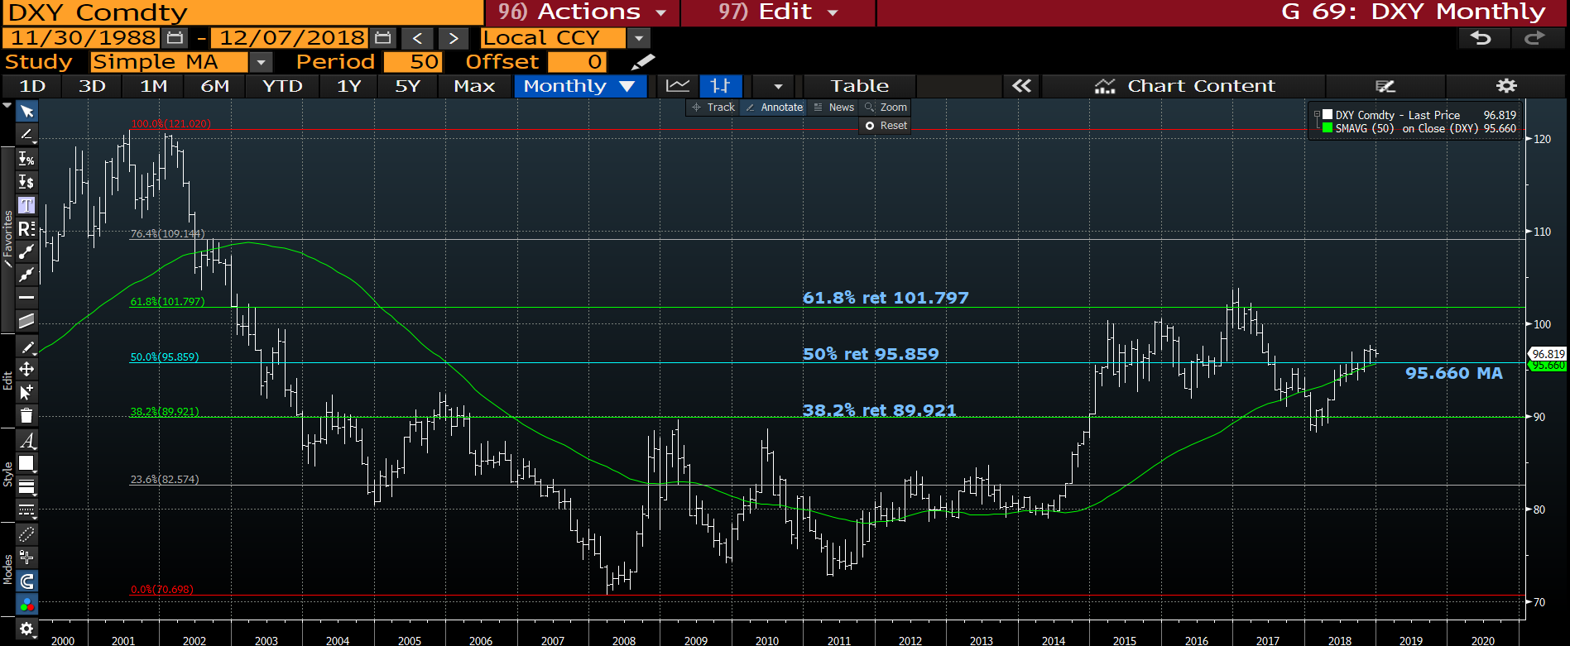
DXY monthly : This remains a CONSTRUCTIVE chart whilst above the 50% ret 95.859, all is VERY POSITIVE. Plenty of CLEAR AIR above us, just need to make use of that opportunity.

Slide 9
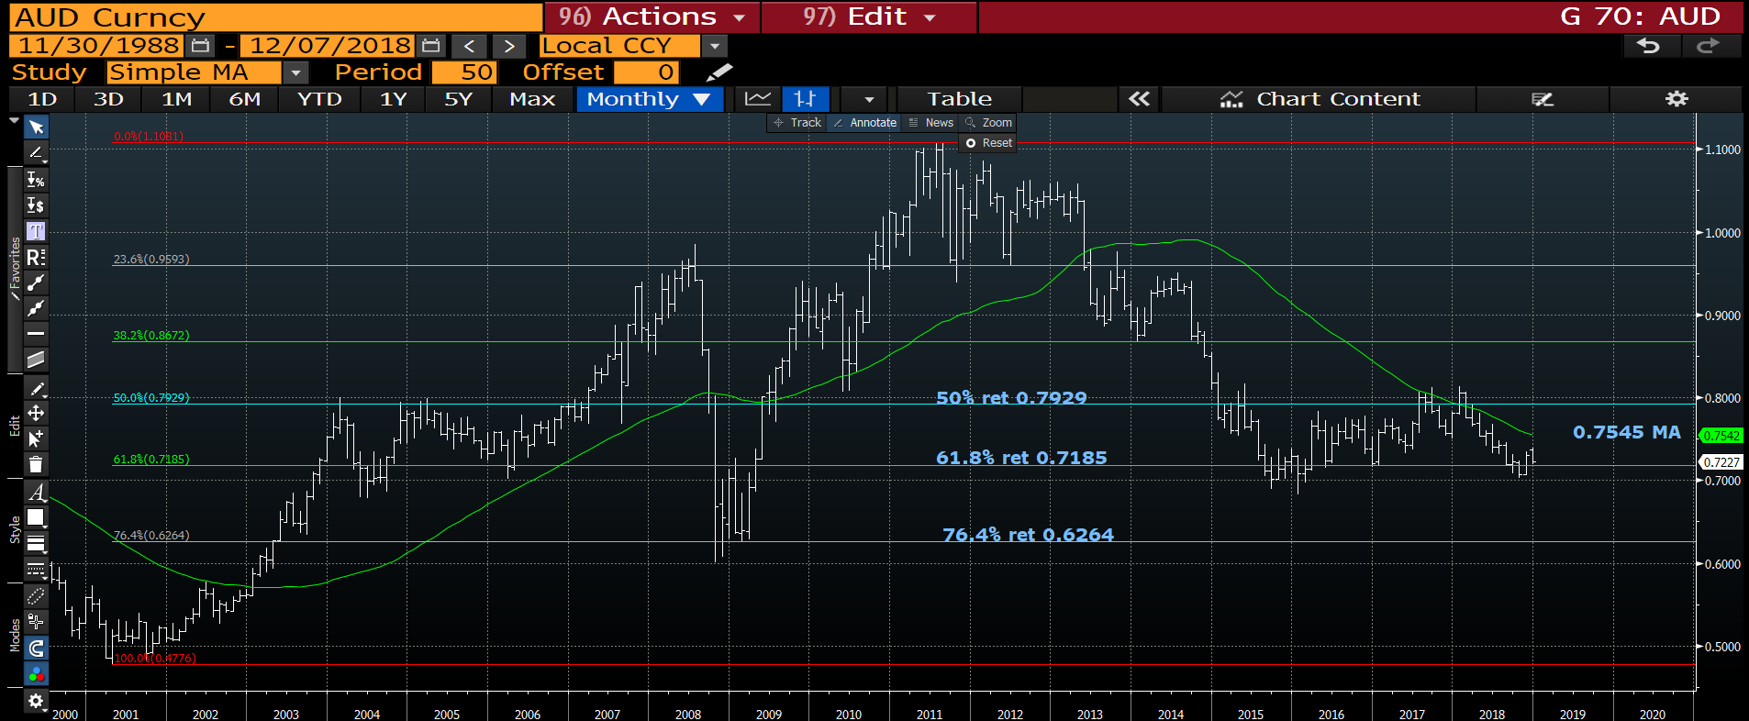
AUD USD monthly : A bit of a SPENT cross and would now be flat. Do not overtrade at these levels.

Slide 10
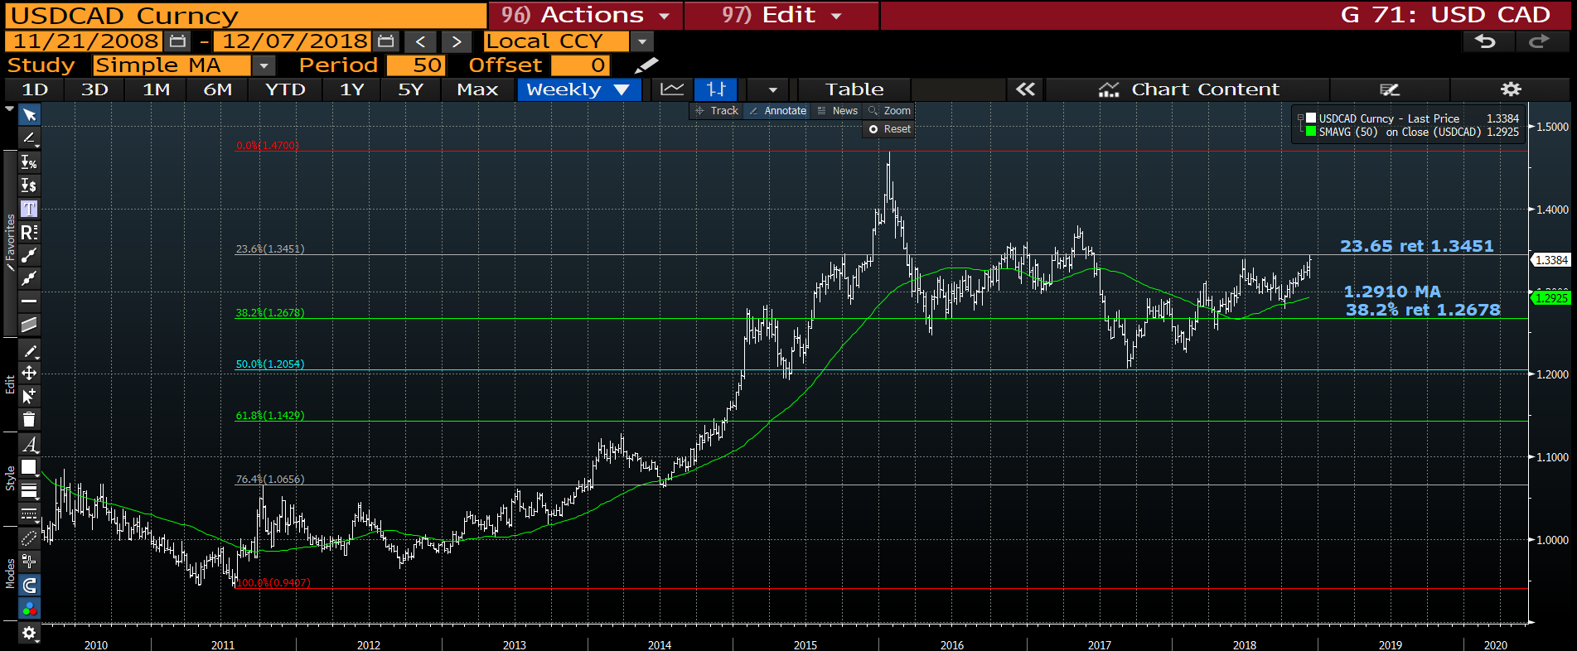
USD CAD weekly : This has trodden water for some time above the 1.2910 moving average and now has free UPSIDE AIR. A breach of the 23.6% ret 1.3451 will trigger bigger stops.

Slide 11
USD EM
SOME GREAT DISLOCATION OPPORTUNITIES
The EM space has been sideways of late but looks ready to reignite its strength this week with MANY back near the lows. REAL MONEY owns EM and should be adding.
USDMXN looks to be failing again.
USD TRY and ZAR ready for fresh lows.
Some ideas are already working. Nice tops now in USD vs BRL, TRY, ZAR, RUB, MYR, INR, TWD and SGD!

Slide 12
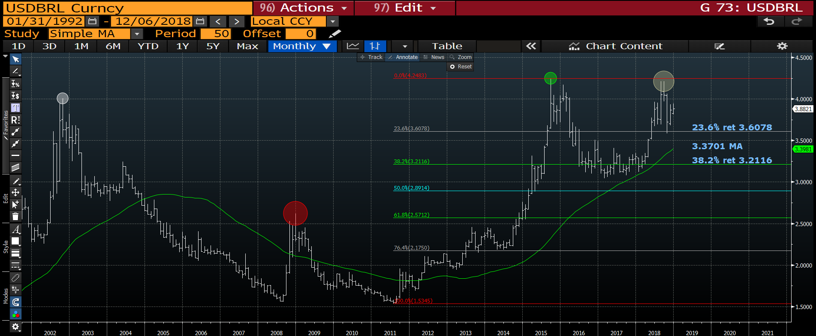
USD BRL monthly : This is one of the BEST long-term trade offerings, these kind of dislocations are RARE especially aided by the recent DOUBLE TOP. We have tested the
23.6% ret 3.6078 but at the second test should SAIL through.

Slide 13
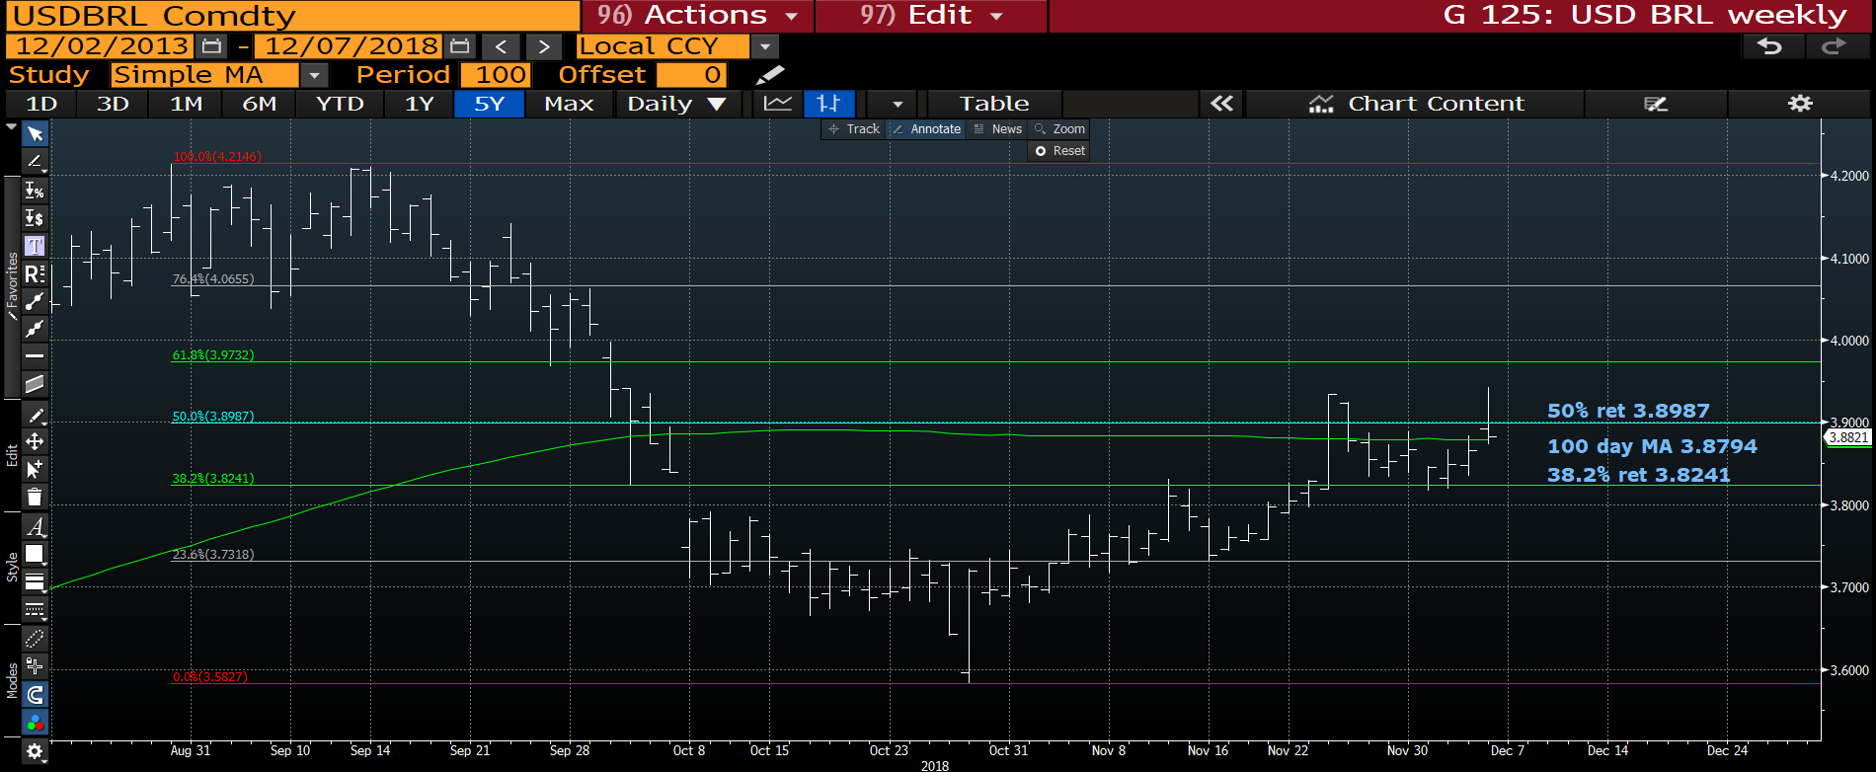
USD BRL daily : Thus far we are rejecting the 100 day moving average 3.8794, a breach of the 38.2% ret 3.8241 will help a lot.

Slide 14
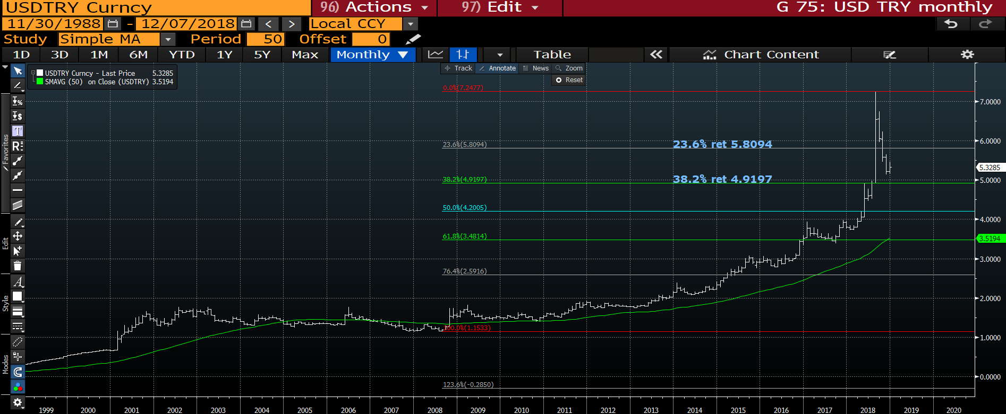
USD TRY monthly : We are well on the way to the 38.2% ret 4.9197.

Slide 15
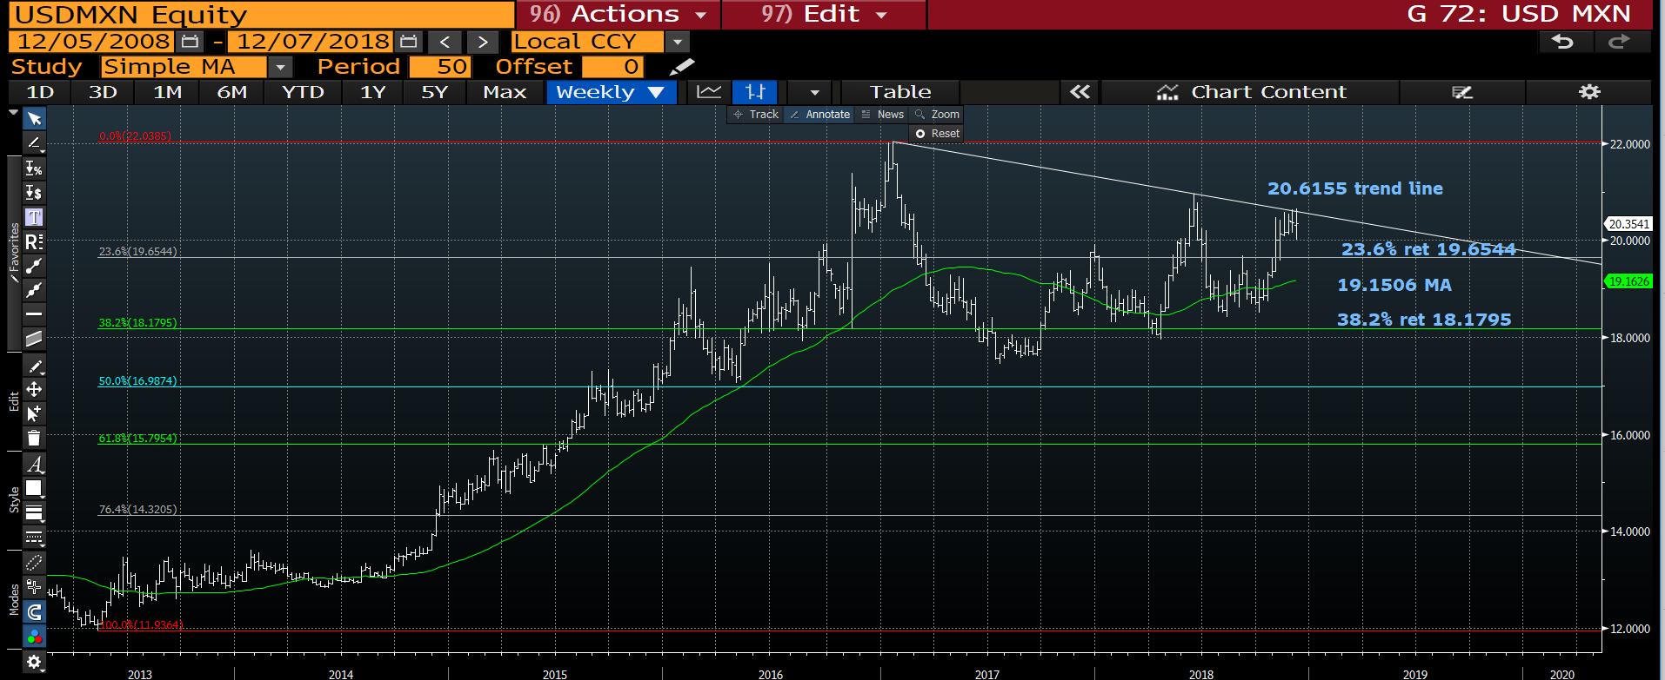
USD MXN weekly : A very similar trend line to Oil a few weeks back. If we breach 20.00 then the 23.6% ret 19.6544 could be seen very quickly.

Slide 16
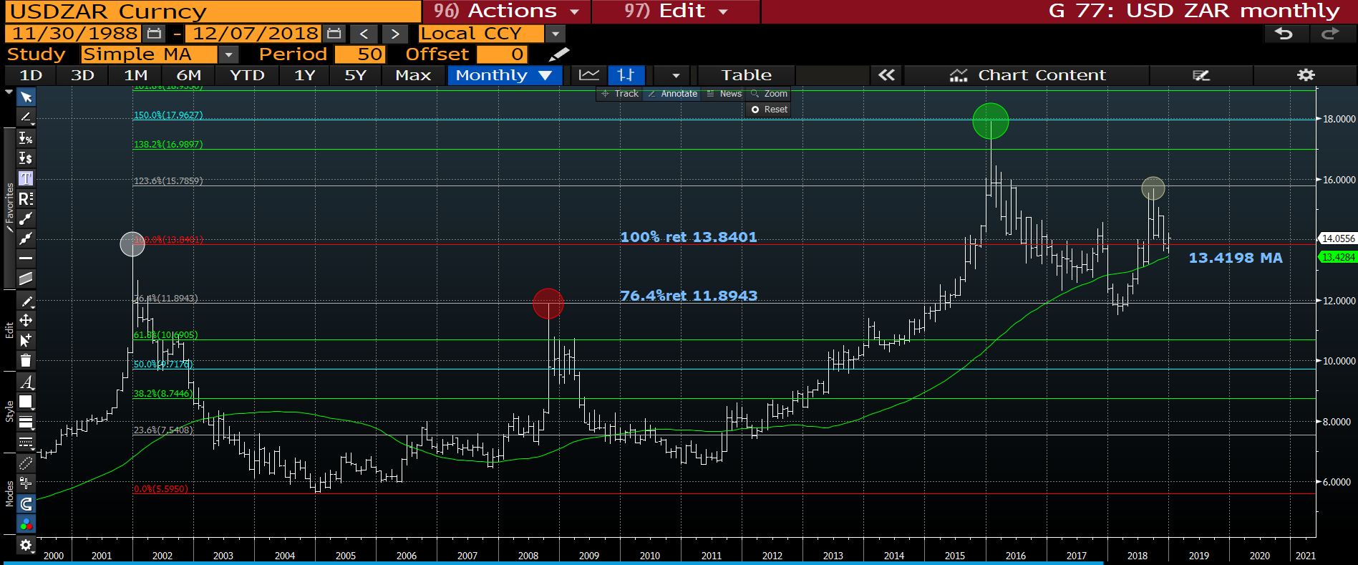
USD ZAR monthly : The 13.4198 moving average is proving to be a difficult to break.

Slide 17
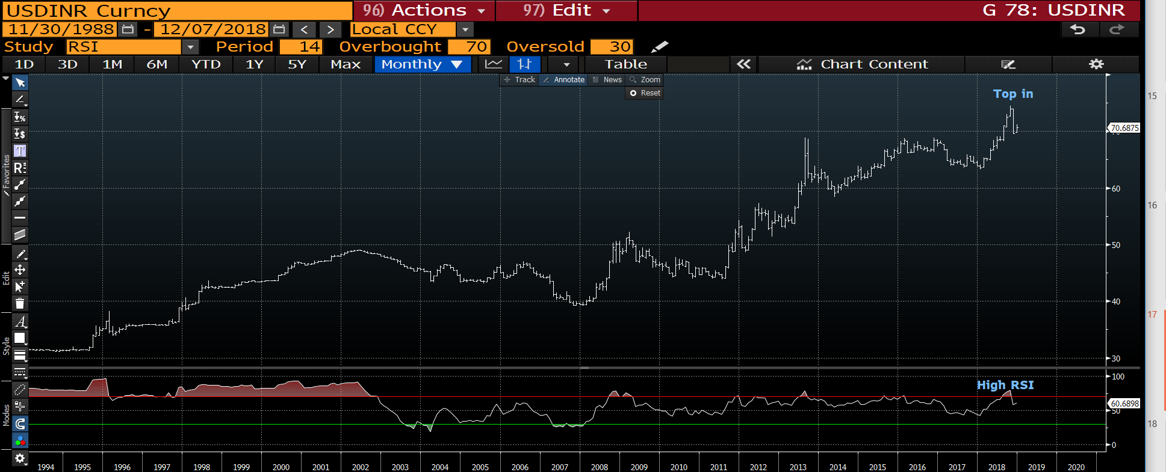
USDINR weekly : The TOP is now confirmed and has a long way to GO.

Slide 18
EQUITIES
Equities : The SCARY issue is SOME ARE NOW BROKEN and the US close to confirming a TERMINAL TOP. It’s a worrying prospect but the strange thing is no one IS WORRIED.
Many stock markets are HOLDING their VERY LAST level of SUPPORT. Lets see what DEMAND we have to formulate a bounce going into YEAR-END.
ANY BREACHES OF LAST MONTHS LOWS MEAN A FREEFALL SCENARIO.
I have laboured the NUMEROUS 1896, 2000, 2008 US stock RSI dislocations, I think we are close to seeing them come into play. The daily RSI’s are low post yesterday but remember to SELL any subsequent rally. BUY OPTION downside to protect any LONG VIEWS.
We now have a MARKED disparity between EUROPE and US stocks, it wont last.
The TECH sector continues to be the DANGER, ELON cant stop twittering and MOST investors trade with the HERB MENTALITY than “VALUED RETURN”. It is obviously hard not to be long tech but it failed before in 2000.

Slide 19
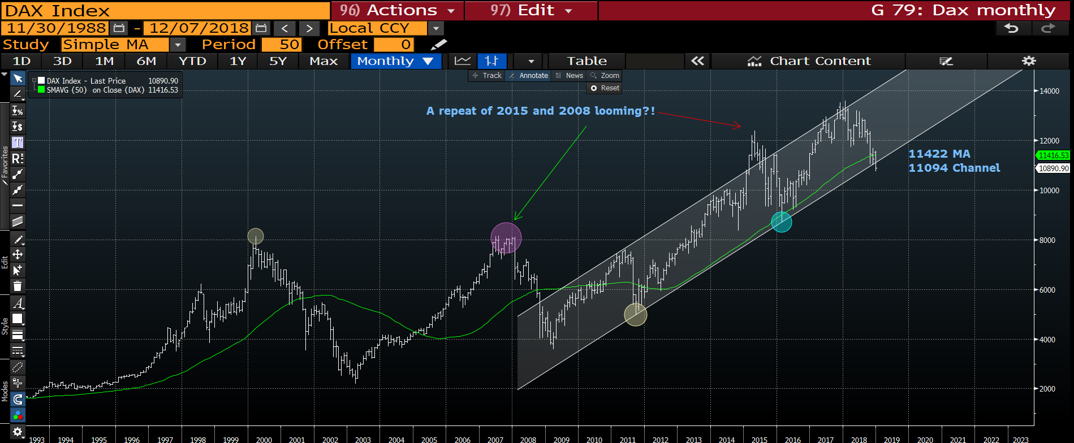
DAX monthly : We have broken a channel in existence since 2011 with out much comment or effort!

Slide 20
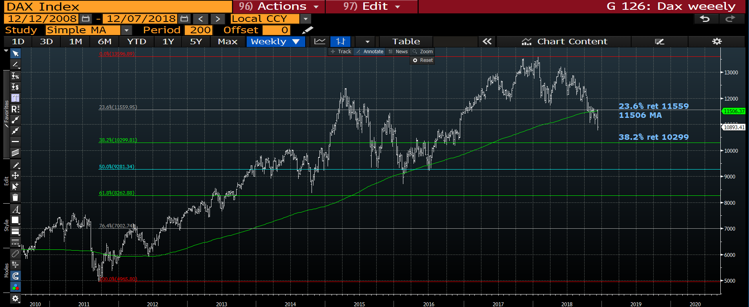
DAX weekly : A particularly negative week and all stemmed from the failure to breach the 200 day moving average-23.6% ret 11559.

Slide 21
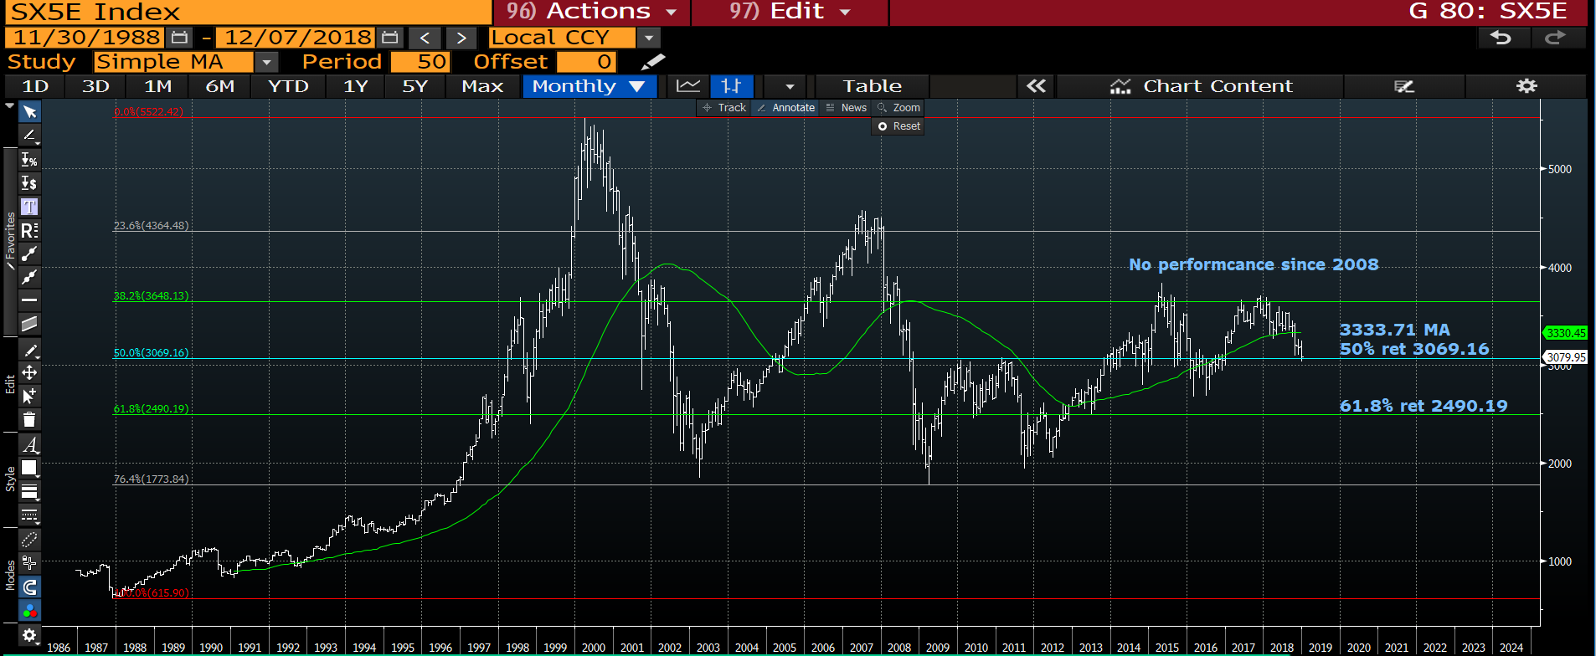
Eurostox monthly : We have hit the 50% ret 3069.16 target, thus now a VERY important close looms.

Slide 22
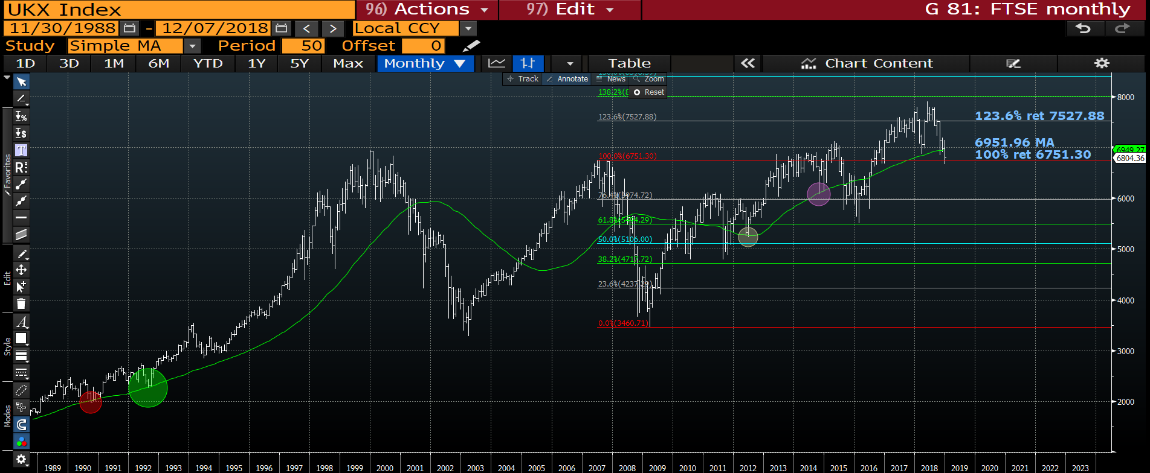
FTSE monthly : Given this has been a VERY technical market then a lot now depends on how we react to the 100% ret 6751.30. A close sub it will confirm the BIG TERMINAL TOP.

Slide 23
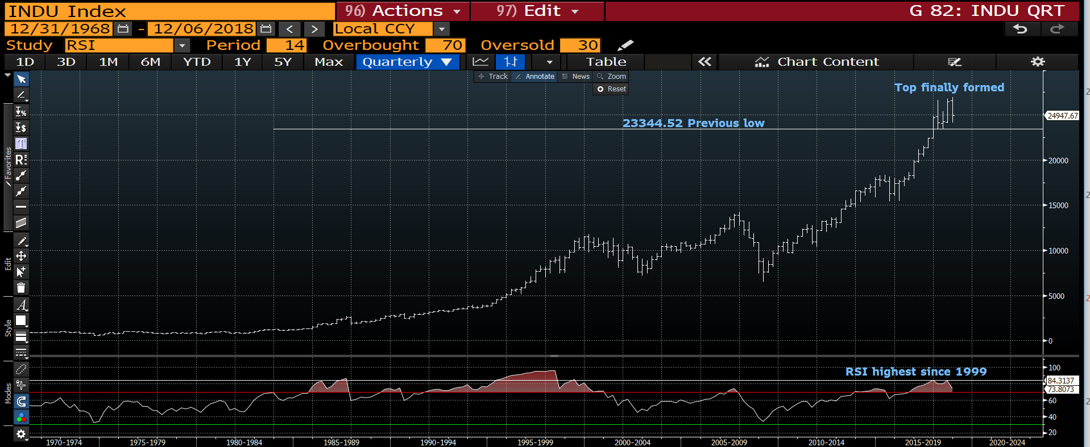
Dow quarterly : The US is close to confirming a terminal TOP. We have not yet breached the 23344.52 previous low but should we do so then its FREE FALL and more importantly a TOP for MANY YEARS. The RSI has plenty of “juice left”.

Slide 24
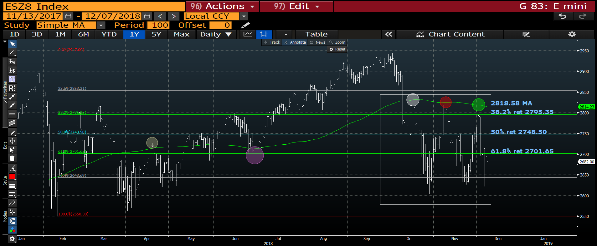
S&P (future) daily : A very negative week given the persistent 100 day moving average failure, we just need to break lower and out of the bottom of the RANGE.

Slide 25
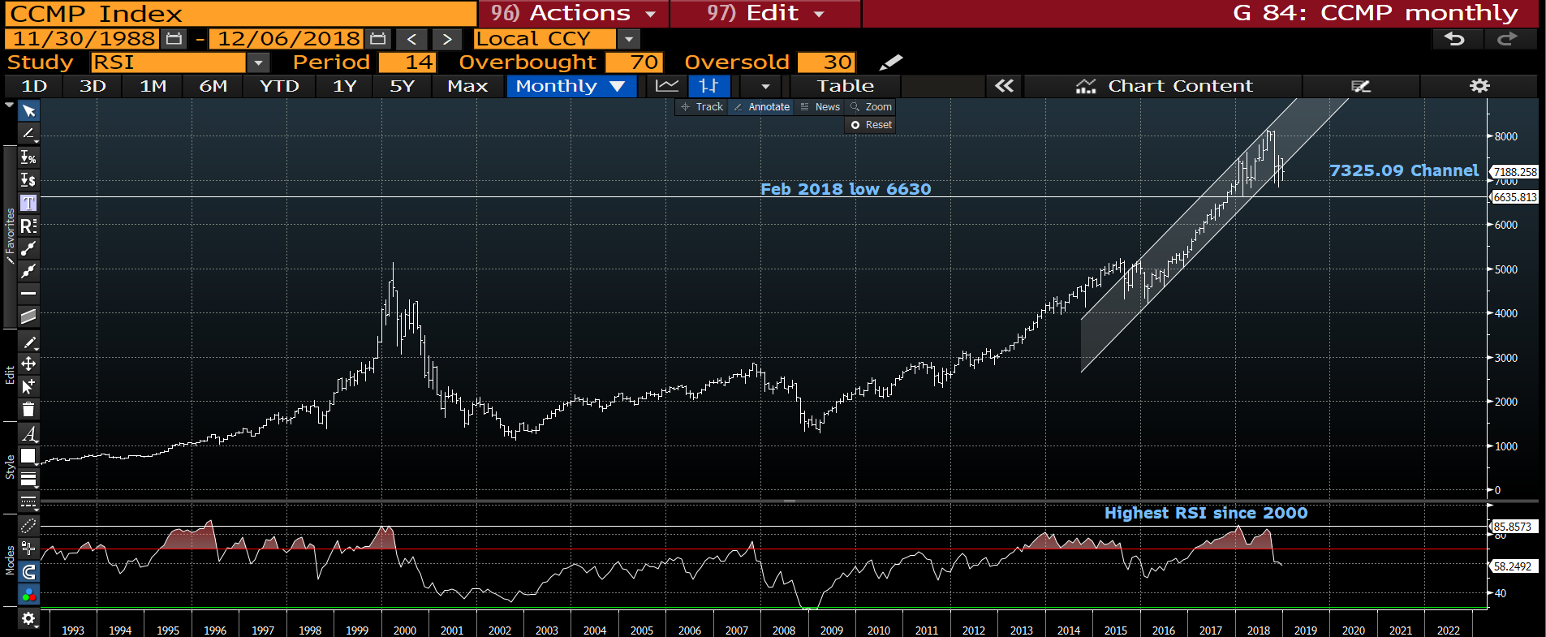
Nasdaq monthly : This is a shorter term CHANNEL but we have breached it! Full confirmation wont come till we breach Feb’s low 6630.

Slide 26
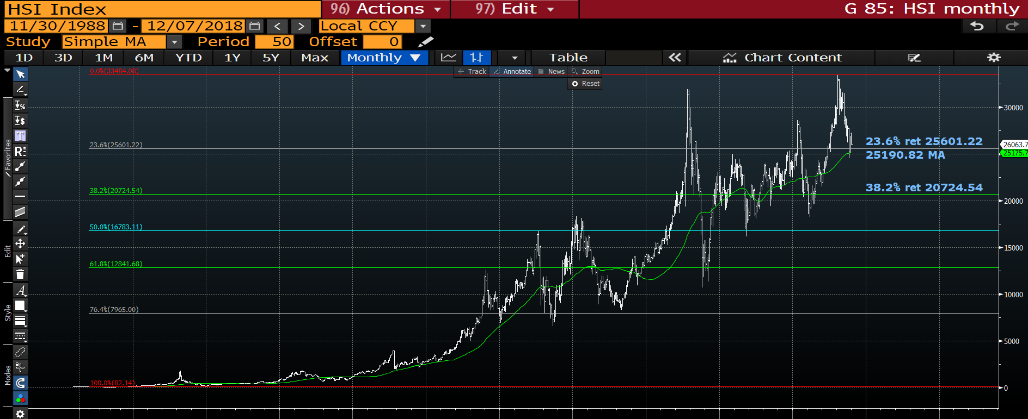
Hang Seng monthly : Yet another HOLD of MAJOR moving average 25131.78 support, lets see how far the recovery goes.

Slide 27
BONDS
WELL AND TRULY back on the agenda. WHAT a WEEK! Whilst many daily yield charts have over extended RSI’s the markets do STILL point toward much lower yields.
European bonds have performed well lately but I still believe need an external driver.
The driver will be stocks in my mind.
The US remains choppy but have posted some sizeable reversals on the month. **Major focus would be if the USGG10yr breaches 3.00%.**
Italy remains a problem, we are holding the 3.410 38.2% ret but no meaningful progress
through it. Next possible target remains the 50% ret 4.142.

Slide 28
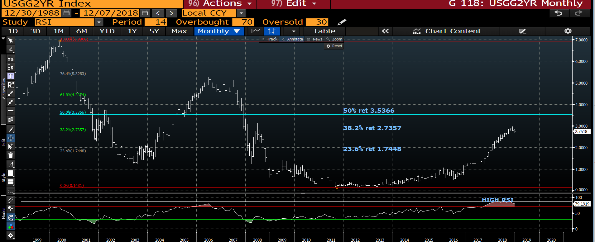
US 2yr yield monthly : The RSI is the highest ever as we test-tease the multi year 38.2% ret 2.7357.

Slide 29
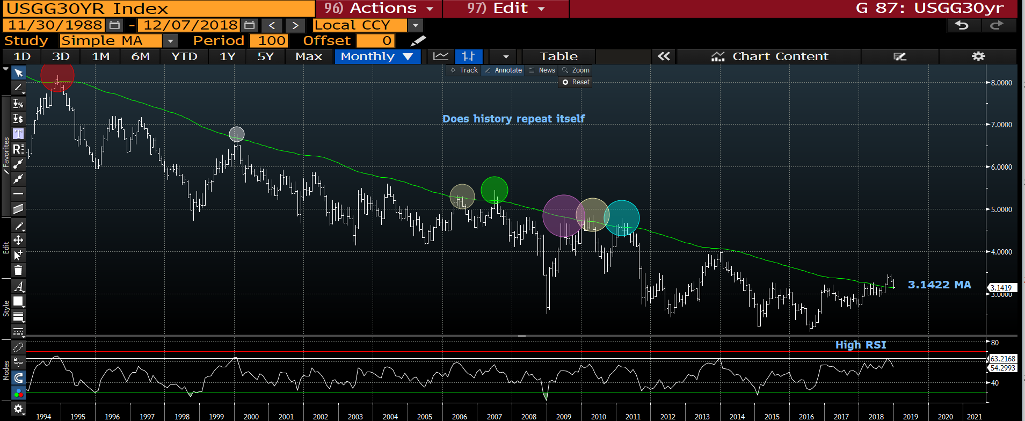
US 30yr yield monthly : We now have 2 sizeable reversals, the only SAVIOUR-HOLD is the 3.1422 moving average, should this be breached then we free fall.

Slide 30
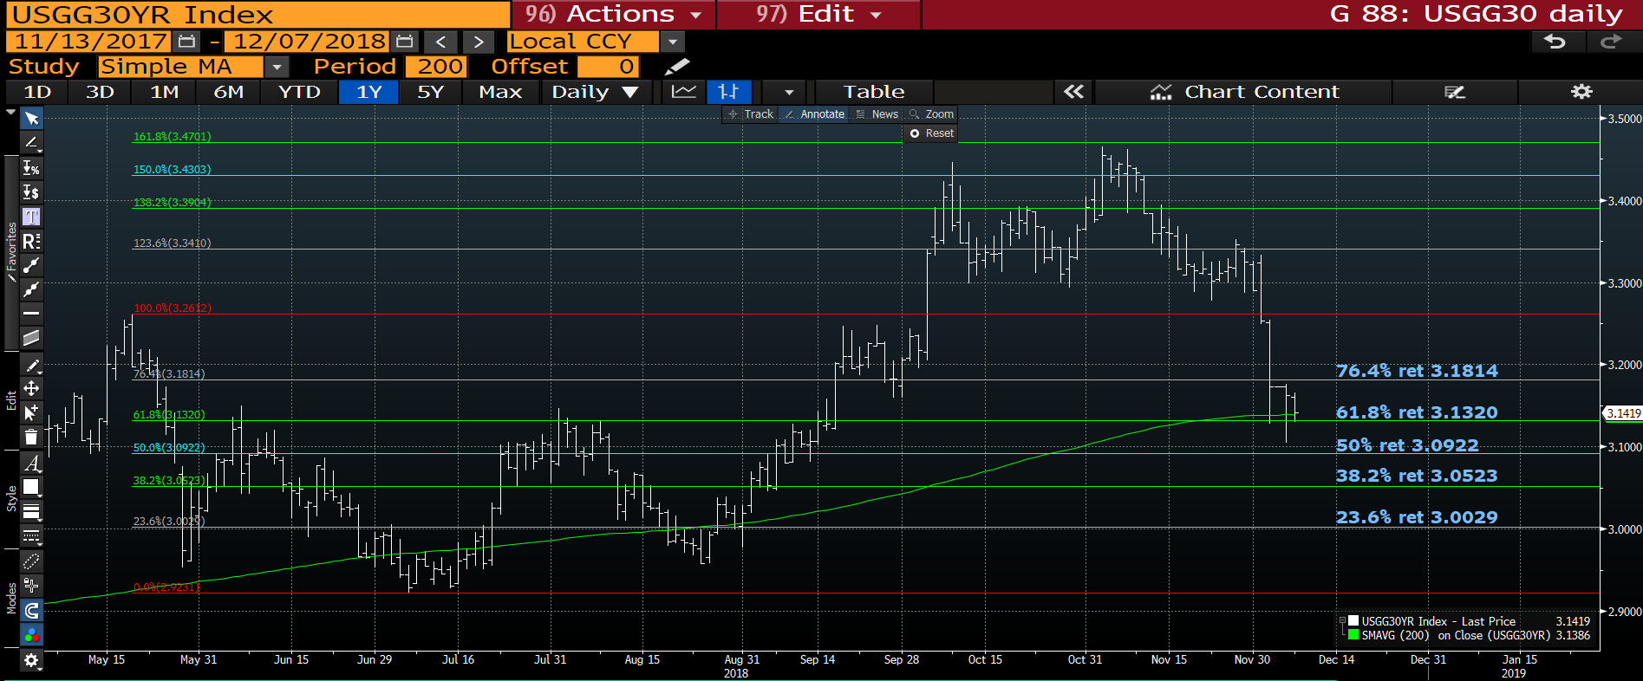
US 30yr yield daily : We probably need to work off some of the extensive DROP on the week BUT sub the 200 day moving average 3.1419 won’t bode well.

Slide 31
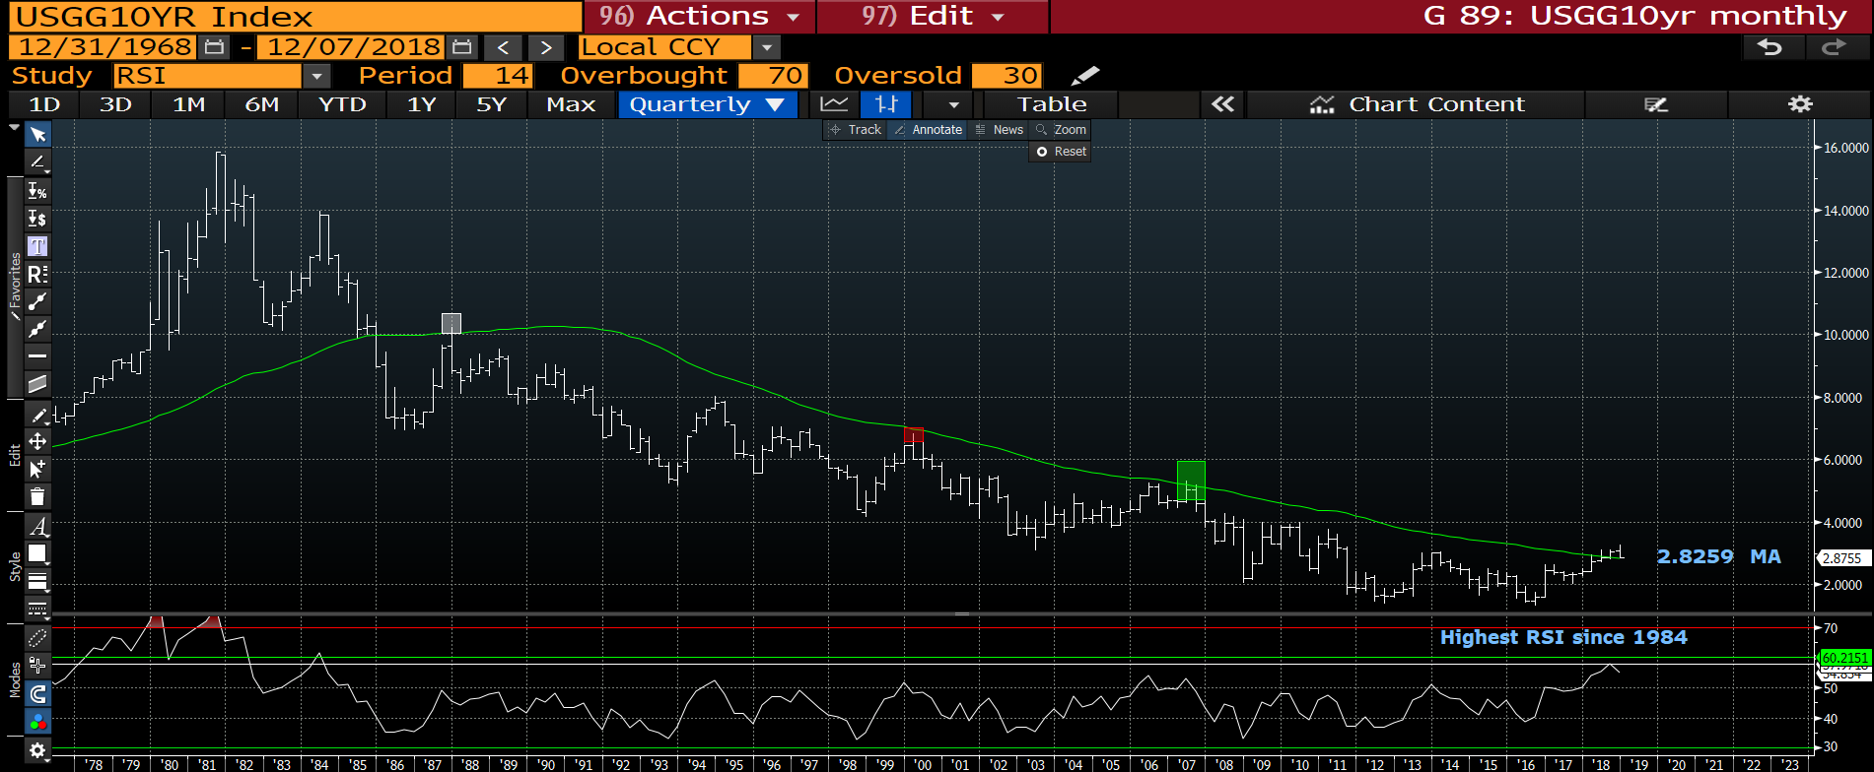
US 10yr yield quarterly : Again a significant reversal on the quarter that has made little IMPRESSION on the RSI. Despite HOLDING the 2.8259 moving average through it and we FREE FALL.

Slide 32
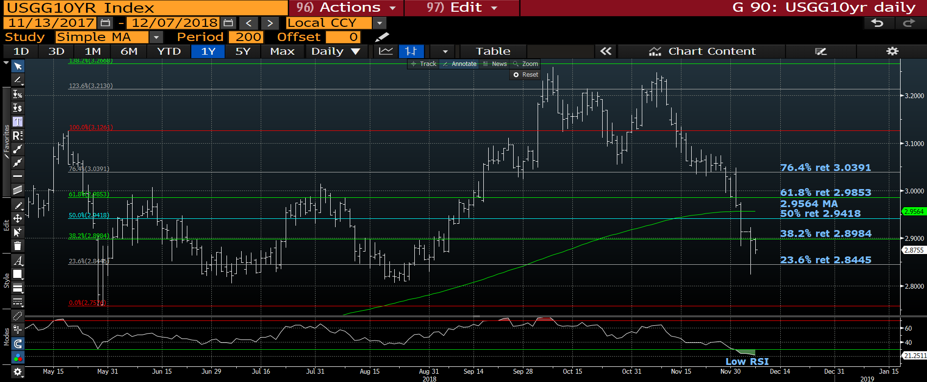
US 10yr yield daily : This time we are SUB the 200 day moving average 2.9564 thus little preventing further downside. Sub 2.800 will be a big statement.

Slide 33
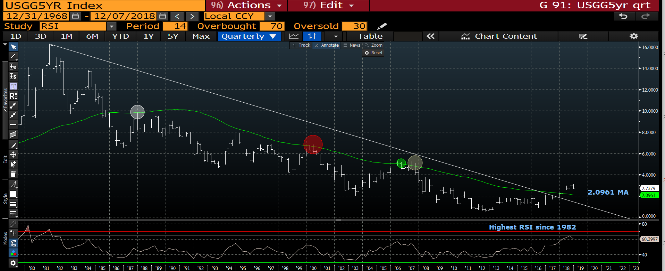
US 5yr quarterly : We are along way off the moving average 2.0961 but the RSI REMAINS at 1982 levels.

Slide 34
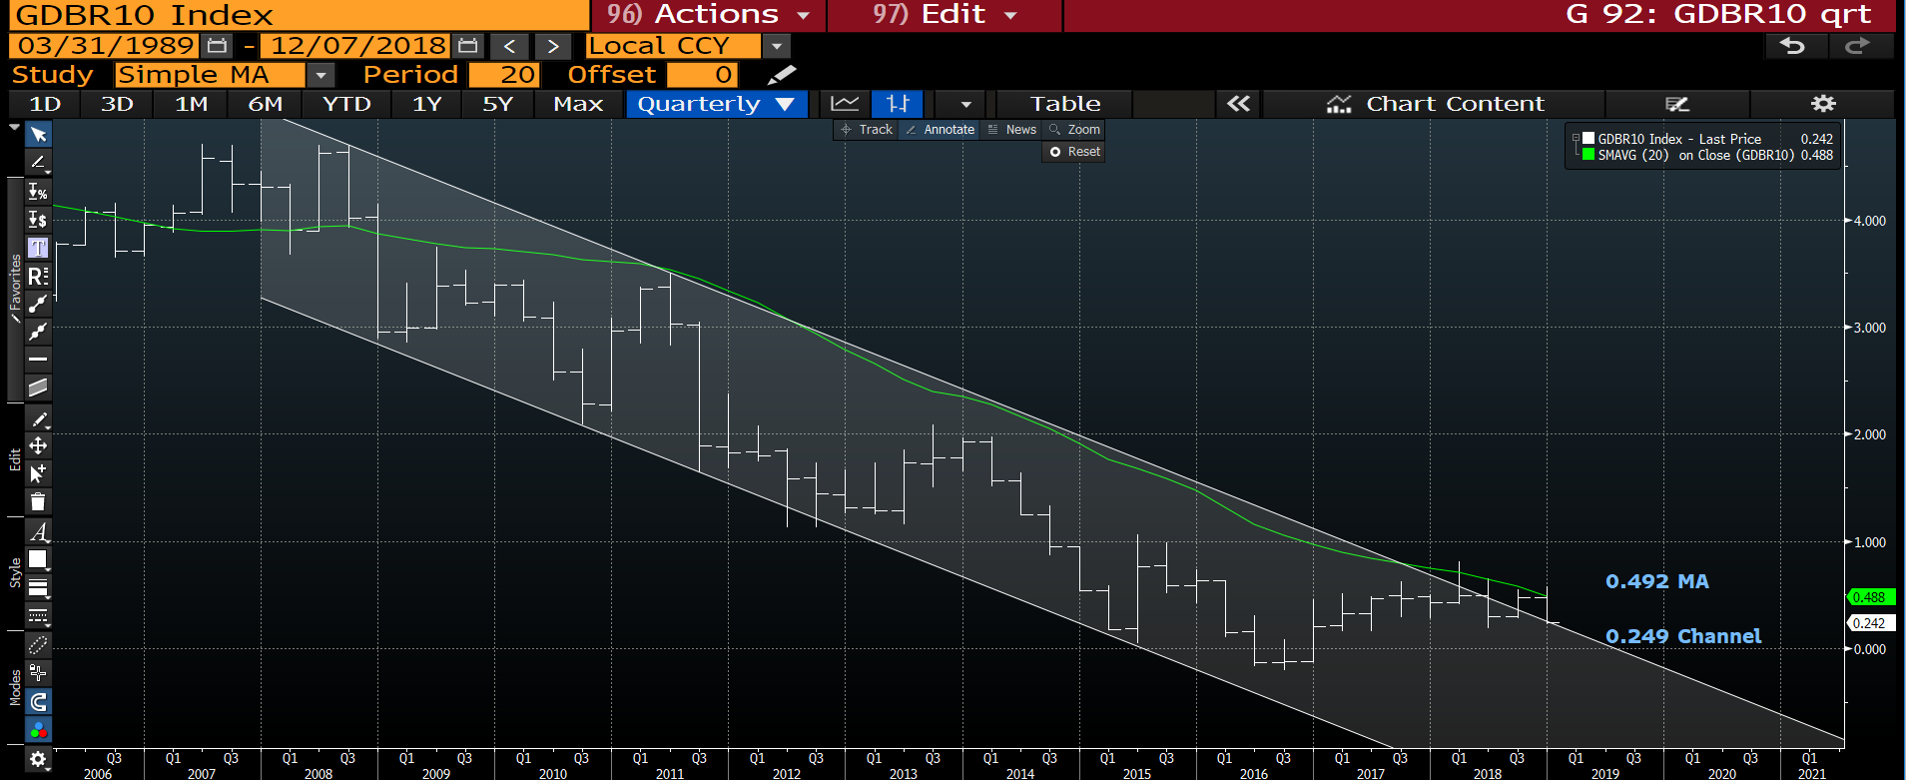
Generic German 10yr quarterly : Its been one way traffic all month and the next KEY test is the 0.249 channel.

Slide 35
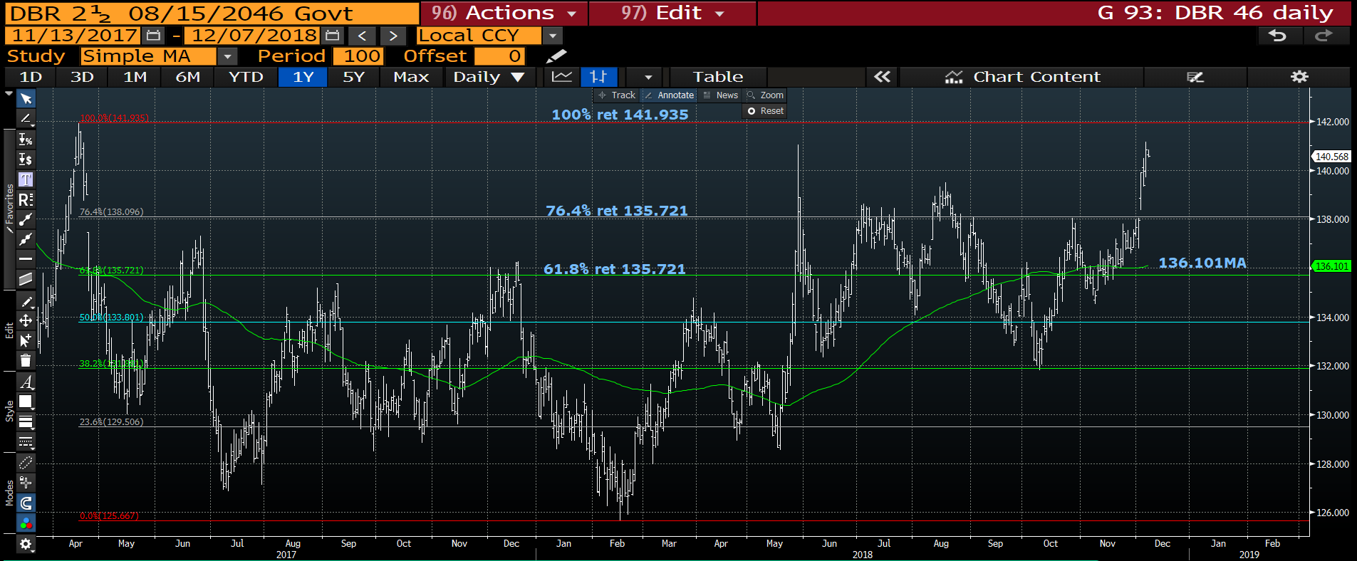
DBR 46 daily : One of the most resilient bonds going and we are well on the way to breaching the 100% ret 141.935.

Slide 36
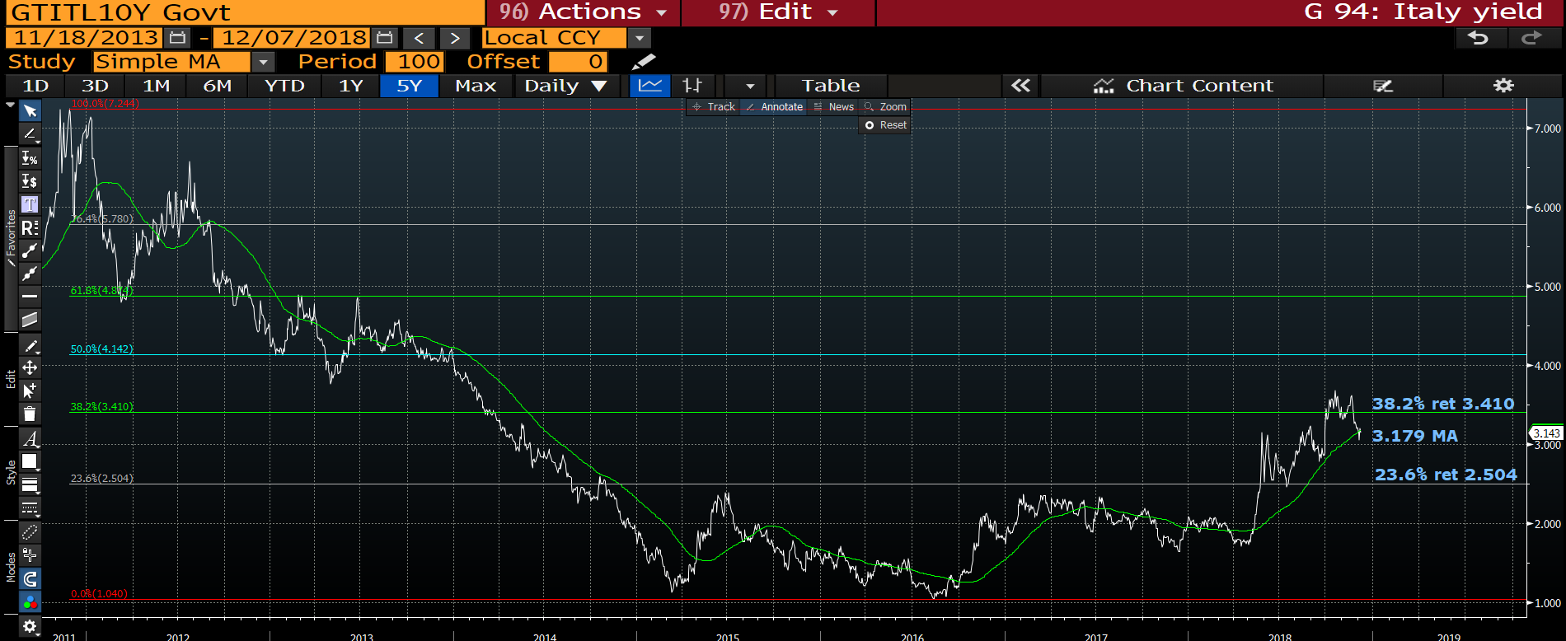
Italian generic 10yr daily : We are TEASING the 3.179 moving average, little else to ADD.

Slide 37
US curves a once in a lifetime opportunity?
Curves continue to steepen in the back and that should persist.
** It seems the BACK END is where the TRADE is given the 2-30, 5-30 and 10-30 performance yesterday.
All generally have low RSI’s, MANY at 2006 levels.
It seems hard at the moment to pinpoint the OPTIMUM curve to go for but contenders already are 2-30, 5-30 and 10-30, that said most could do with quarter end confirmation.
REMEMBER ALL RSI’s ARE EXTENDED AND MANY HAVE HIT MULTI YEAR 76.4% RETRACEMENTS!

Slide 38
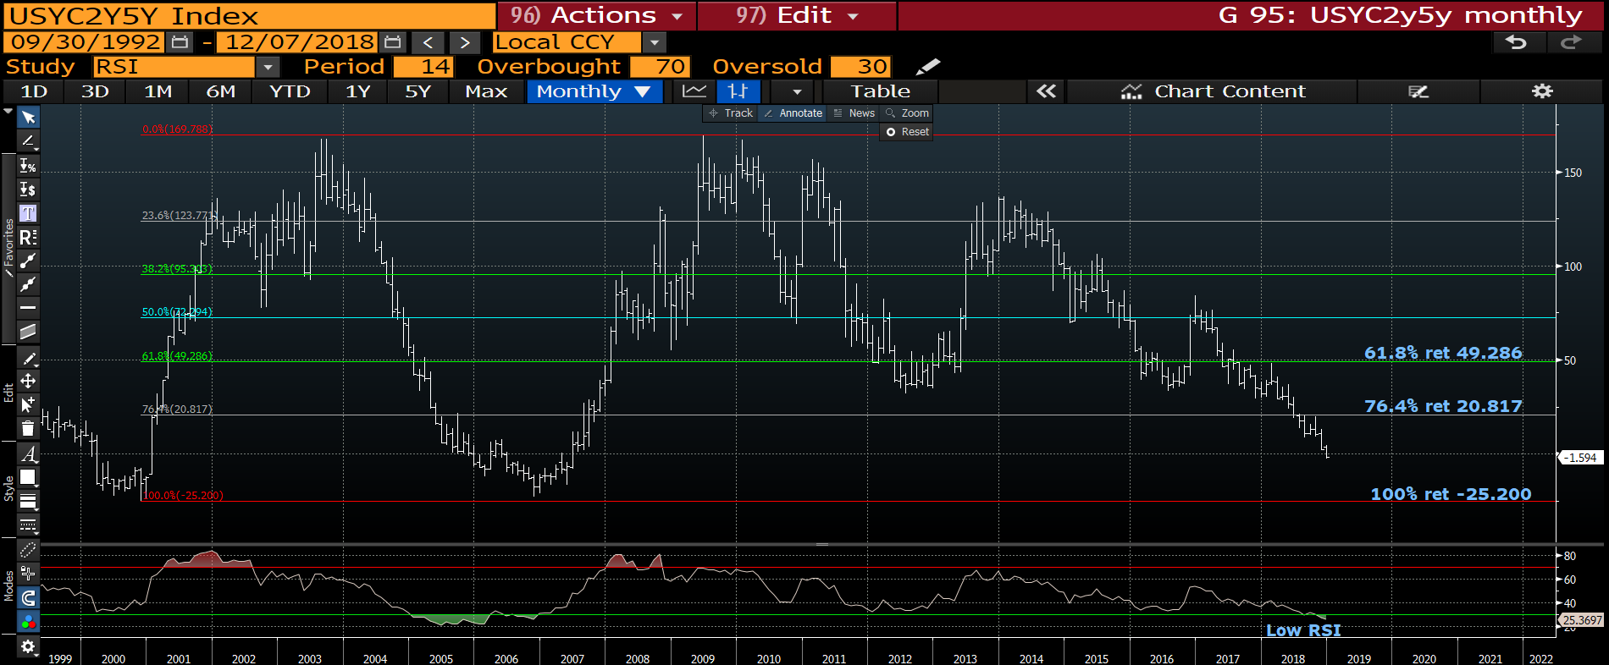
US 2-5 curve monthly : We continue to flatten and the trend seems firmly in place as the RSI fails to be over stretched.

Slide 39
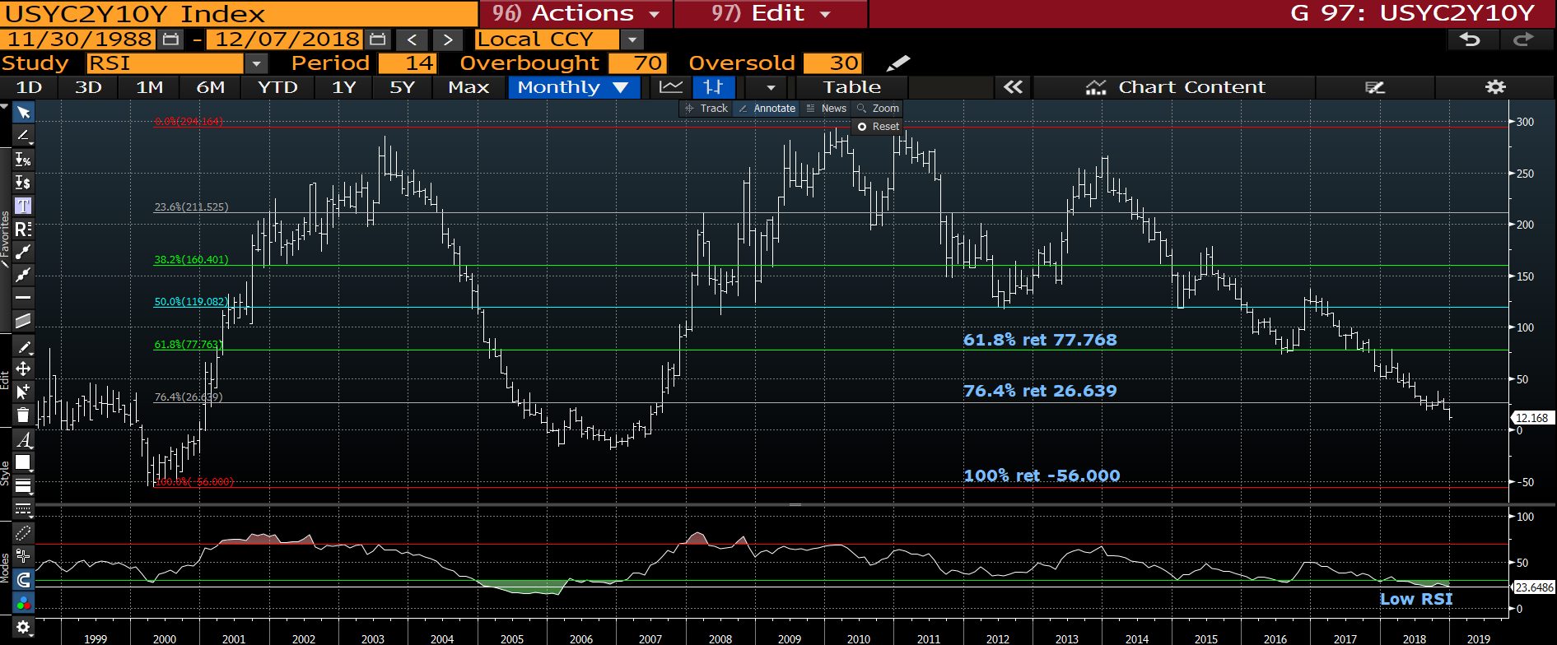
US 2-10 curve monthly : A perpetual bleed lower despite the oversold RSI.

Slide 40
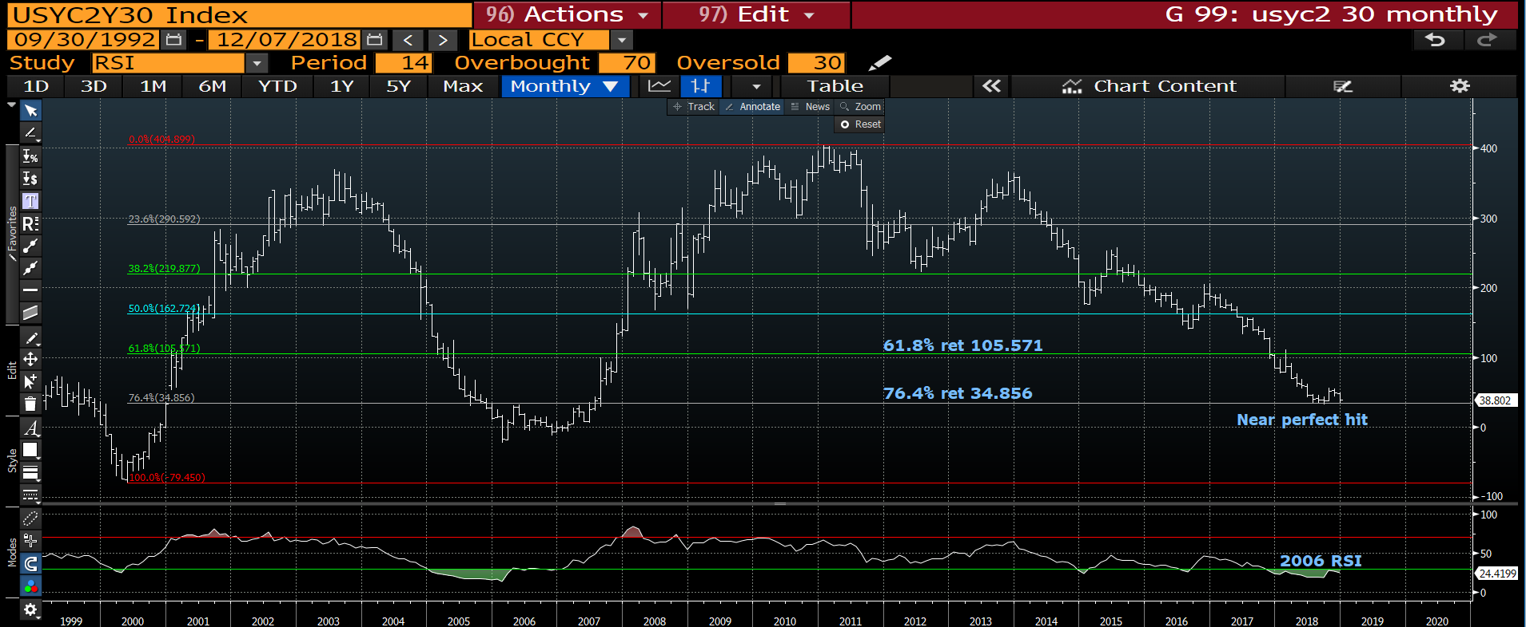
US 2-30 curve monthly : This has been the clinical trade, hitting the multi year
76.4% ret 34.856 on the NOSE. We just need to see if the retracement holds second time down.

Slide 41
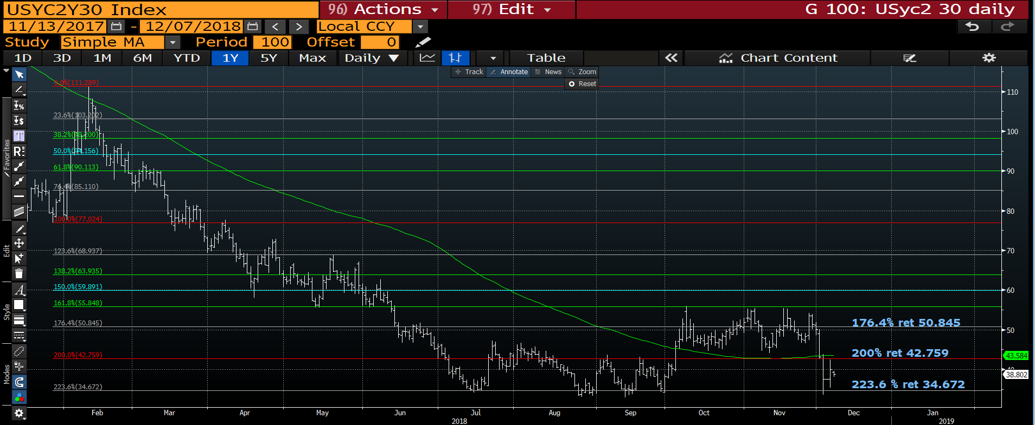
US 2-30 curve daily : We have held the recent low 223.6% ret 34.672 and now need to POP above the 200% ret 42.759.

Slide 42
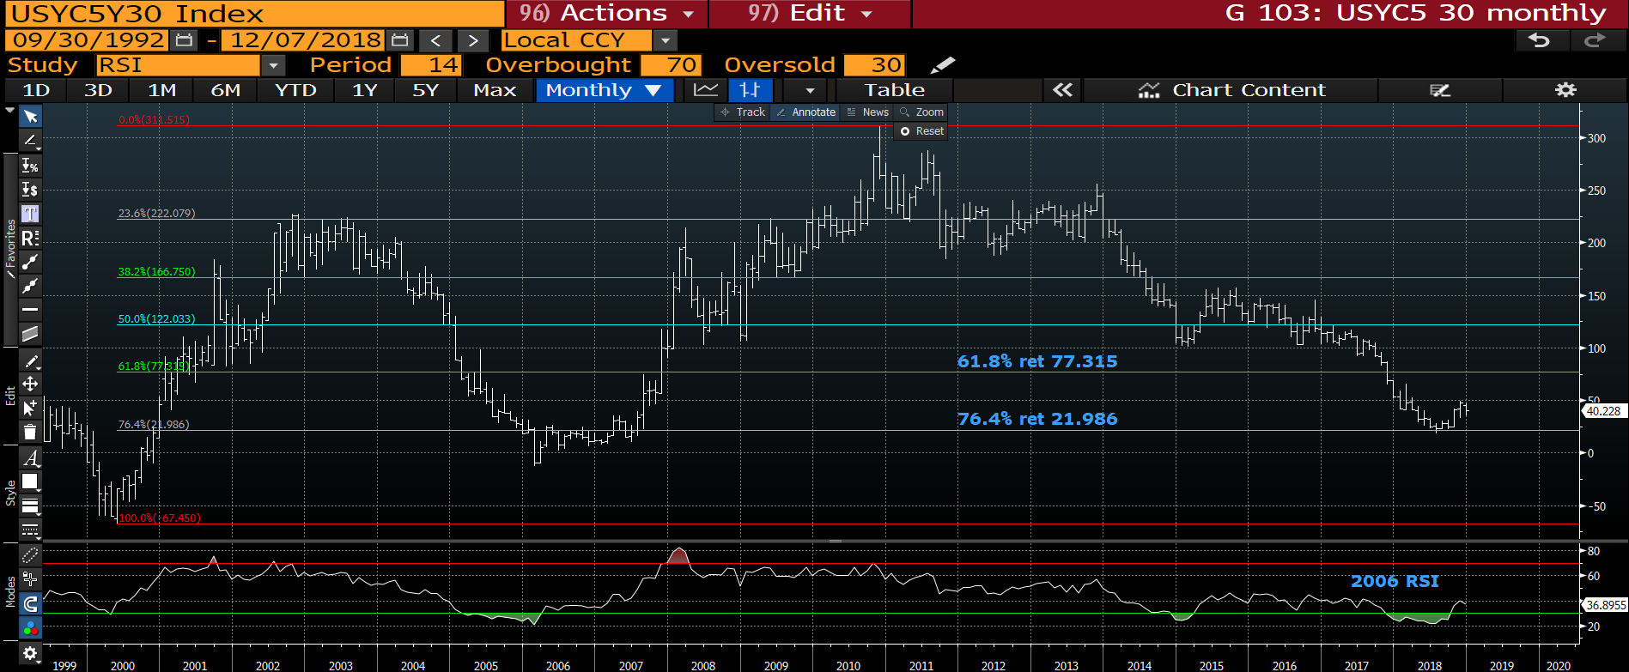
US 5-30 curve monthly : A very SUPPORTED area of the curve as we seem to HOLD DIPS WELL. Hopefully we can breach 50.oo on any bounce.

Slide 43
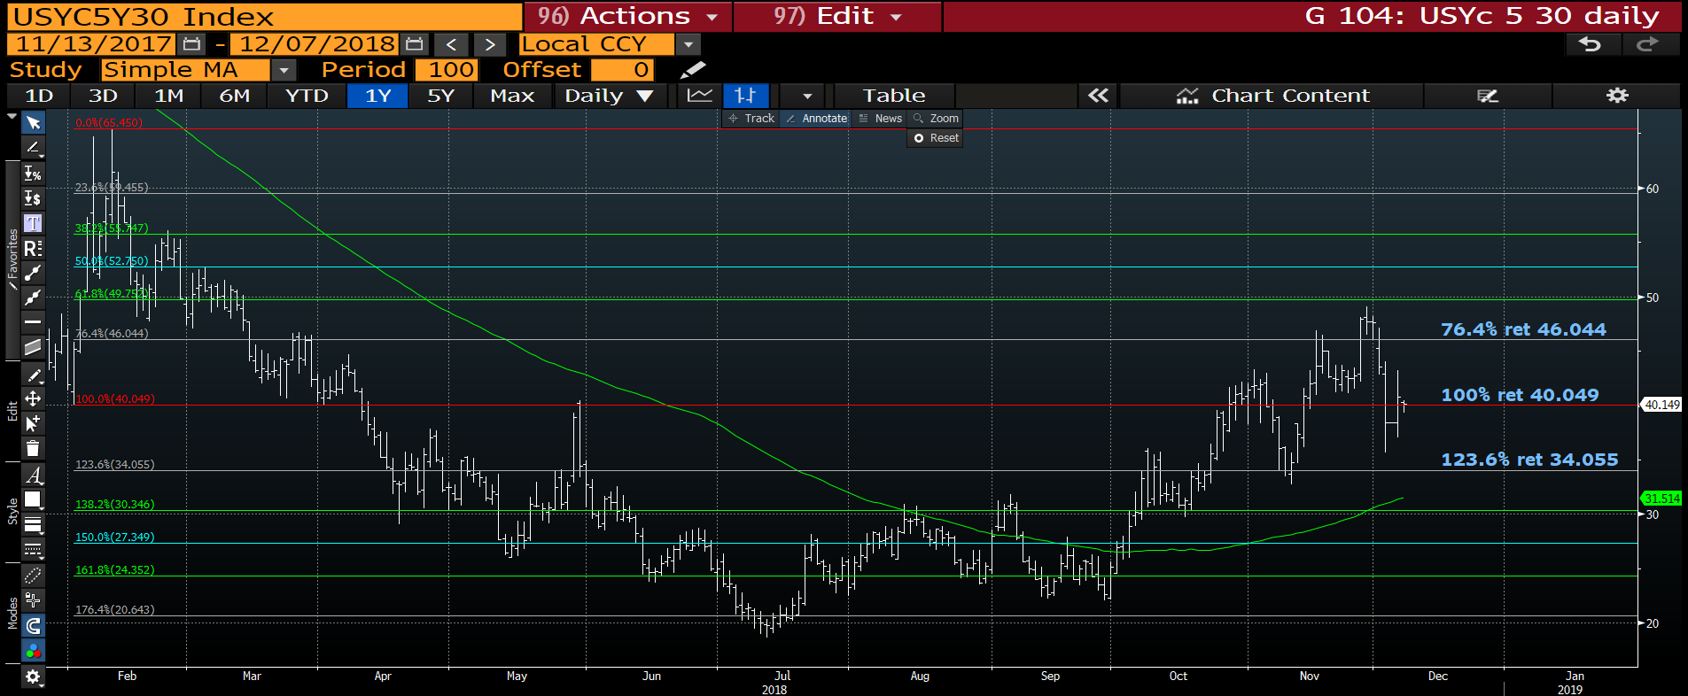
US 5-30 curve daily : Hopefully this is the extent of the DIP and we climb higher into the weekend.

Slide 44
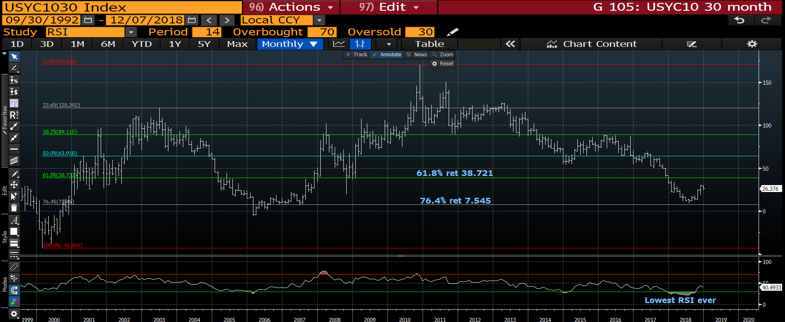
US 10-30 curve monthly : The dip seems to be holding and should head higher.

Slide 45
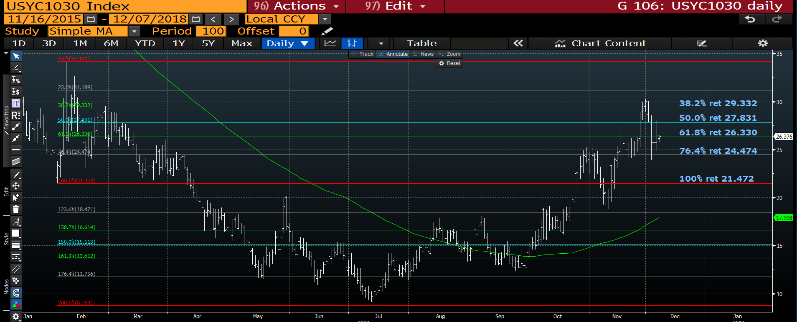
US 10-30 curve daily : Again a reasonable dip but ideally we close above the 50% ret 27.831 in order to maintain momentum.

Slide 46
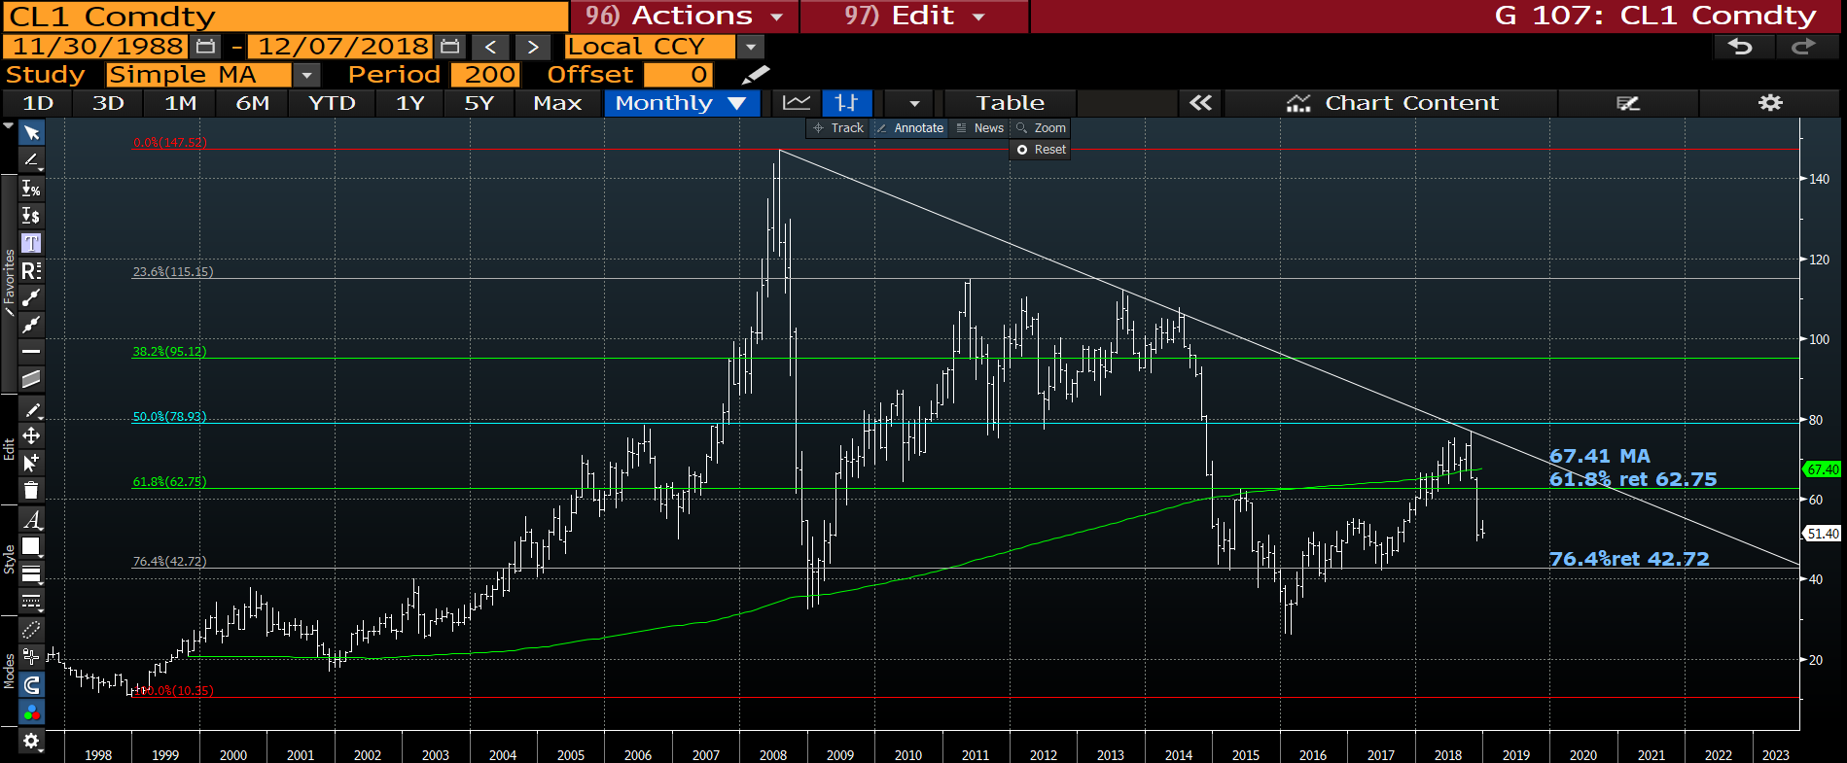
CL1 monthly : We have triggered significant stops lately and one versus natural gas. Despite the recent oversold daily RSI we struggle to HOLD. Next BIG support is the 76.4% ret 42.72.

Slide 47
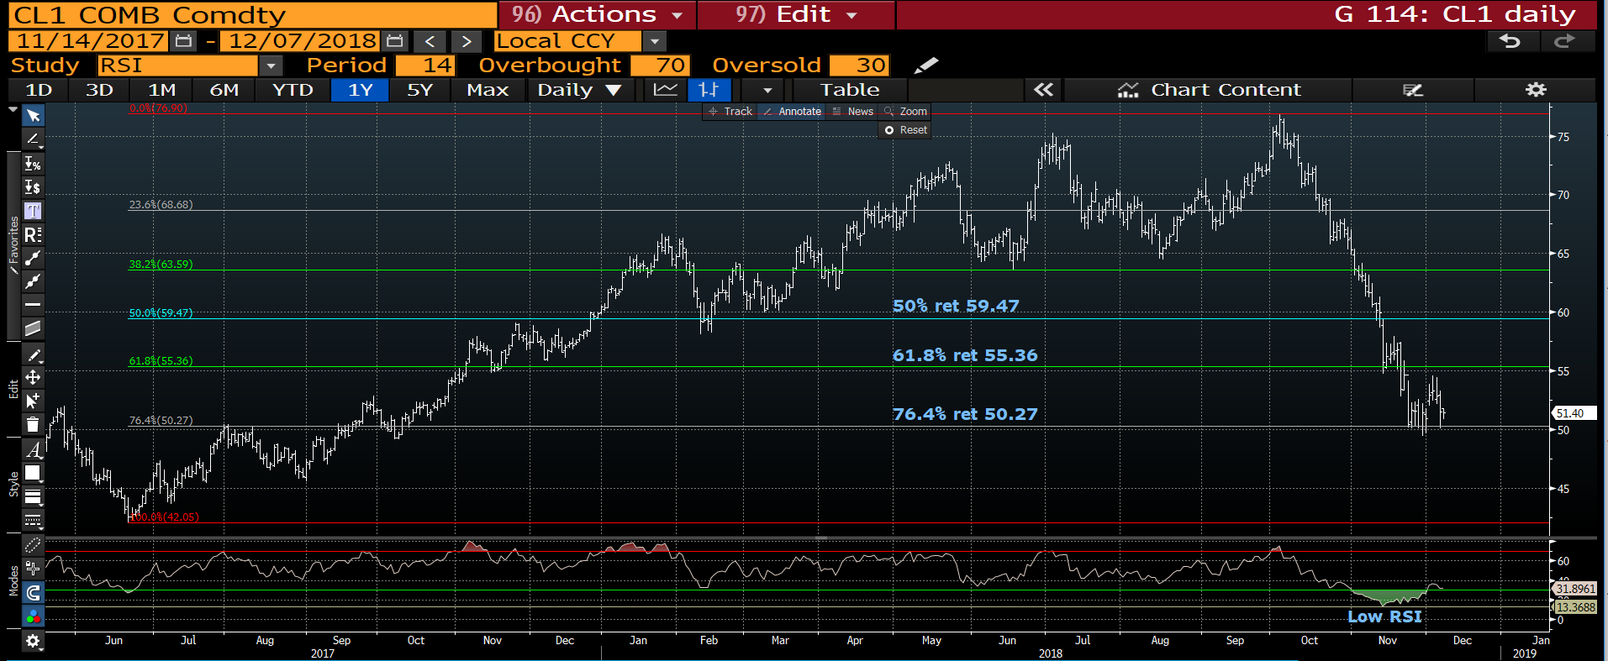
CL1 monthly : Despite holding the 76.4% ret 50.27 we are struggling to do anything with it.

Slide 48
