Slide 1
USFS 10-20 We have formed a top and could be well on the way to a VERY long-term rejection of the HISTORICAL moving average!
The HISTORICAL opportunity remains, only the SIXTH time in 18 years hence needs discussion.
** There maybe a good chance to get this position on next month given we’ll know more, whilst attaining confirmation. OVERALL this is a RARE scenario. **
Target wise this should run for a many months but initial support should be the 38.2% ret 2.9840. Don’t lose the position for short term gain.
The RSI also extends to the weekly denoting a very long term opportunity is here.

Slide 2
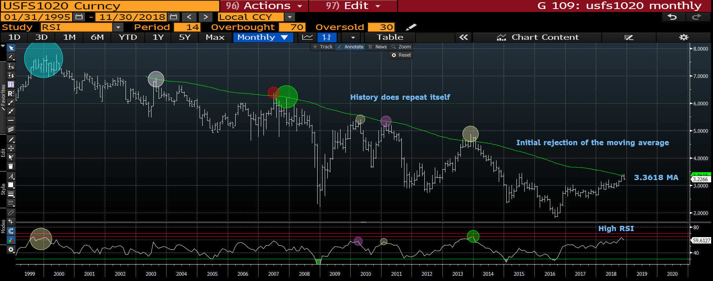
USFS 1020 monthly : As can be seen this is the SIXTH time in 18 years that we have touched and failed this 50 period moving average 3.3618! The REJECTION is taking place and so next month is confirmation time.

Slide 3
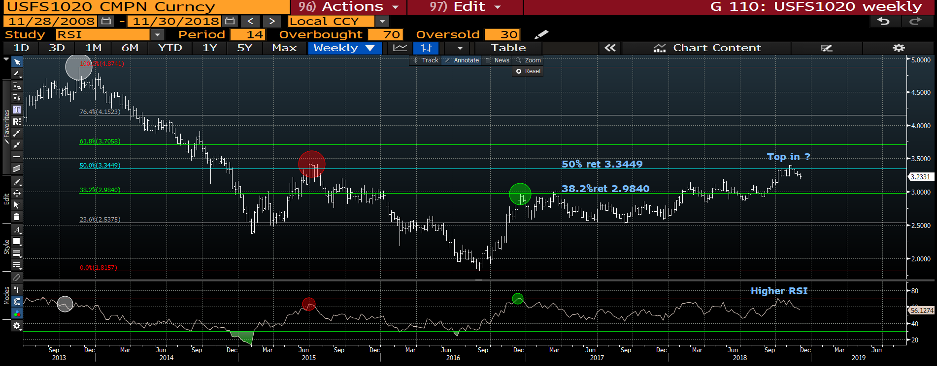
USFS1020 weekly : The high RSI compliments the previous dislocation thus the trade has longevity. A breach of the 38.2% ret 2.9840 will be a MAJOR reversal signal and put us on a MAJOR PATH LOWER FOR 2019.

Slide 4
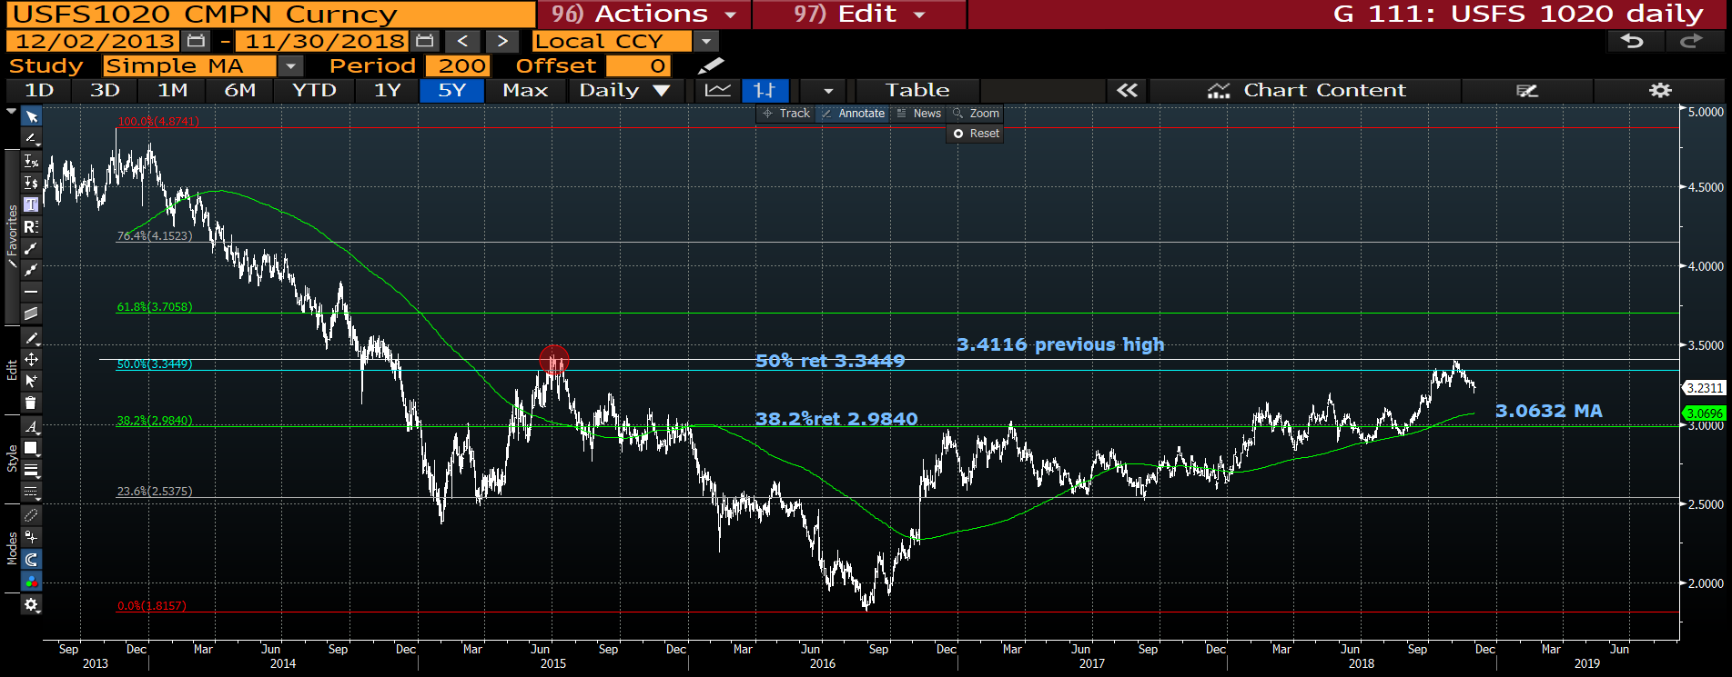
USFS 1020 daily : We have rejected the previous high although overshot a little, next week be poised to sell into any BOUNCE. Do remember to ADD significantly if the 200 day moving average 3.0632 is breached, this is a LONG-TERM trade.

Slide 5


