Slide 1
FX UPDATE
FX UPDATE : The EURO has witnessed a DECENT correction but that should END in the next day or two.
******EM now flagging itself up as a BUY versus the USD on MANY crosses,
page 17 onwards.*****
Positions :
December 107.00 Puts for 35.0 ticks (Now 5.00/7.00).
October 112.50 Puts for 17.0. (Now 5.00/7.00).
**POSITION CLOSED SHORT DATED PUTS say EUR USD SEP 1.1400 Puts 21.0/22.0 Currently (116.0/118.0) Ref Sep future 1.1361, take 50% profit on the position.
AUD USD has hit and held solid retracement support.

Slide 2
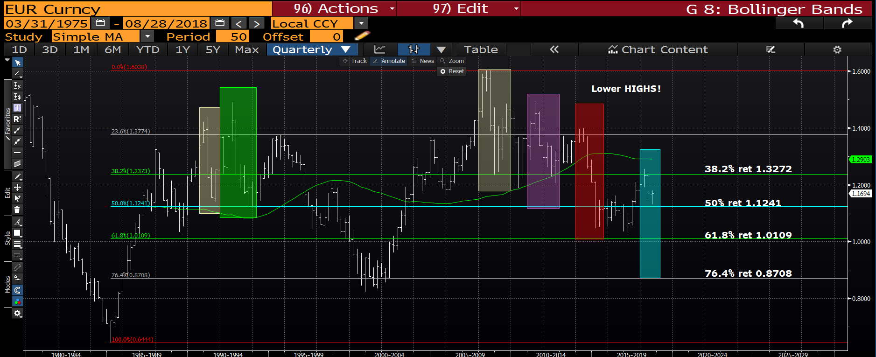
EUR USD quarterly : The recovery in recent weeks has been significant BUT should stall within the next day or two.

Slide 3
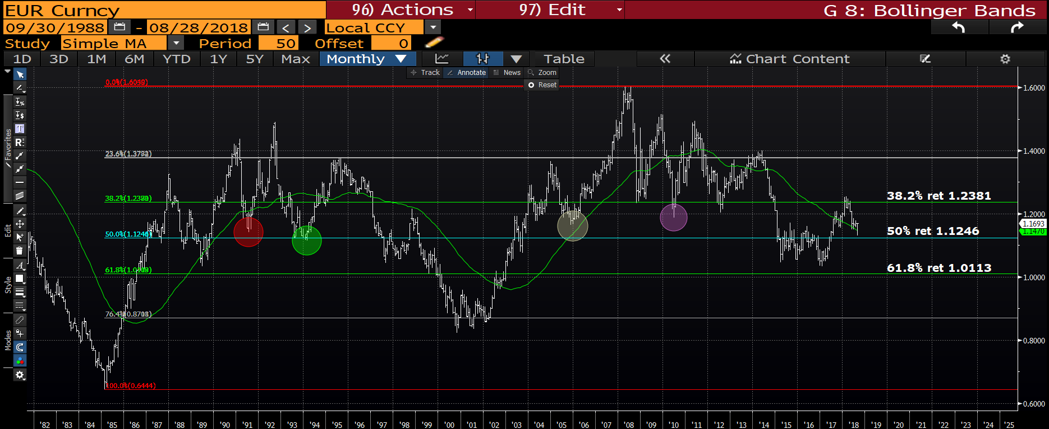
EUR USD monthly : We have found support just shy of the 50% ret 1.1246. Hopefully we fail over the next day or two and close the month sub this level.

Slide 4
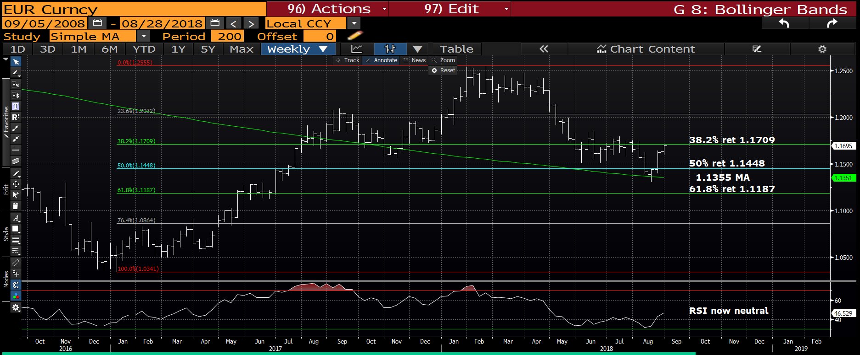
EUR USD weekly : This is the FLY IN THE OINTMENT, a mildly bullish chart so contradicts the CALL to ADD. The bounce is now testing major resistance at the 38.2% ret 1.1709.

Slide 5
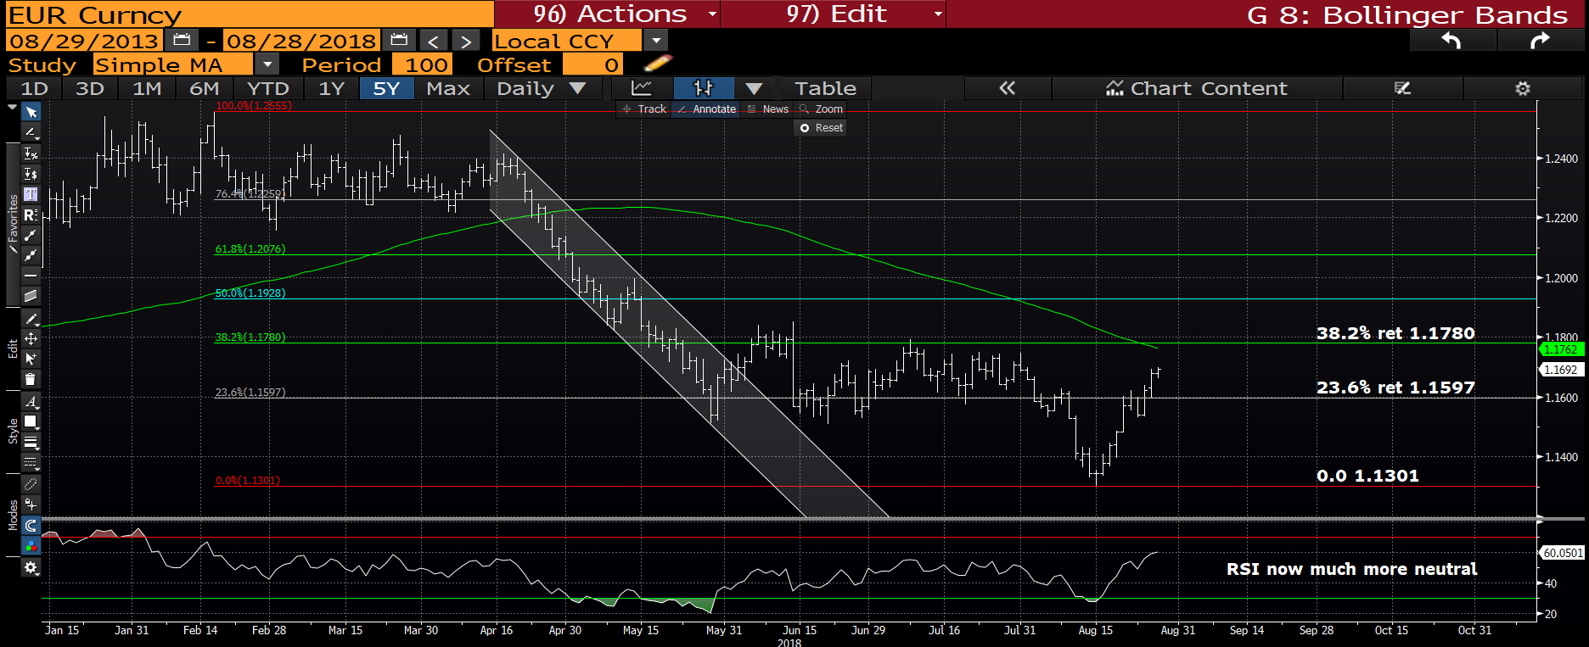
EUR USD daily : We are now producing a LOFTY RSI SHY of the 38.2% ret 1.1780.

Slide 6
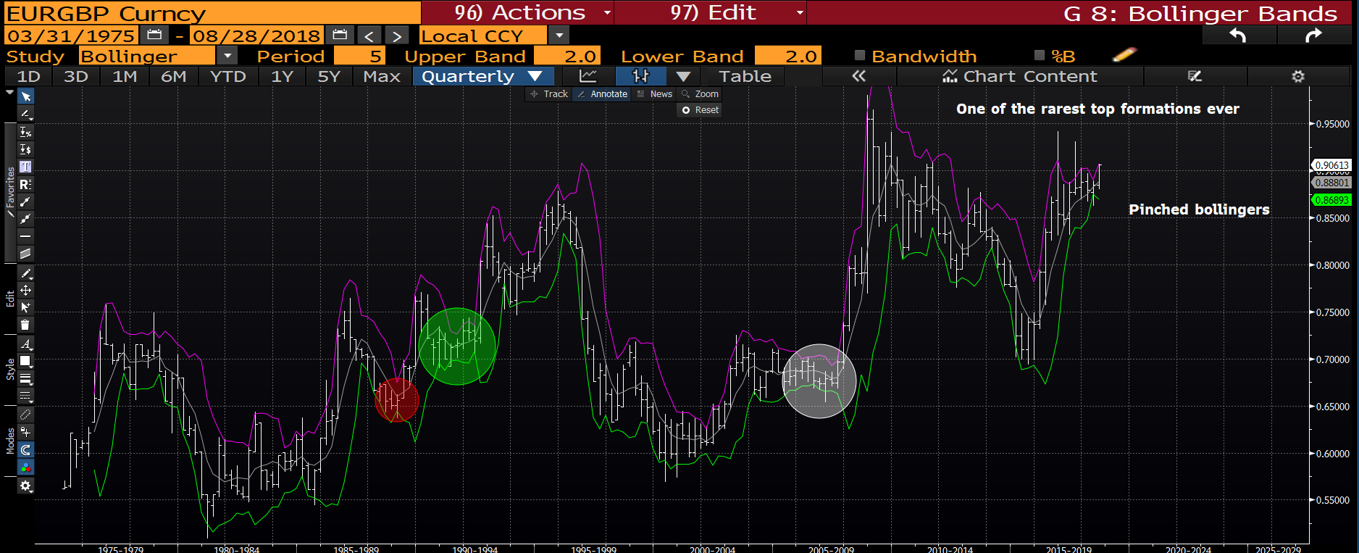
EUR GBP quarterly : This remains one of the MOST NEGATIVE formations I have seen.
I still maintain this will be a nice SELL EUR-BUY GBP Brexit trade but the timing isn’t right yet.

Slide 7
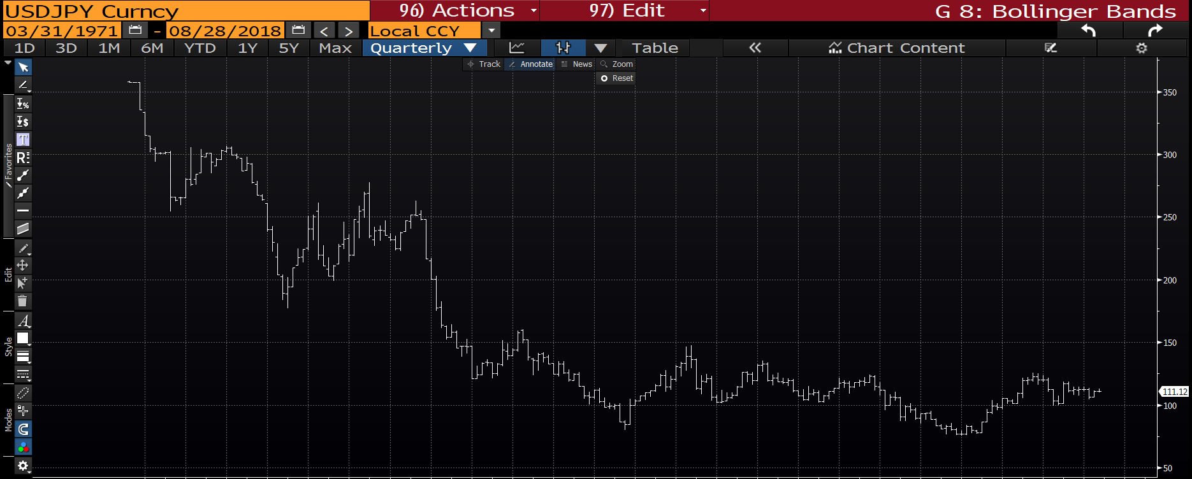
USD JPY quarterly : A very limited set of neutral ranges. Not one to focus on.

Slide 8
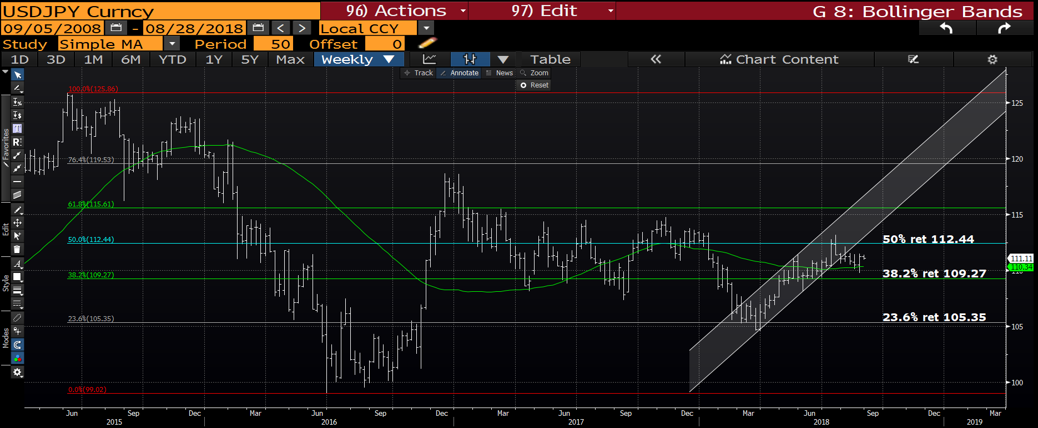
USD JPY weekly : We are grinding lower but MOMENTUM the biggest issue with this cross.

Slide 9
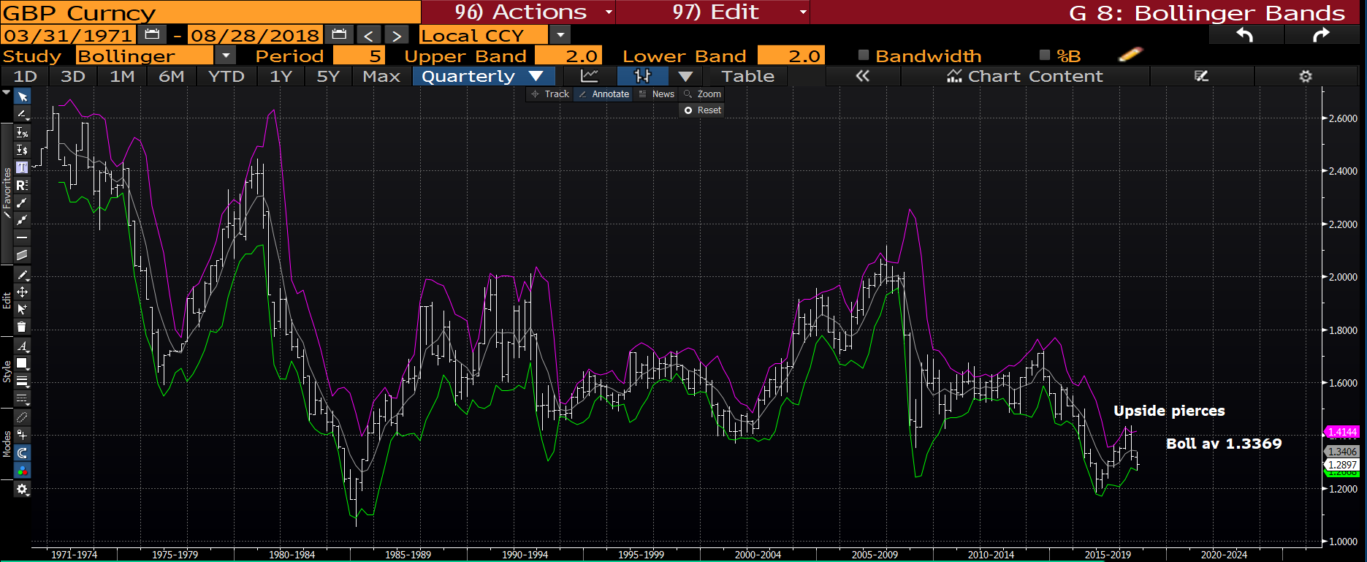
Cable Quarterly : This quarters bollinger bands have formulated the range nicely so more focus on shorter dated charts for the next move.

Slide 10
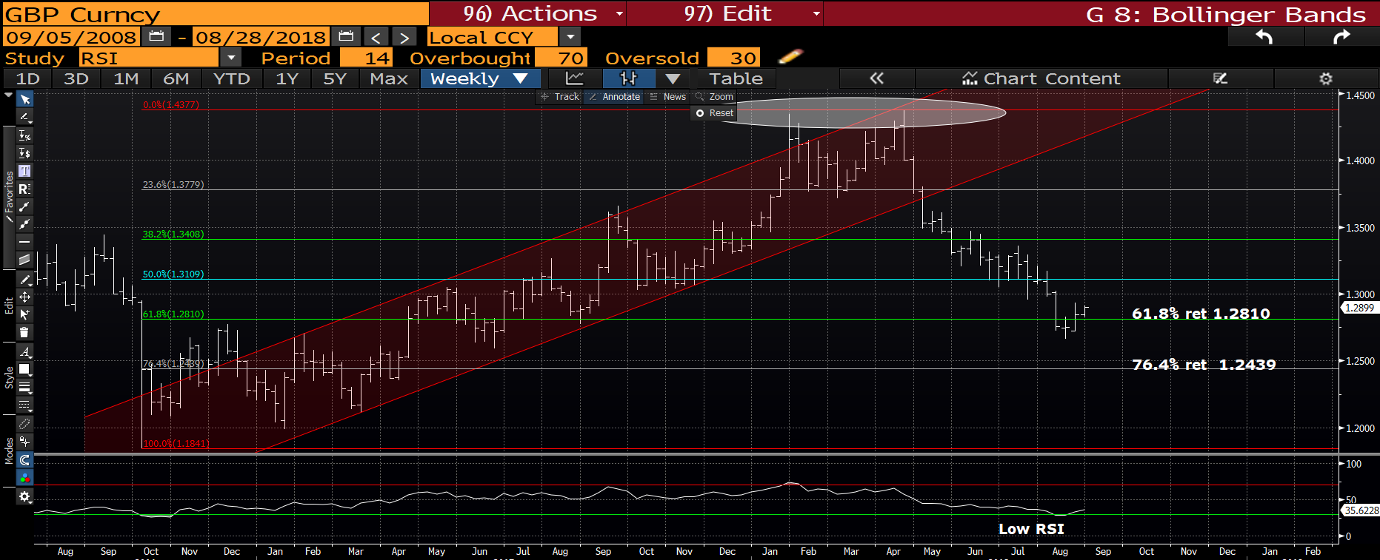
Cable weekly : I do think CABLE is a BUY in its own right given the RSI, we need to shrug off the current correlation with the EURO. Back above the 61.8% ret 1.2810 a small long looks attractive.

Slide 11
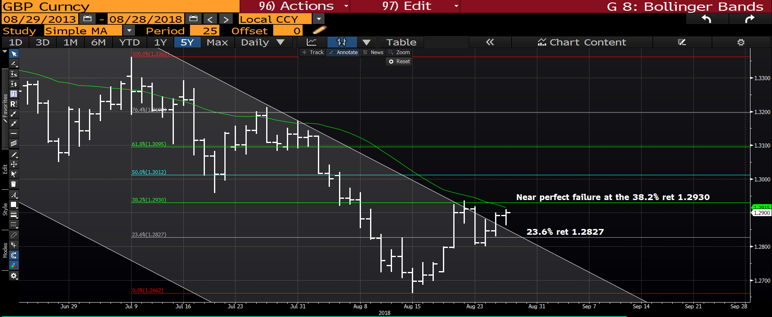
Cable daily : We have breached the channel and about to breach the
1.2915 moving average-38.2% ret 1.2930. If we do breach this level then we MAY have a move higher independent of the EURO?!

Slide 12
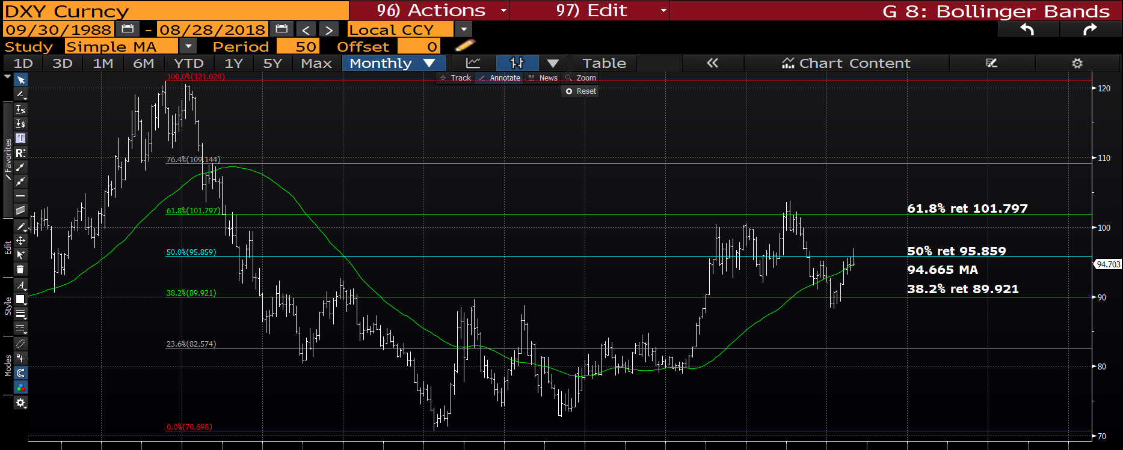
DXY monthly : We have dipped below the 50% ret 95.859 BUT holding the 50 day moving average 94.665 JUST.

Slide 13
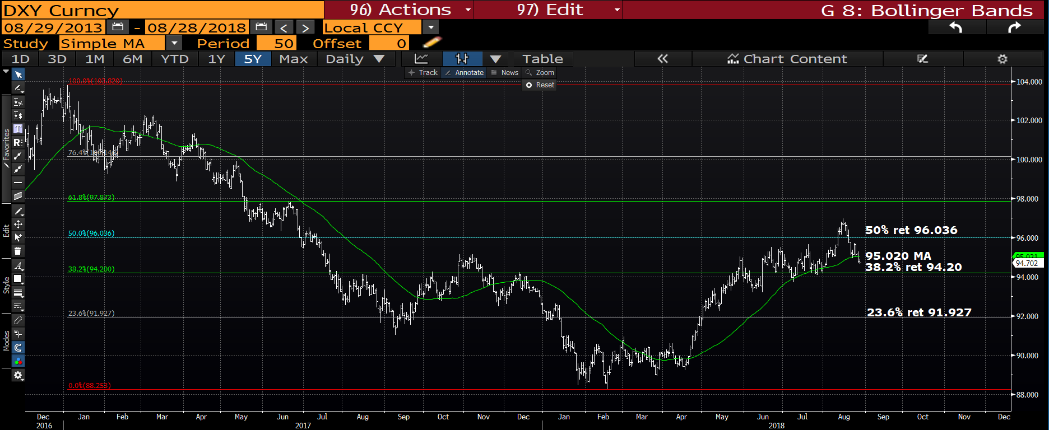
DXY monthly : We have dipped below the 95.020 moving average however support is looming in the 38.2% ret 94.20.

Slide 14
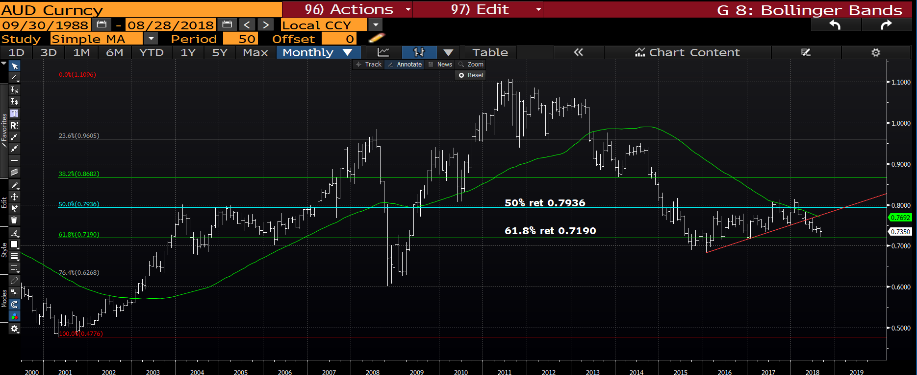
AUD USD monthly : We have taken time out at the 61.8% ret 0.7190 but should head LOWER this week!

Slide 15
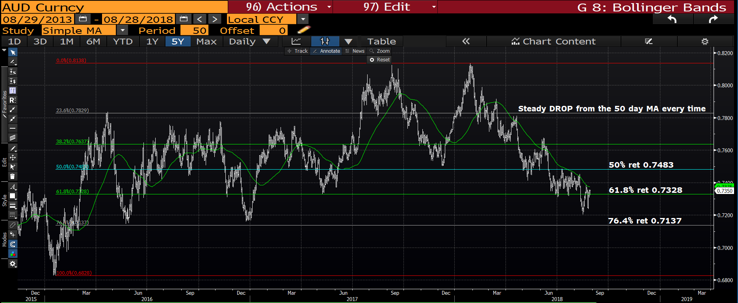
AUD USD monthly : A decent chance of a move lower given the VERY reliable 50 day moving average! A move sub the 61.8% ret 0.7328 will trigger BIGGER STOPS.

Slide 16
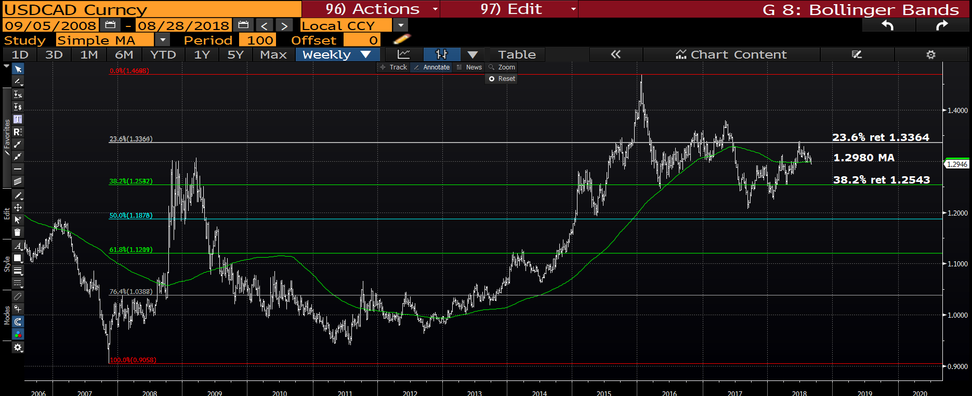
USD CAD weekly : We have breached the 1.2980 100 period moving average BUT am not convinced we head much lower.

Slide 17
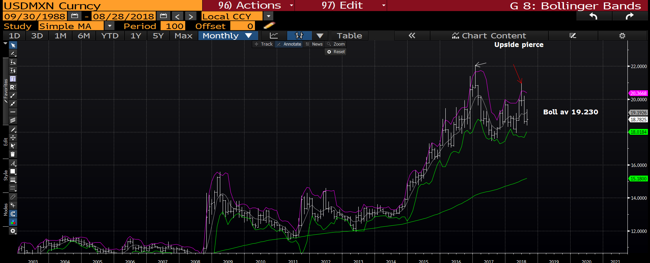
USD MXN monthly : We have two MAJOR upside pierces and providing we maintain sub the bollinger average 19.23 all is very negative. This has always been a NEGATIVE chart BUT several bounces have made it hard to remain in a short.

Slide 18
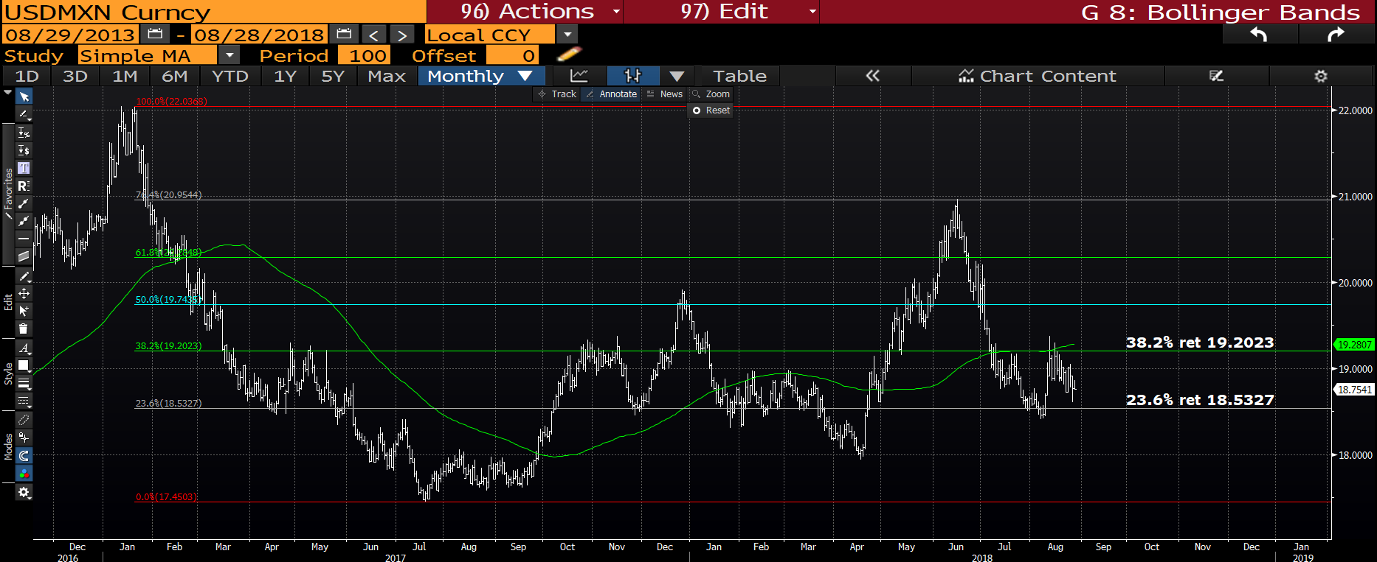
USD MXN daily : The recent bounce has stalled at the 38.2% ret 19.2023, next target is a breach of the 23.6% ret 18.5327.

Slide 19
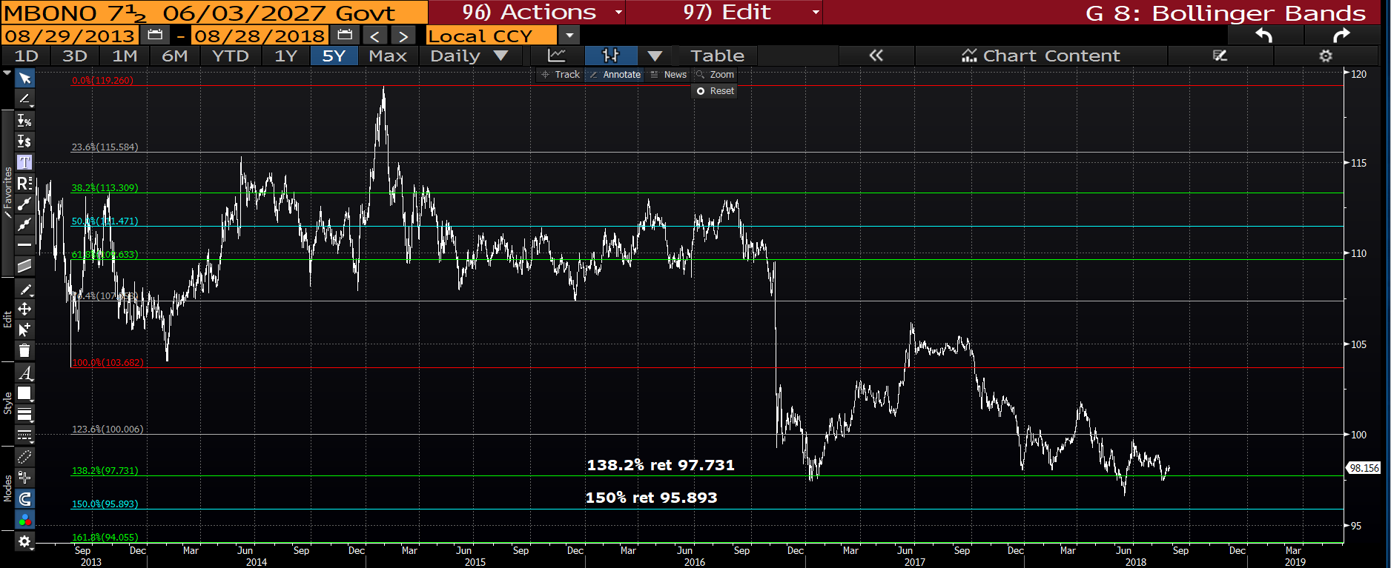
MBONO 7.5 27’s : We have held the 138.2% ret 97.731 which is positive but there is an urgency to breach the 123.6% ret 100.006 to allow continuation. We seem to of lost ALL momentum.

Slide 20
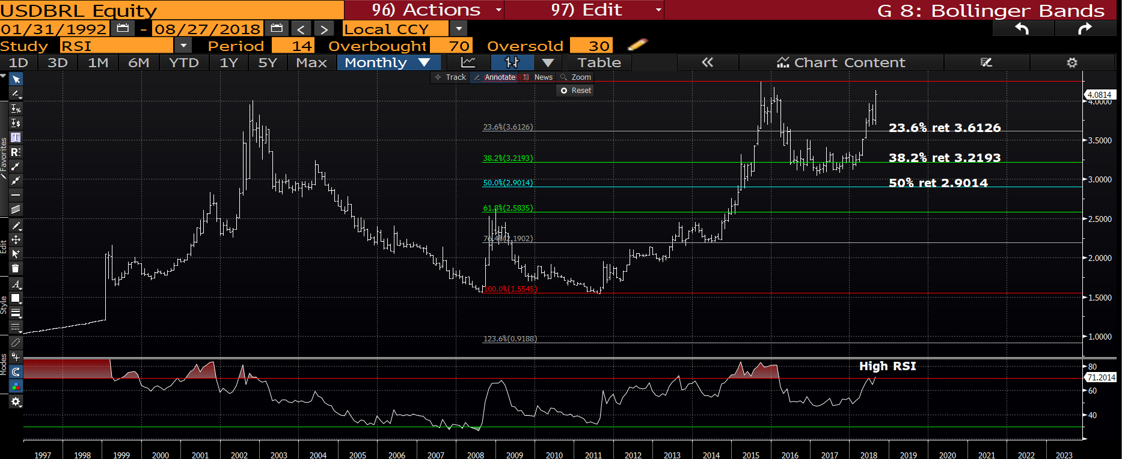
USD BRL weekly : We have popped the range despite the RSI, a struggle either way here.

Slide 21
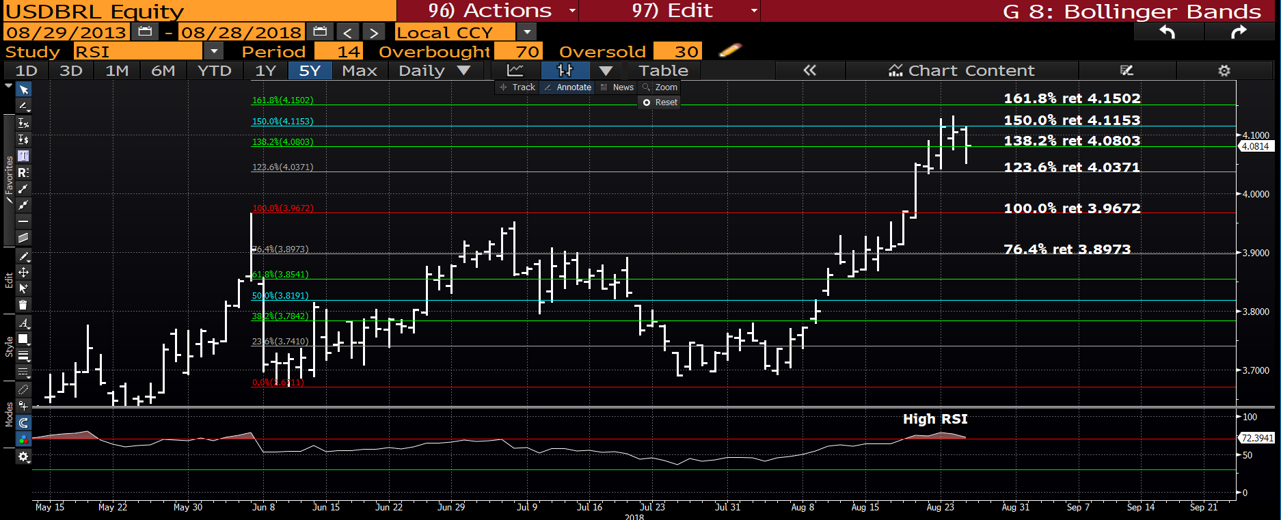
USD BRL daily : The RSI is obviously high AGAIN and would fade the cross with a 4.170 stop.

Slide 22
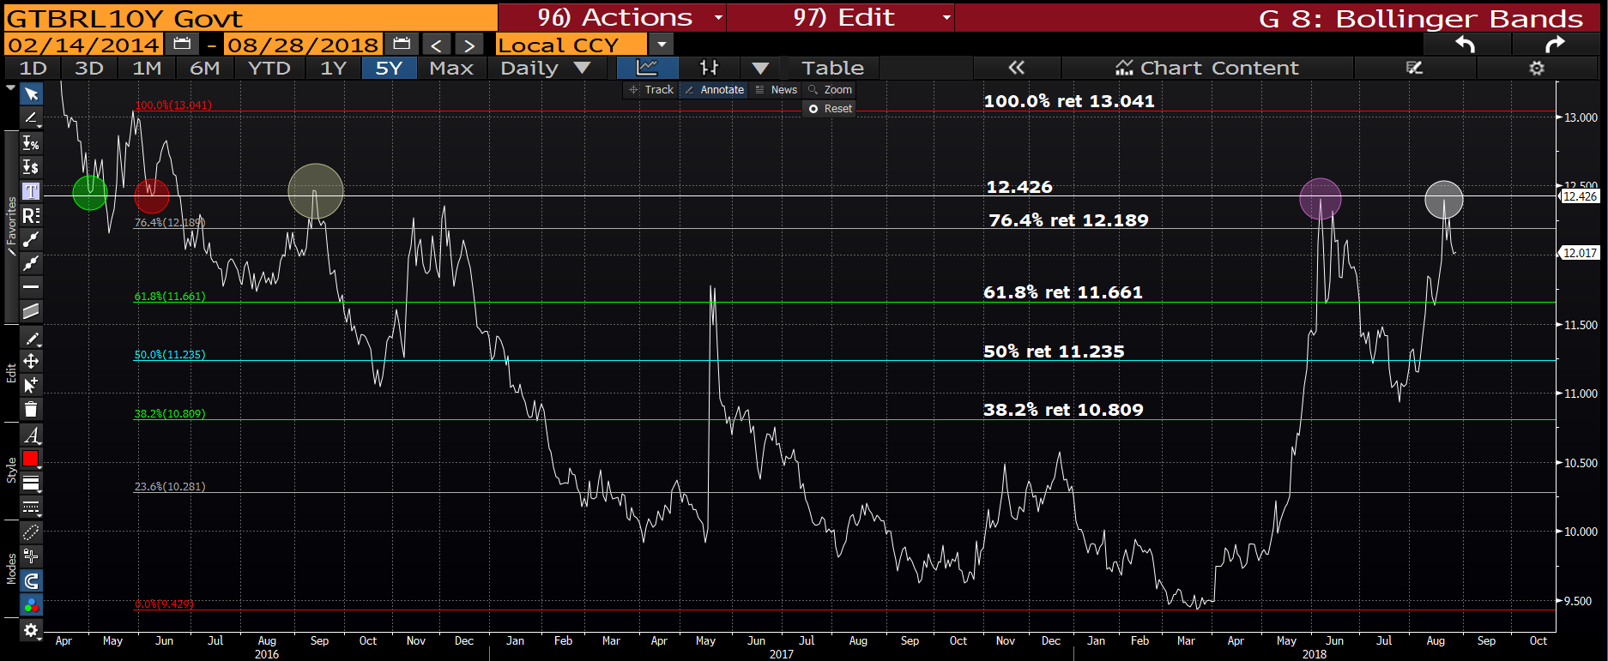
GTBRL10Y daily : The yield has topped again against the 12.426 previous high so should head lower now. I think this is confirmation to OWN more bonds.

Slide 23
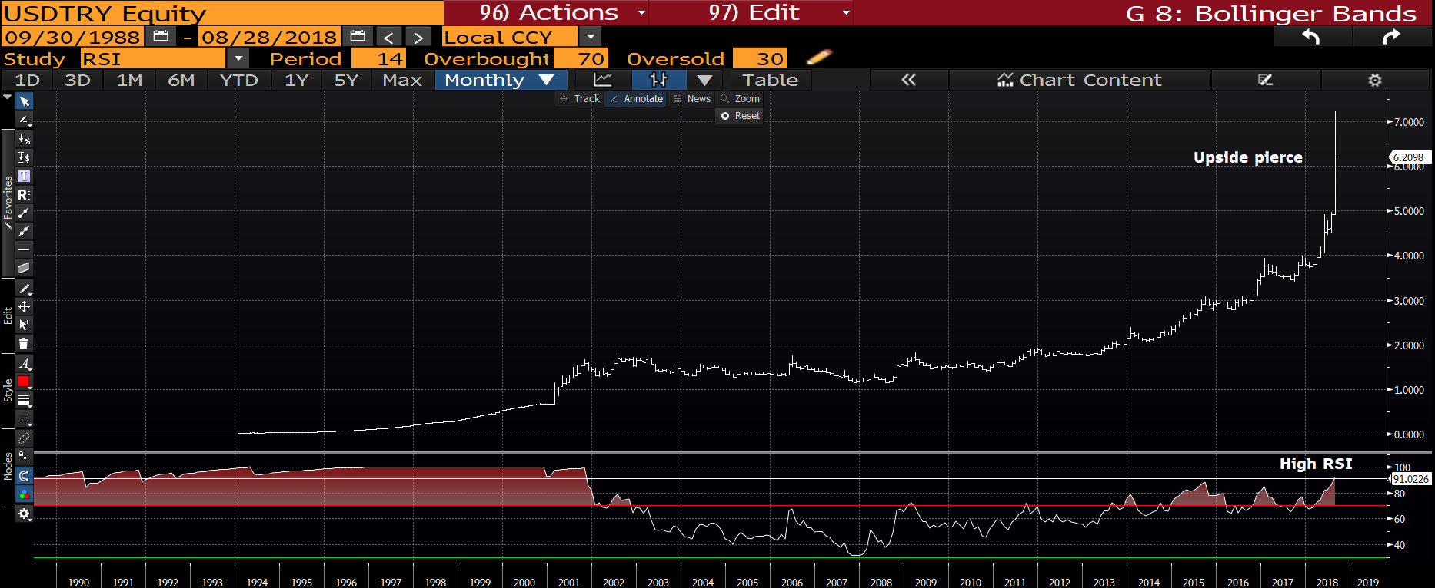
USD TRY monthly : We could have a TOP! The latest upside pierce is VERY dramatic and the RSI obvious so LOWER WE GO.

Slide 24
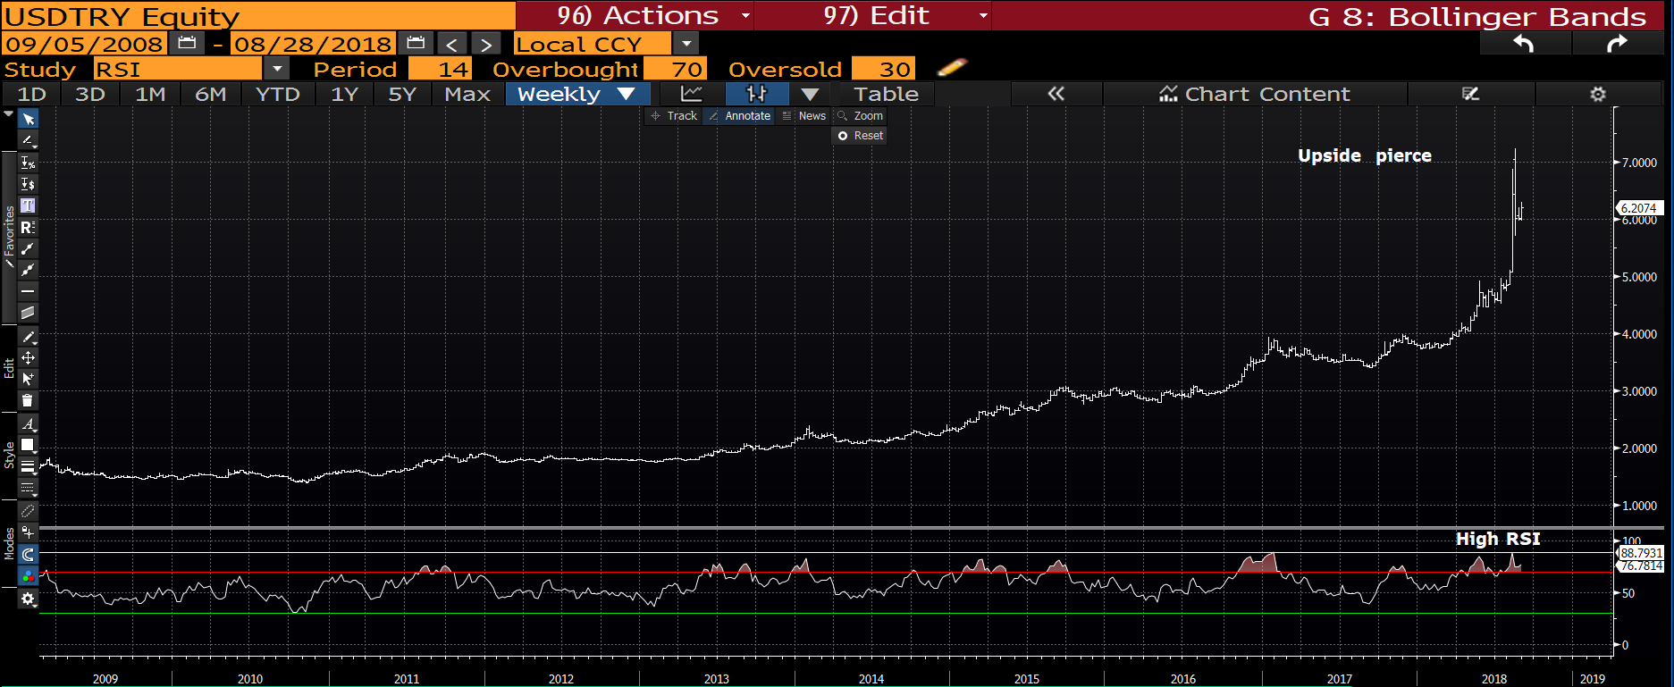
USD TRY weekly : Last weeks range and top could now be signalling a move lower for this cross.

Slide 25
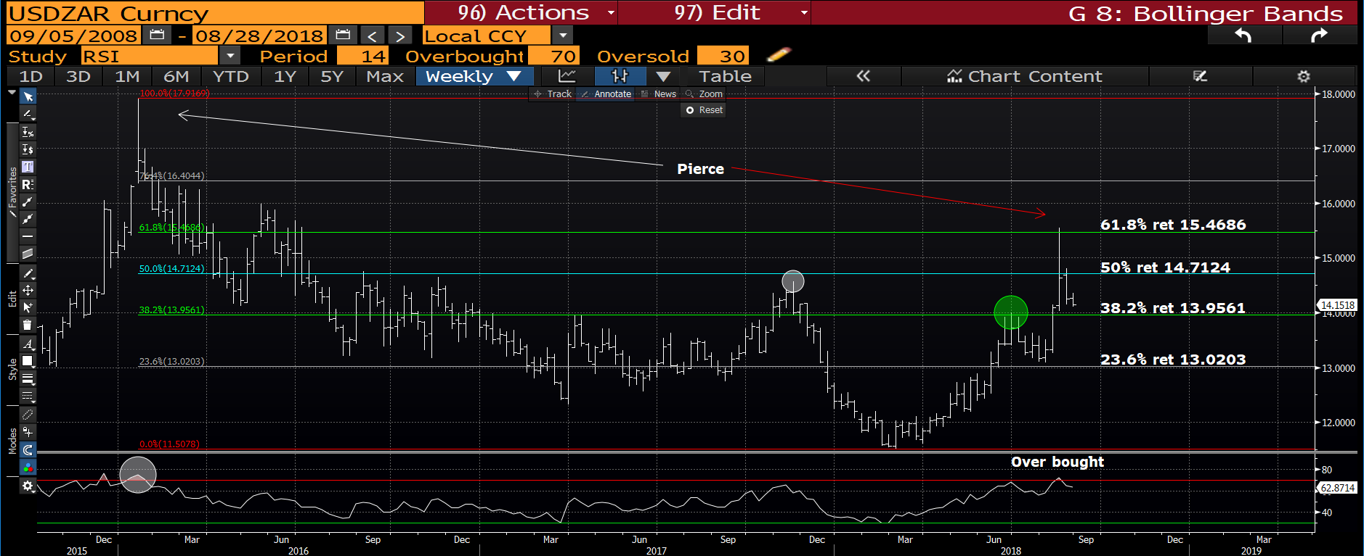
USD ZAR weekly : This has definitely developed a nasty upside pierce and that is complimented by an over bought RSI. We should stall, sub the 38.2% ret 13.9561 will provide confirmation of further acceleration.

Slide 26
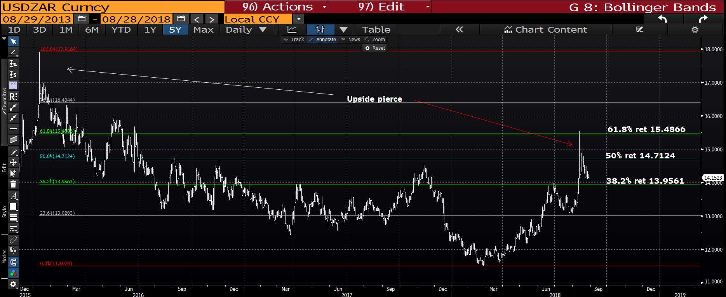
USD ZAR daily : We failed nicely at the 61.8% ret 15.4866 and remaining sub the 38.2% ret 13.9561 will signal a major reversal LOWER.

Slide 27
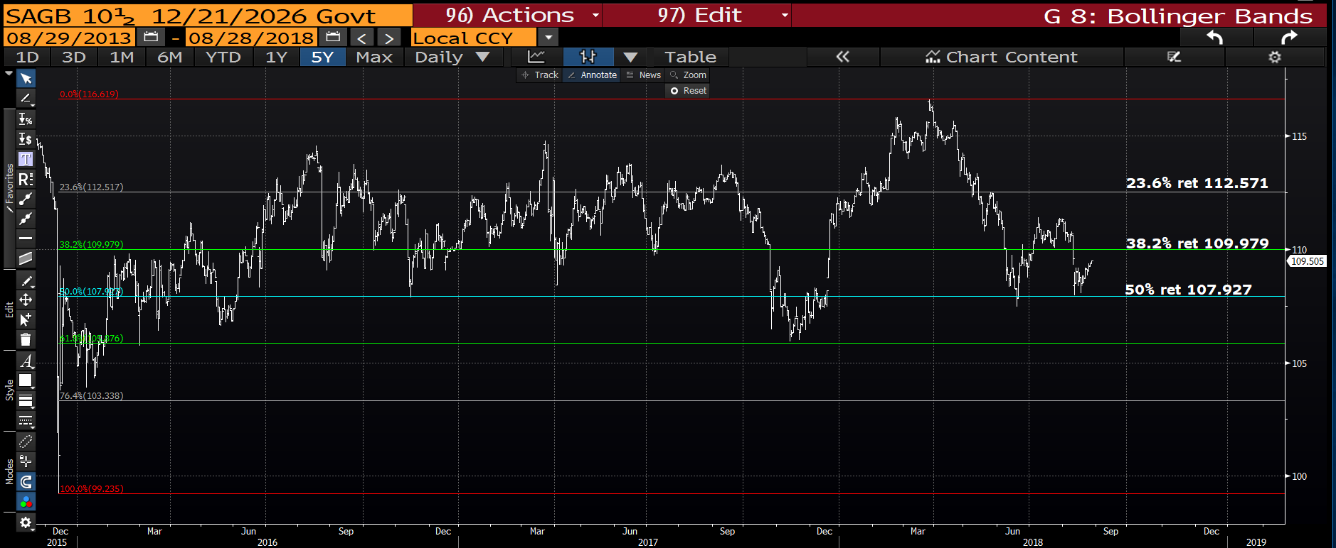
SAGB 26’s weekly : The bond is HOLDING but struggling with momentum despite holding the 50% ret 107.927. Above the 38.2% ret 109.979 should reignite interest.

Slide 28
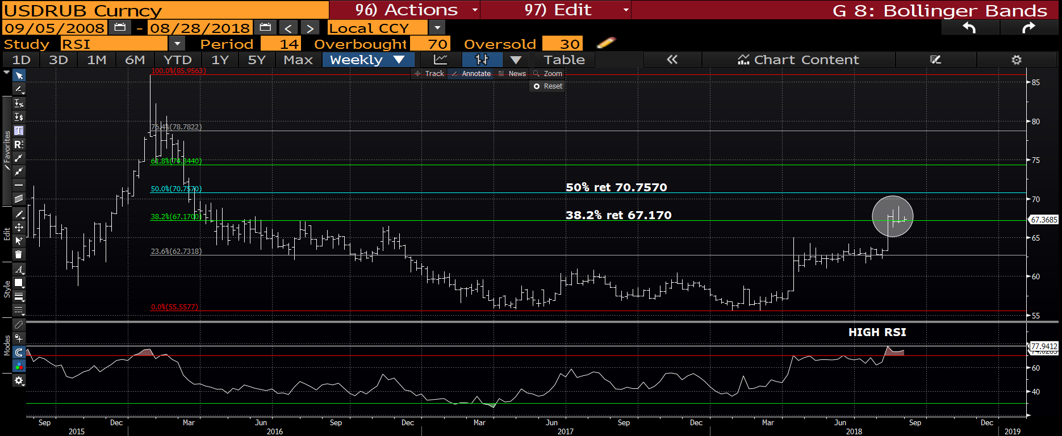
USD RUB weekly : A sizeable bounce and the RSI now matches that of early 2016.
This is now worth fading given the 38.2% ret 67.170 breach.

Slide 29
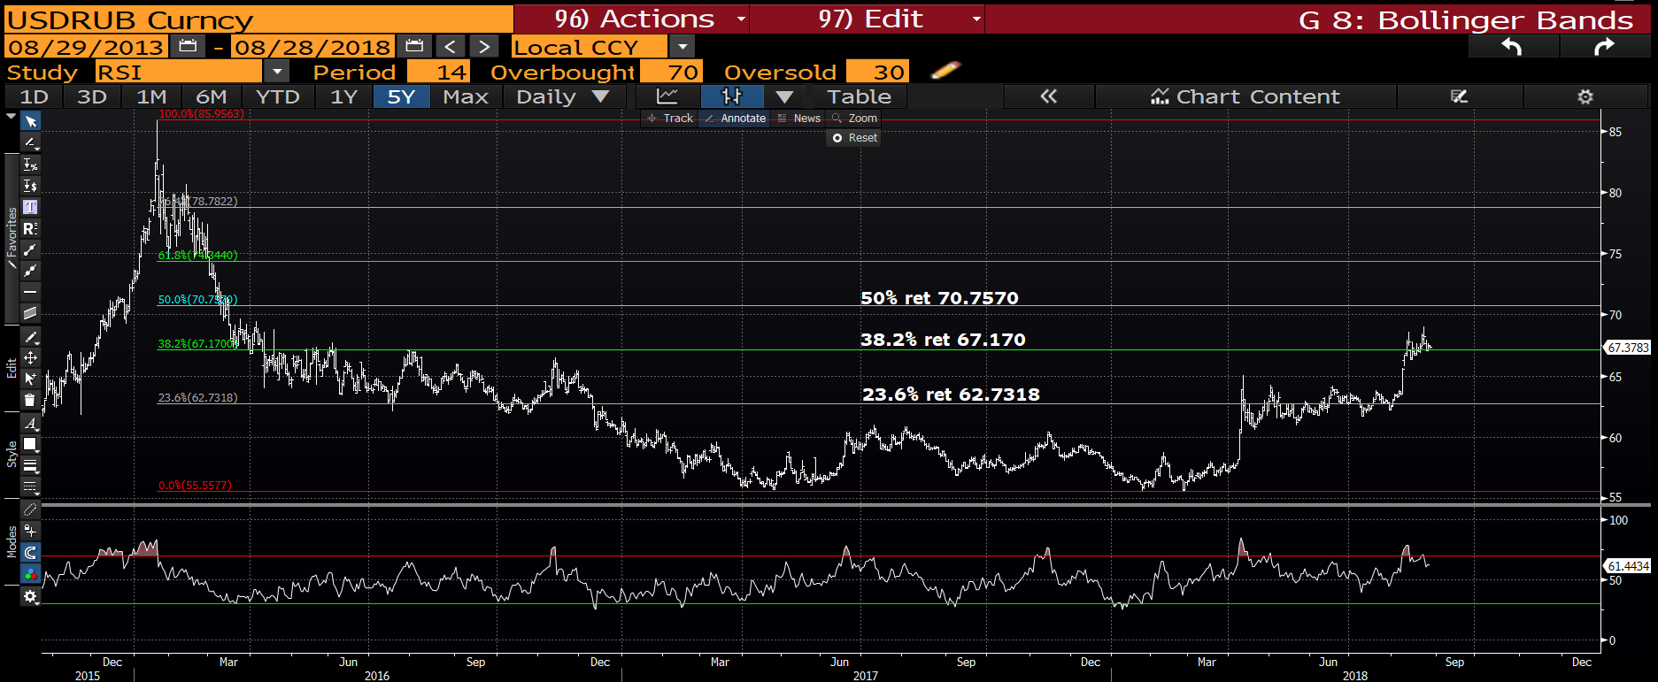
USD RUB daily : The daily RSI is SHY of the recent highs so any stop needs to be tight.

Slide 30
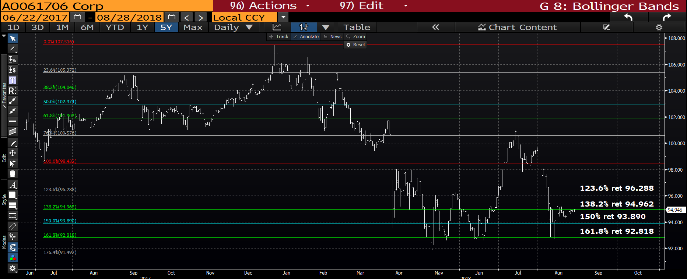
RUSSIA 47’s daily : The bond is HOLDING and a breach of the 138.2% ret 94.962 will help.

