Slide 1
BUNDS BUY UPSIDE : Despite the recent dip I still think the trend higher remains in tact, CTA’s have an appetite for more as well as REAL MONEY.
Trade ideas (Skew currently set up for PUTS) all REFERENCE 162.00 on the future.
Idea 1 :
RXU8 160.0/164.0 Combo is 8 ticks in favour of puts
Idea 2 :
RXU8 163.5/164.5 Call Spread 11.5/12.5 11 Delta
Idea 3 : Just to highlight put skew
RXU8 163.5/164.5 Call Spread vs 159 Puts is 1.5/2.5 for the call spread
(call sp = 1.5pts OTM p = 3.pts OTM) 20 Delta

Slide 2
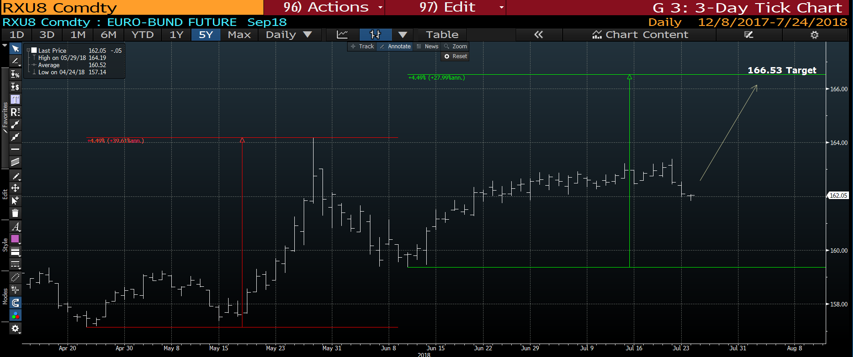
Bund daily : I think the DIP is sufficient and feel we hold here with a 166,53 target over the next few weeks. Stop on the idea at 161.48.

Slide 3
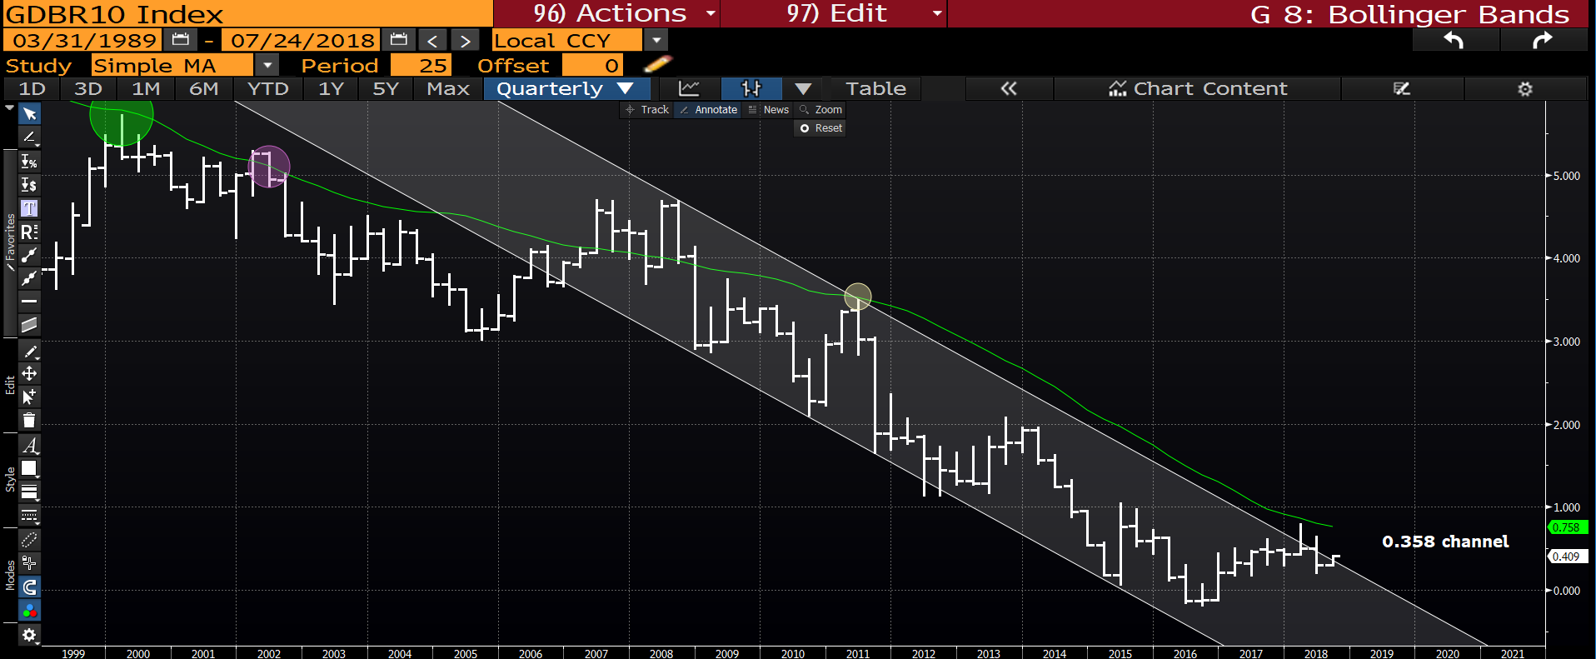
German 10yr yield quarterly : Despite being outside of the trend channel resistance remains.

Slide 4
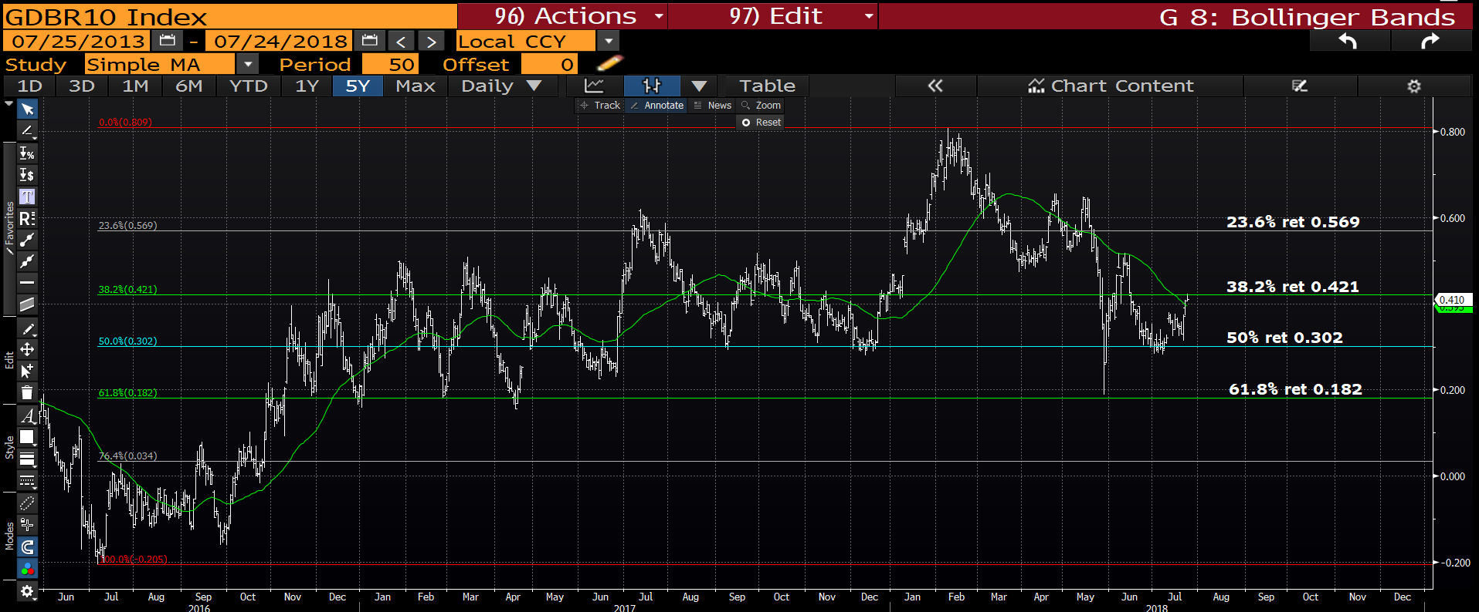
German 10yr daily : A good day to fade yields given the 38.2% ret 0.421 is offering very good resistance.

Slide 5
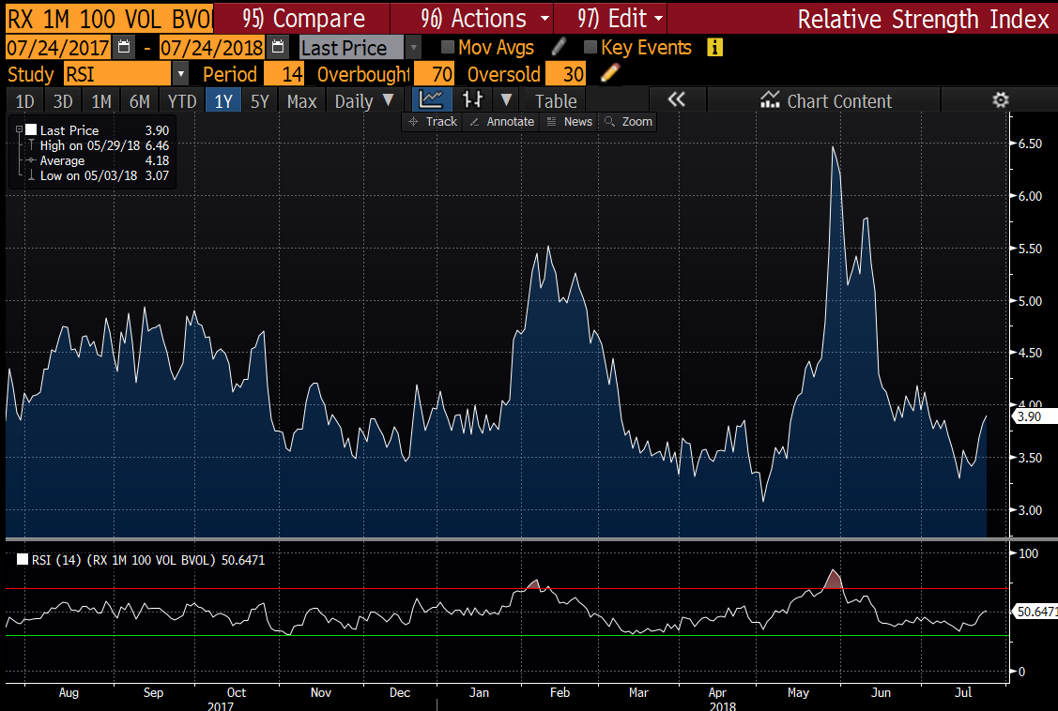
Bund VOL daily : Bund VOL remains LOWISH so should help make extra money.

Slide 6
