Slide 1
FX UPDATE
FX UPDATE : Another market of expectation followed by disappointment. Sadly I was expecting more from USD strength into month end BUT still time given the BOJ, FED and BOE this week.
ALL eyes on the EURO closing weaker into month end, the BIG DANGER is the current ranges are TOO SMALL. Buy SHORT DATED PUTS say EUR USD 1.1400 Puts 21.0/22.0 Ref Sep future 1.16885. (Now 15.0/16.0).
USD strength and EM LOWS in place.
The EURO could casually fail today for a few months!
USD EM has seen many BLOW OUT scenarios and TOPS now in on USD BRL, MXN, TRY and ZAR.
USD CAD continues a SLOW but effective GRIND.

Slide 2
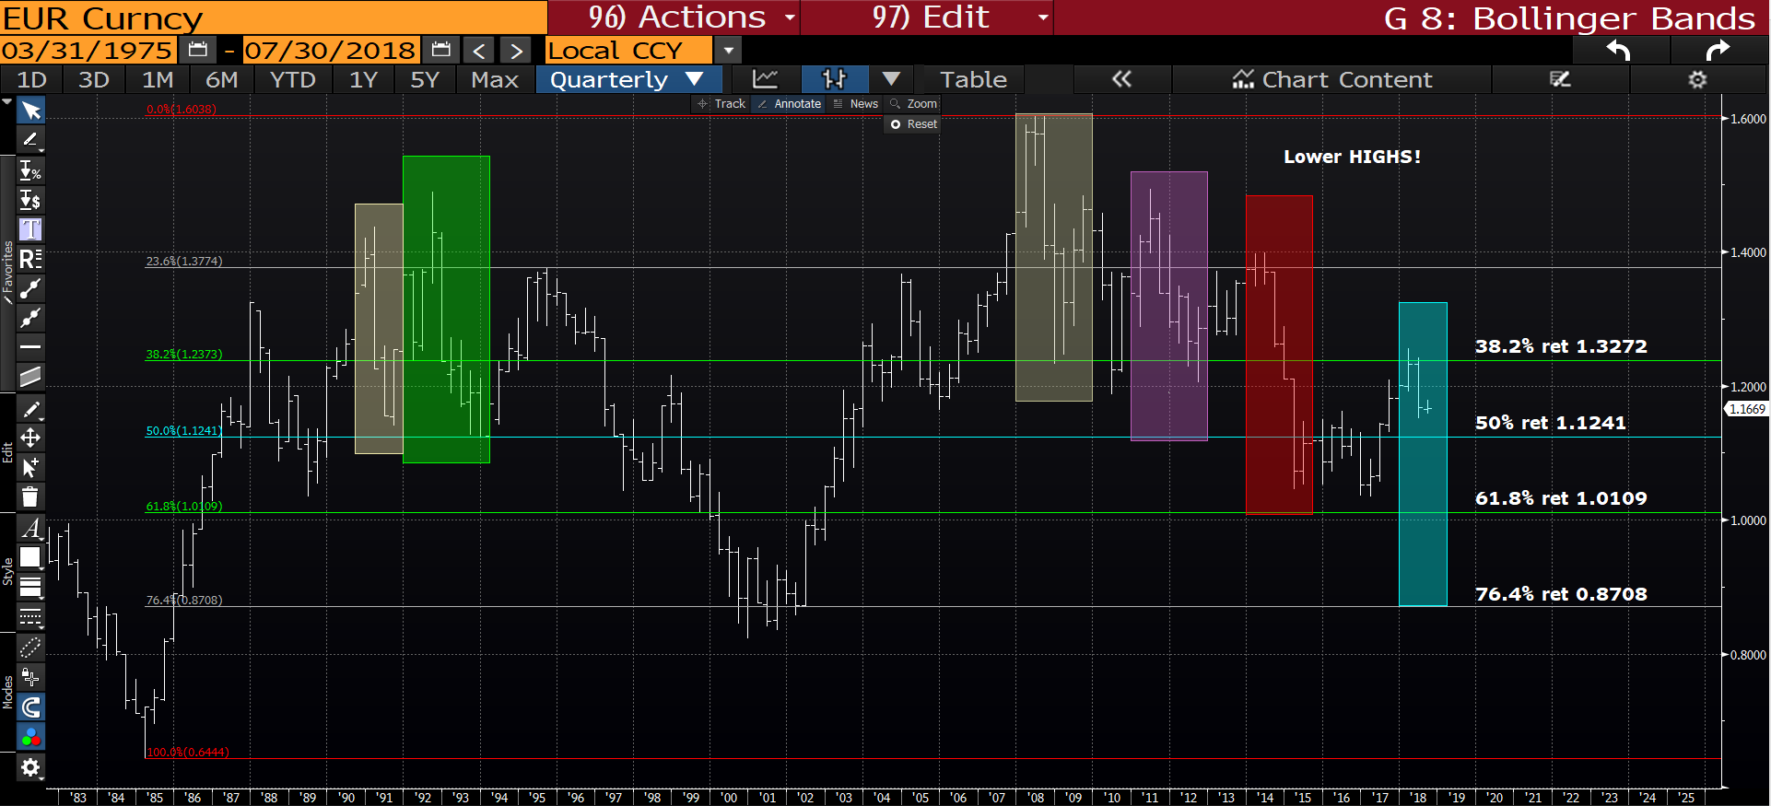
EUR USD quarterly : The months range is FAR TOO SMALL thus we could see a very MESSY and negative RUSH in to month end, BE PREPARED!!! We are stalling, as can be seen by the BLUE BOX if 1.1509 is breached we will be literally in FREE FALL.

Slide 3
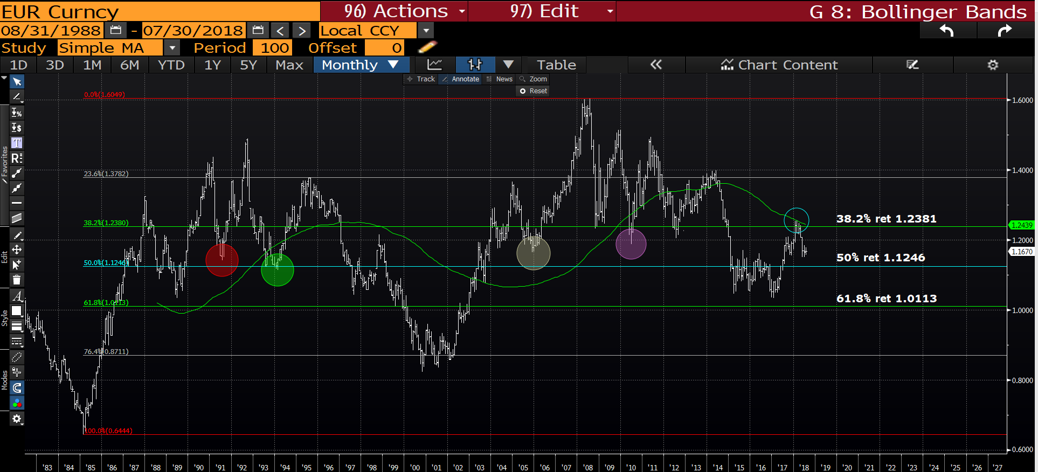
EUR USD monthly : This months range is too narrow so ideally we head lower, minimally targeting the 50% ret 1.1246.

Slide 4
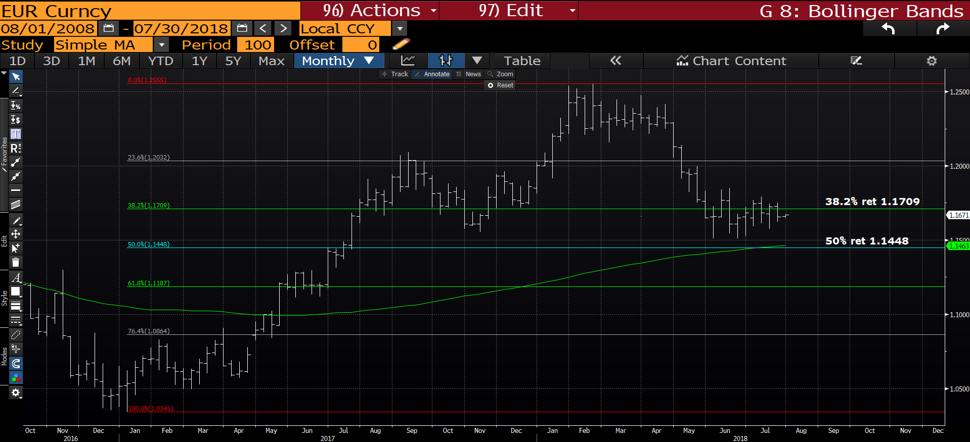
EUR USD weekly : We have dipped back through the 38.2% ret 1.1709 targeting the
100 period moving average 1.1448.

Slide 5
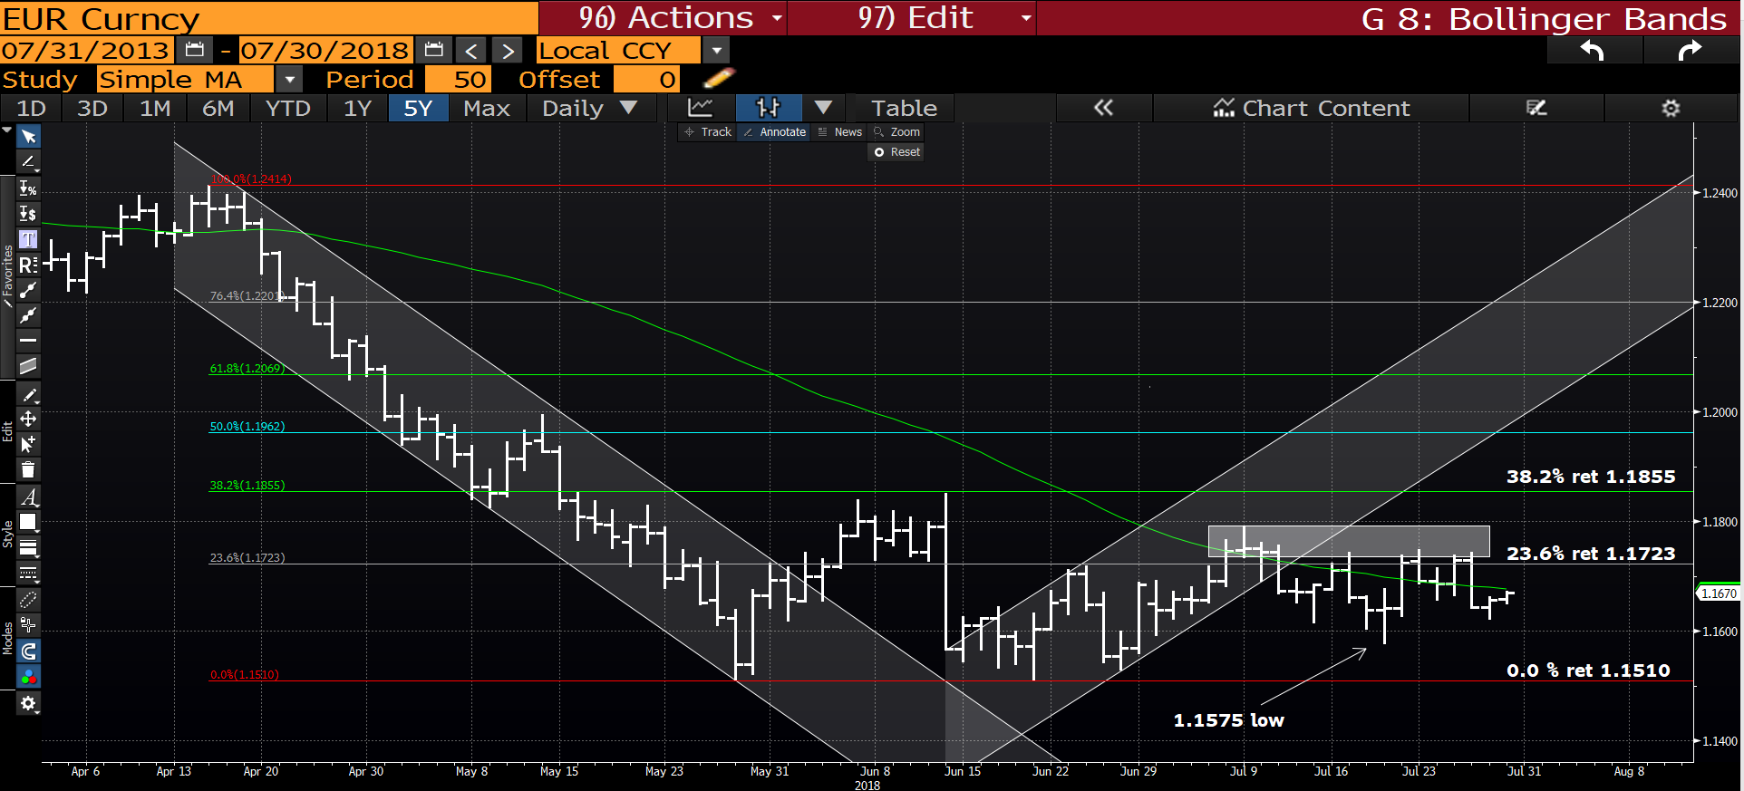
EUR USD daily : We continue to LACK any kind of BOUNCE. Providing we remain sub the 23.6% ret 1.1723 then 1.1509 remains the target before month end. Stop all short above the 1.18 level including any short dated options.

Slide 6
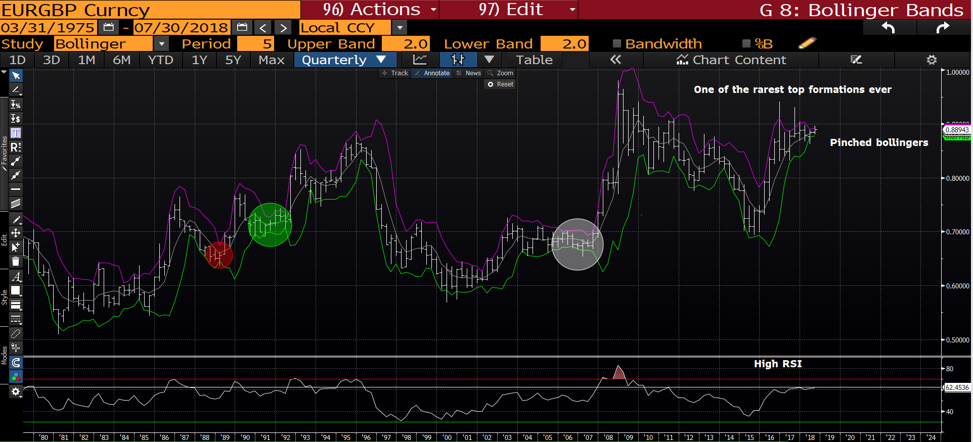
EUR GBP quarterly : This remains one of the MOST NEGATIVE formations I have seen. Currently we are being constrained by the bollingers with little scope for a break out. Sooner of later this will MOVE.

Slide 7
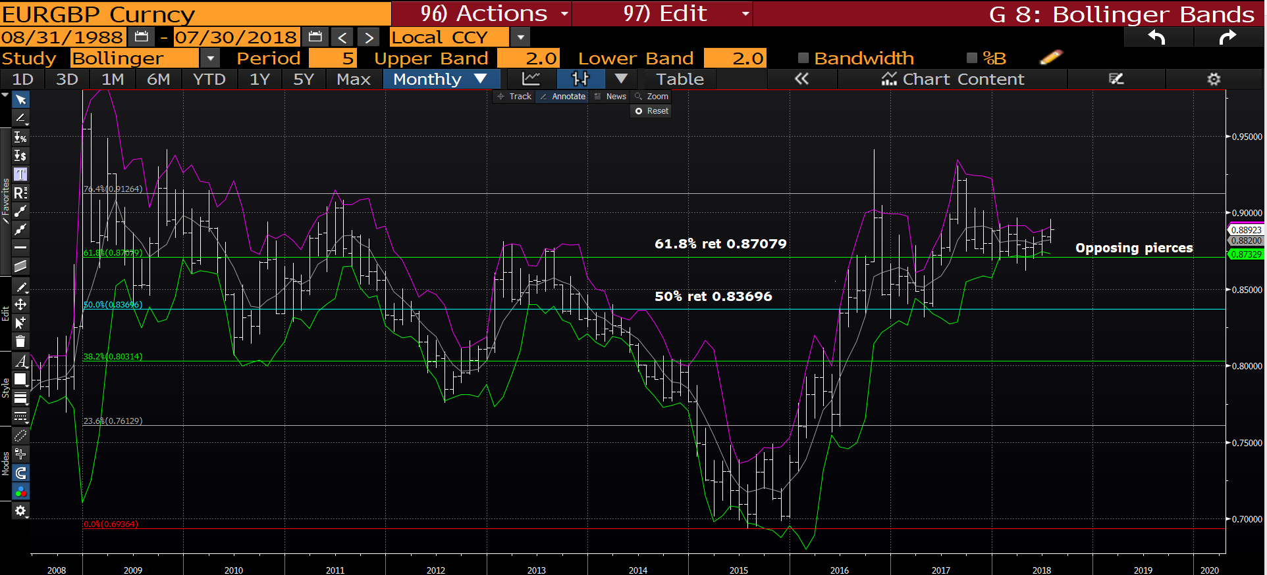
EUR GBP monthly : We have numerous opposing pierces highlighting an inability to break out, however the latest is to the upside and thus negative for the EURO.

Slide 8
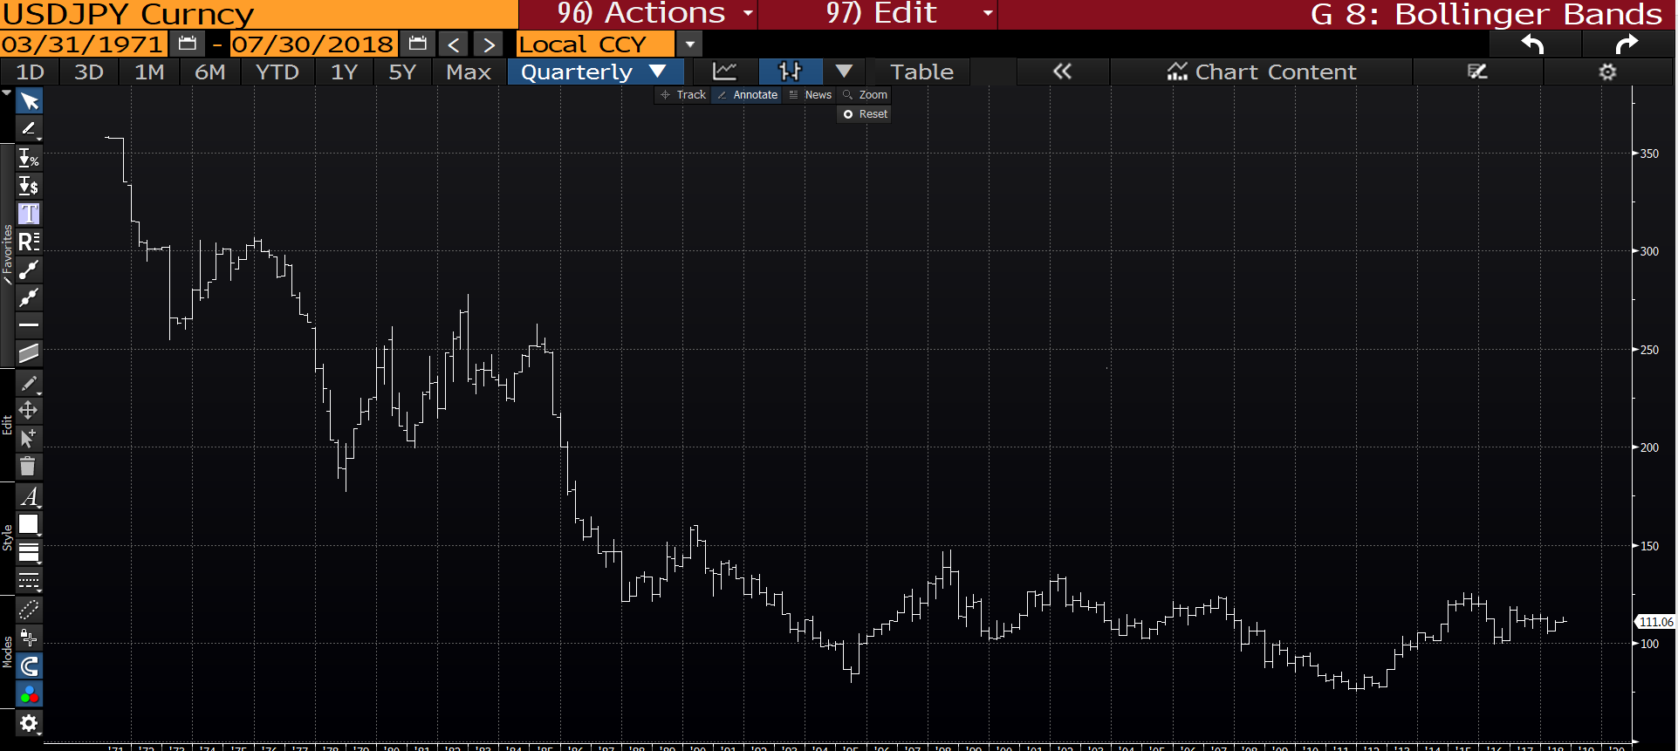
USD JPY quarterly : A very limited set of neutral ranges. Not one to focus on.

Slide 9
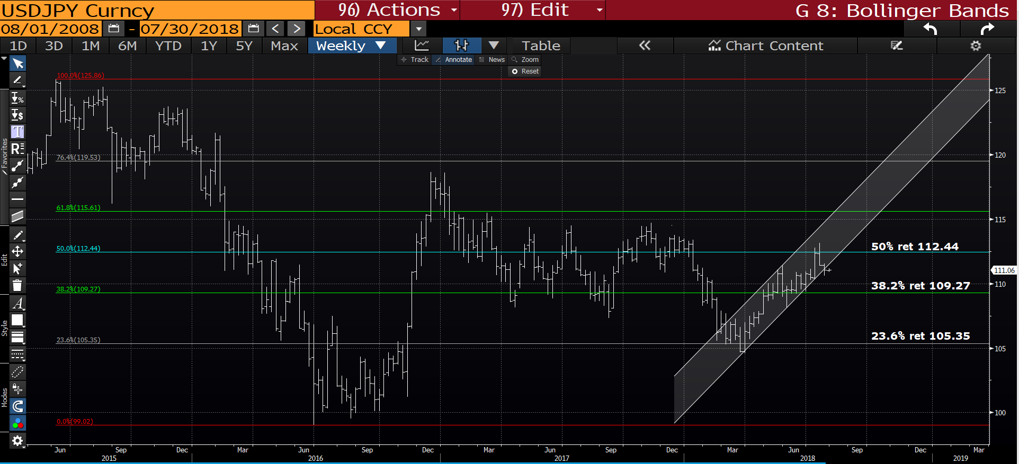
USD JPY weekly : This continues to remain a very neutral chart.

Slide 10
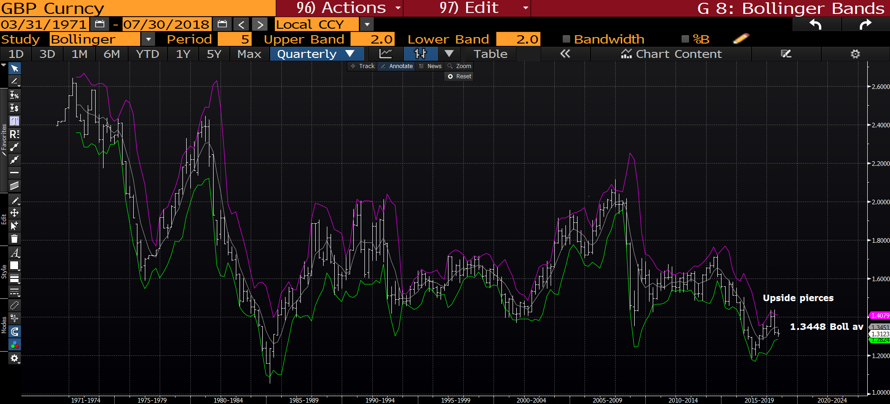
Cable Quarterly : This remains a very negative formation given we have two upside pierces and are now sub the bollinger average 1.3448. The next support is the bottom bollinger 1.2814.

Slide 11
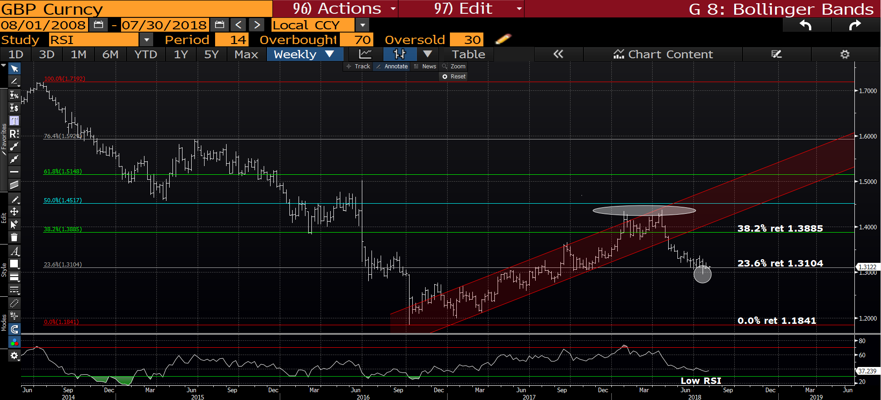
Cable weekly : We continue to hold the 23.6% ret 1.3104 and the latest PIERCE should allow for a bounce. The RSI is low and should help.

Slide 12
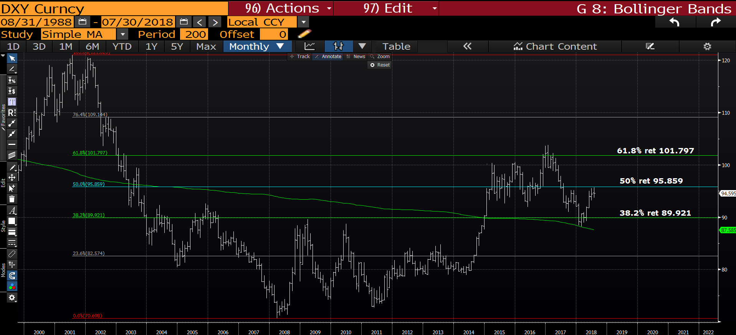
DXY monthly : We are approaching the 50% ret 95.859 SO hoping for a breach shortly.

Slide 13
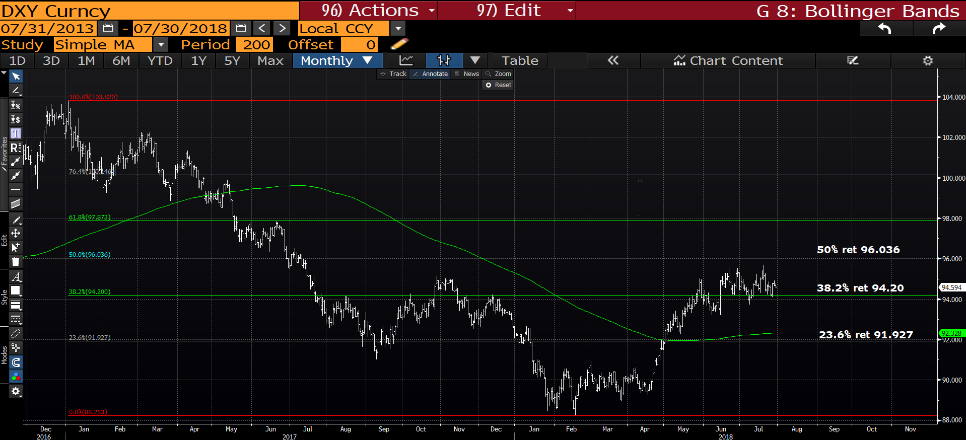
DXY daily : The BIG struggle here is momentum or LACK of it, but we are holding the
38.2% ret 94.20.

Slide 14
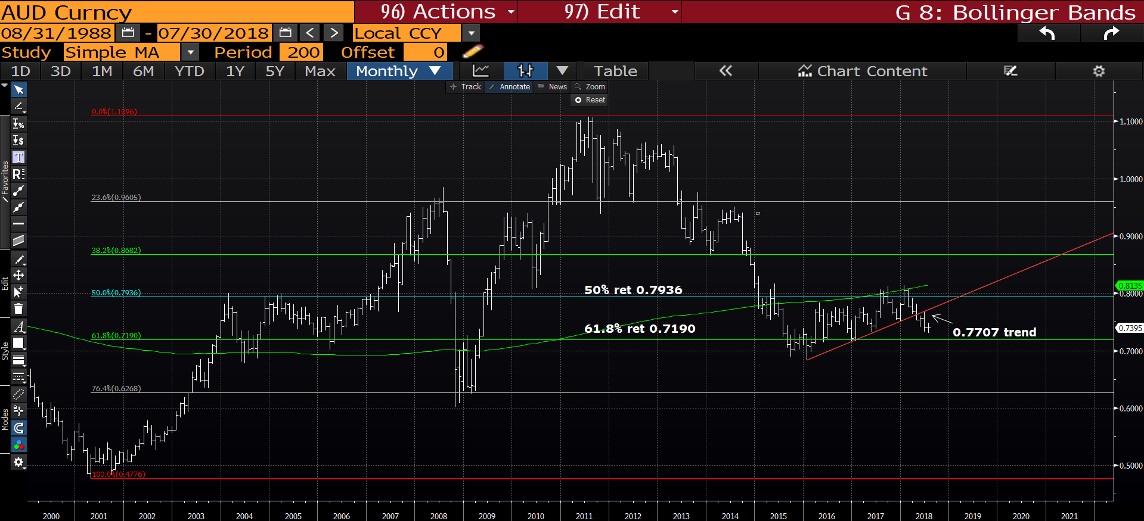
AUD USD monthly : The range this month seems too small and we should see this increase with a further downside push. Sub the 61.8% ret 0.7191 will be a significant breach.

Slide 15
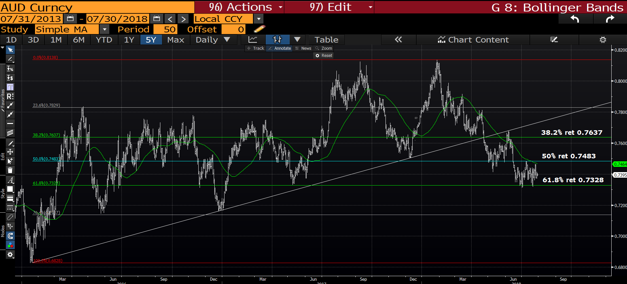
AUD USD daily : A VERY NEAT chart given we seem to readily adhere to the retracements. Hopefully we can breach the 61.8% ret 0.7328.

Slide 16
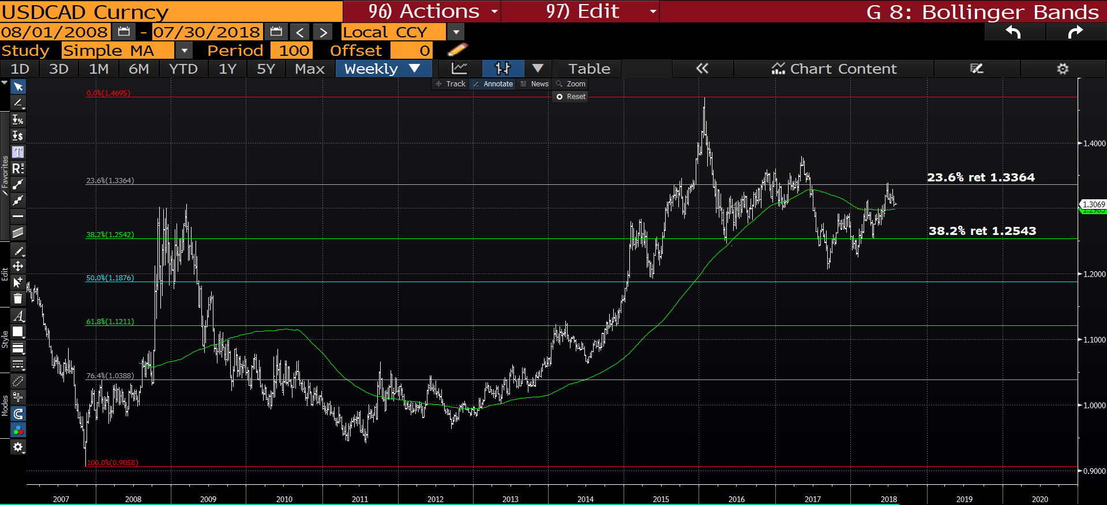
USD CAD weekly : This has gradually ground higher BUT we need a breach of the
23.6% ret 1.3364 and HOLD the 1.300 100 period moving average.

Slide 17
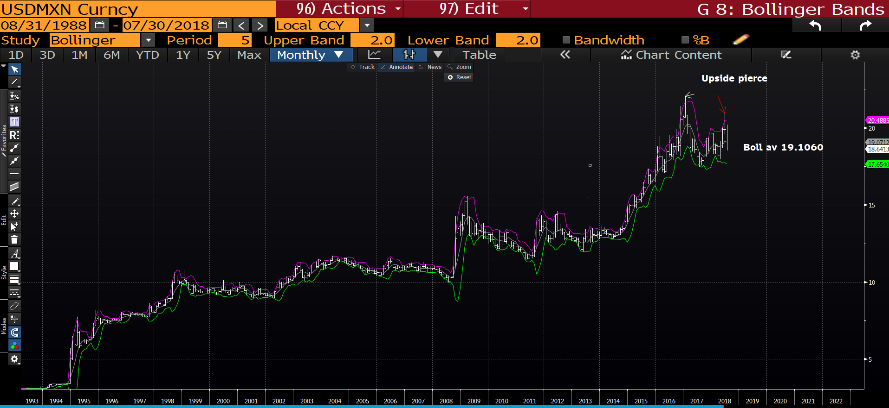
USD MXN monthly : This has now become a VERY NEGATIVE chart given we have breached the trend friend bollinger average 19.1060. The next target is 17.7248.

Slide 18
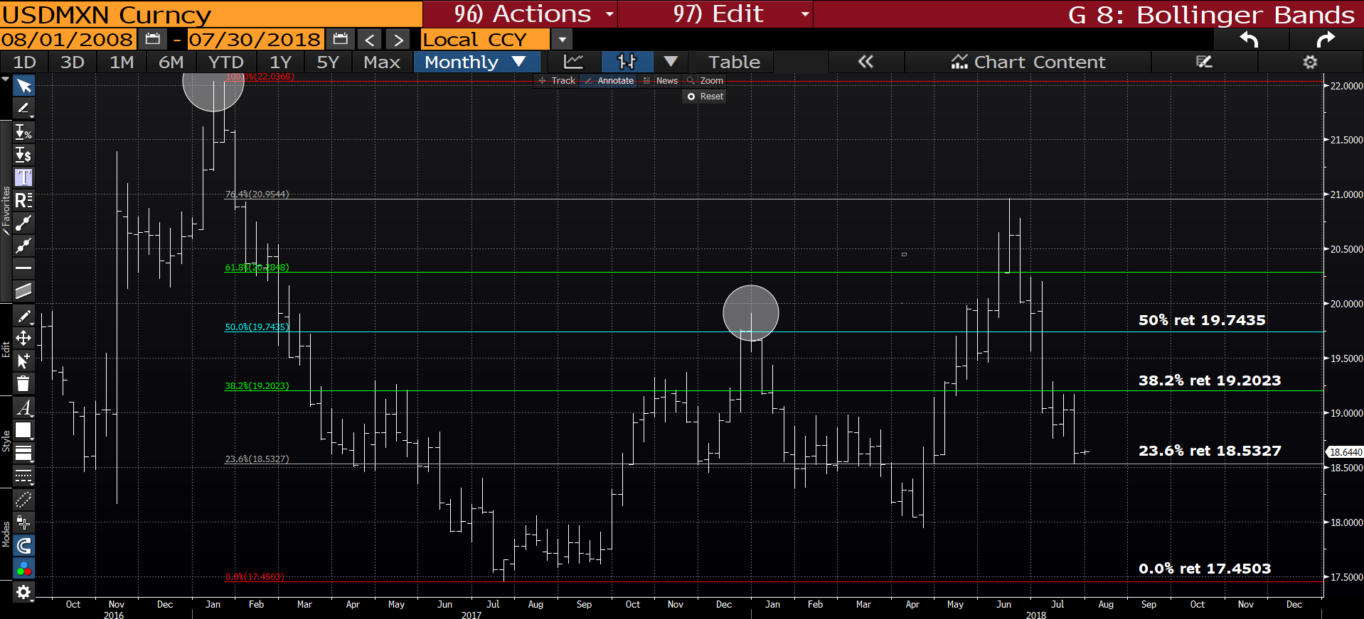
USD MXN weekly : We have had a decent drop and the next target is to breach the
23.6% ret 18.5327.

Slide 19
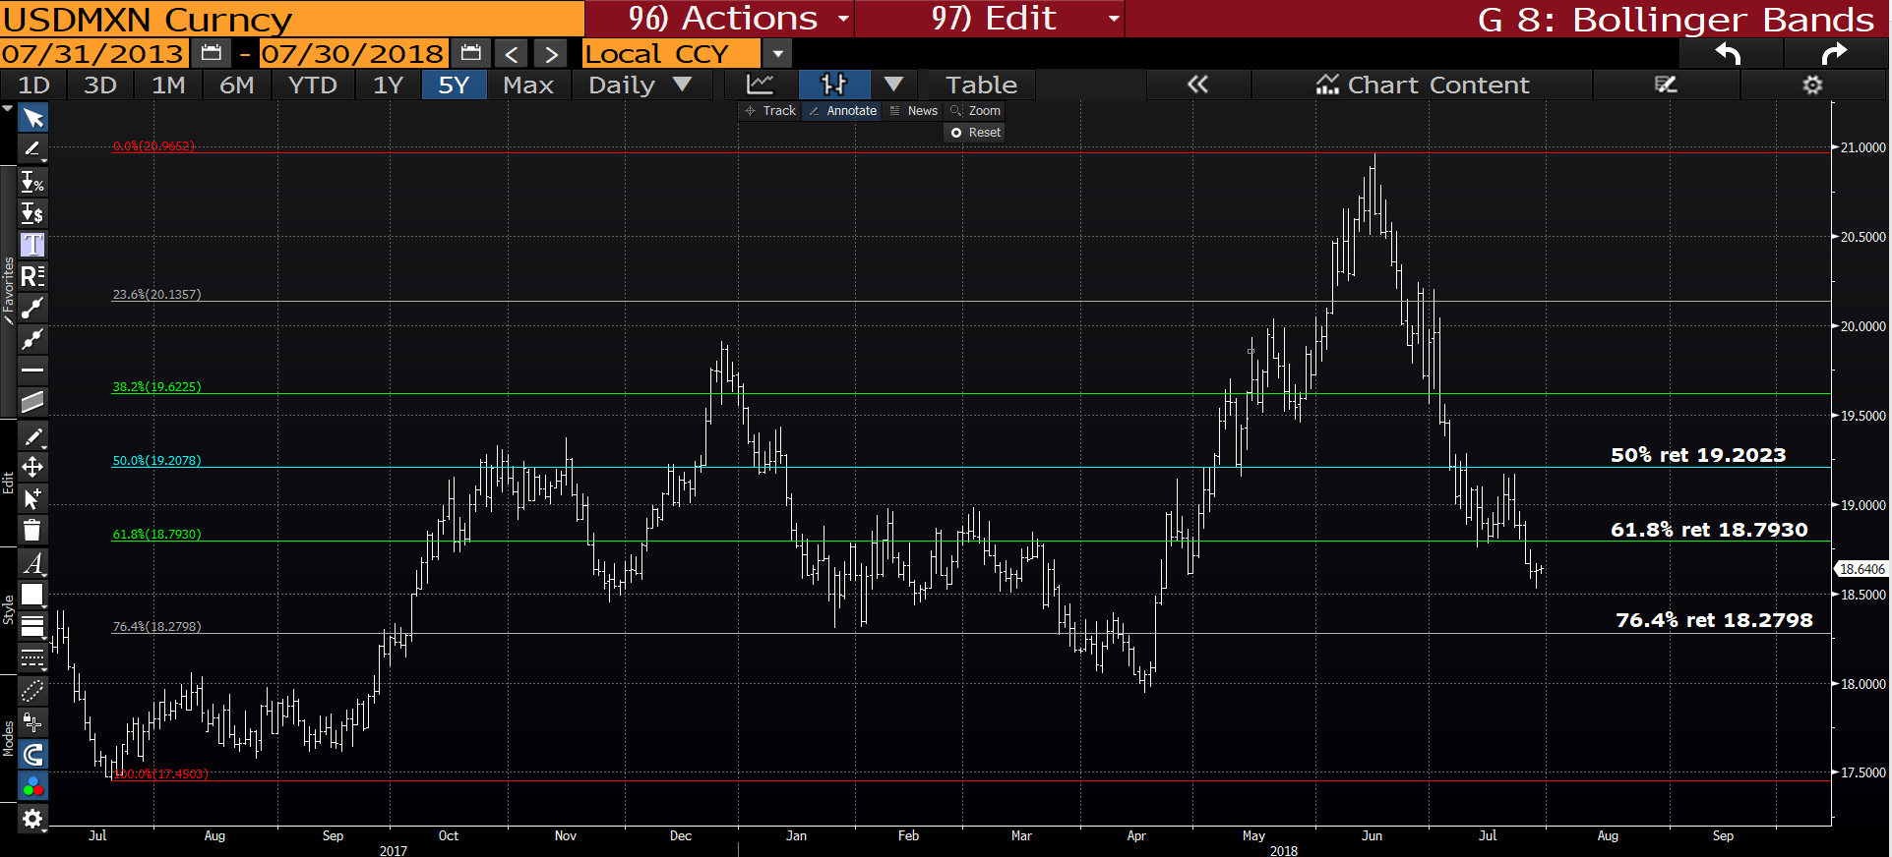
USD MXN daily : We have come along way and could yet go further, maintain shorts sub the 61.8% ret 18.7930.

Slide 20
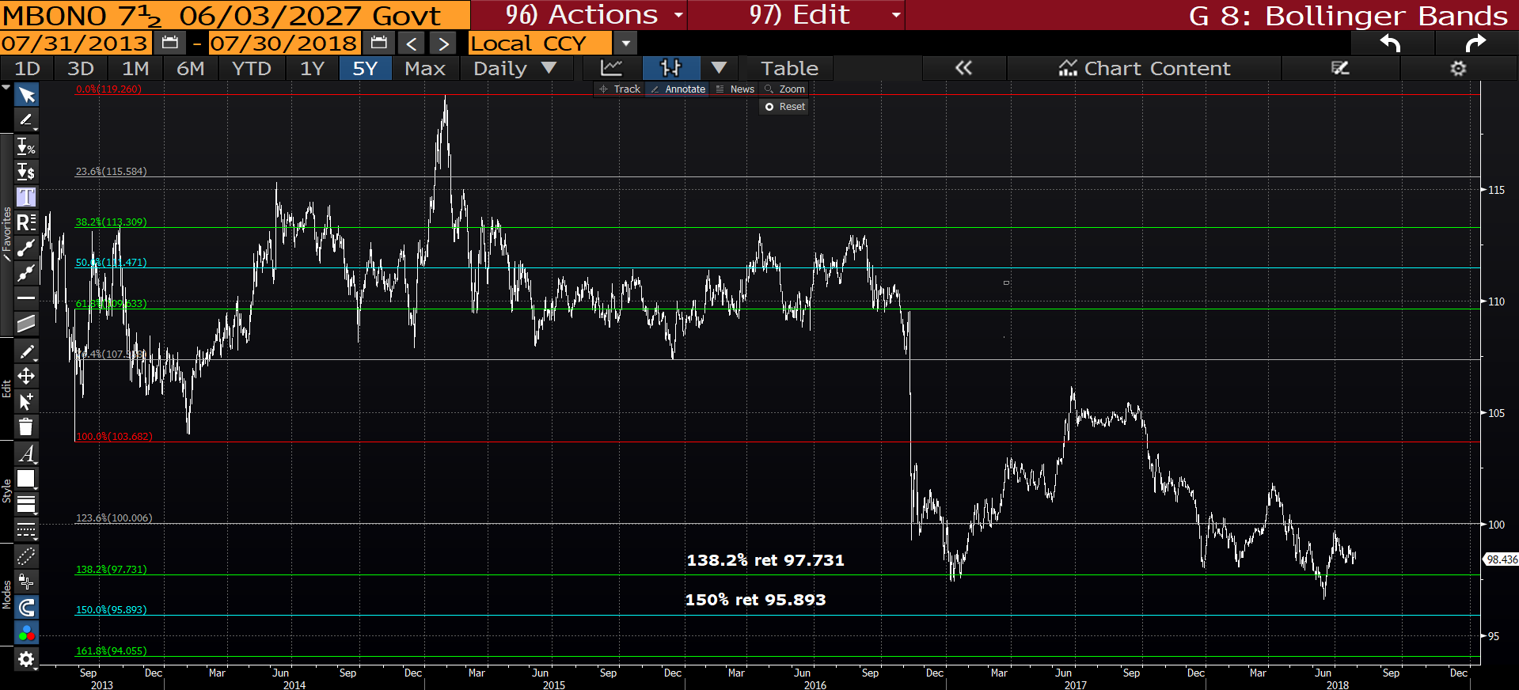
MBONO 7.5 27’s : We have held the 138.2% ret 97.731 which is positive but there is an urgency to breach the 123.6% ret 100.006 to allow continuation. We seem to of lost ALL momentum.

Slide 21
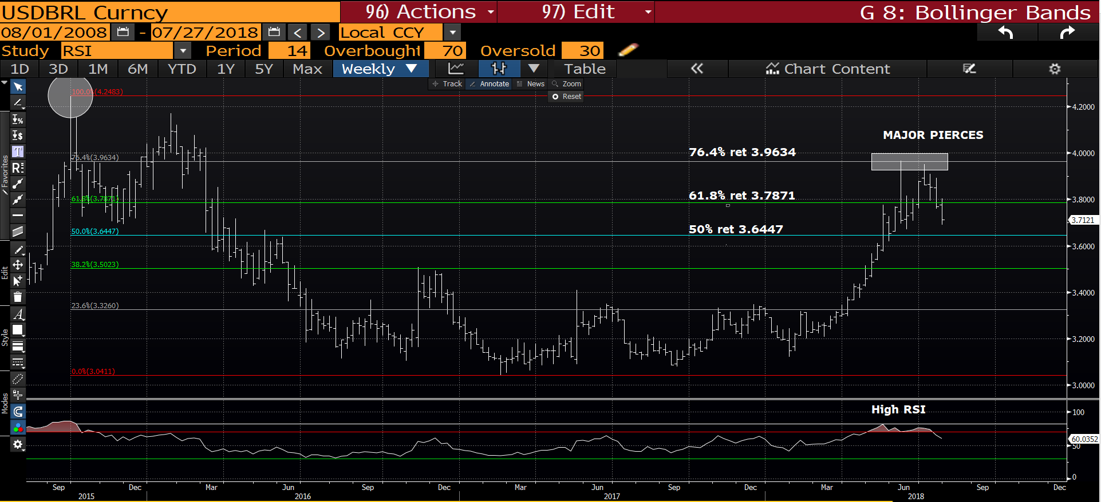
USD BRL weekly : We are FINALLY failing as we now have TWO upside pierces. Having broken below the 61.8% ret 3.7871 should hit stops and draw us to the 50% ret 3.6447. Sub the 61.8% ret continues the negative theme.

Slide 22
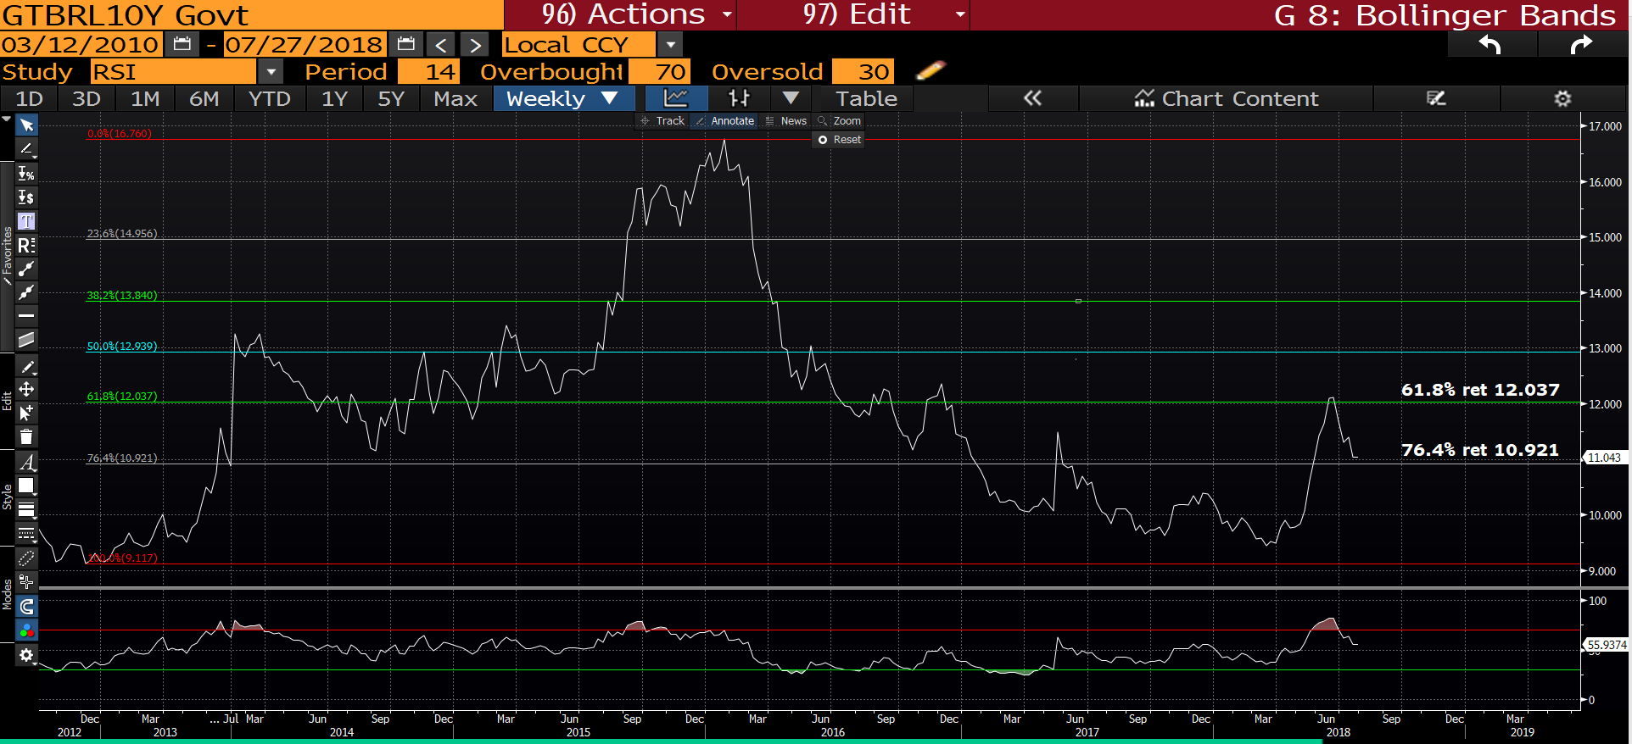
GTBRL10Y weekly : Yields have dropped nicely and the next step is to breach the 76.4% ret 10.921.

Slide 23
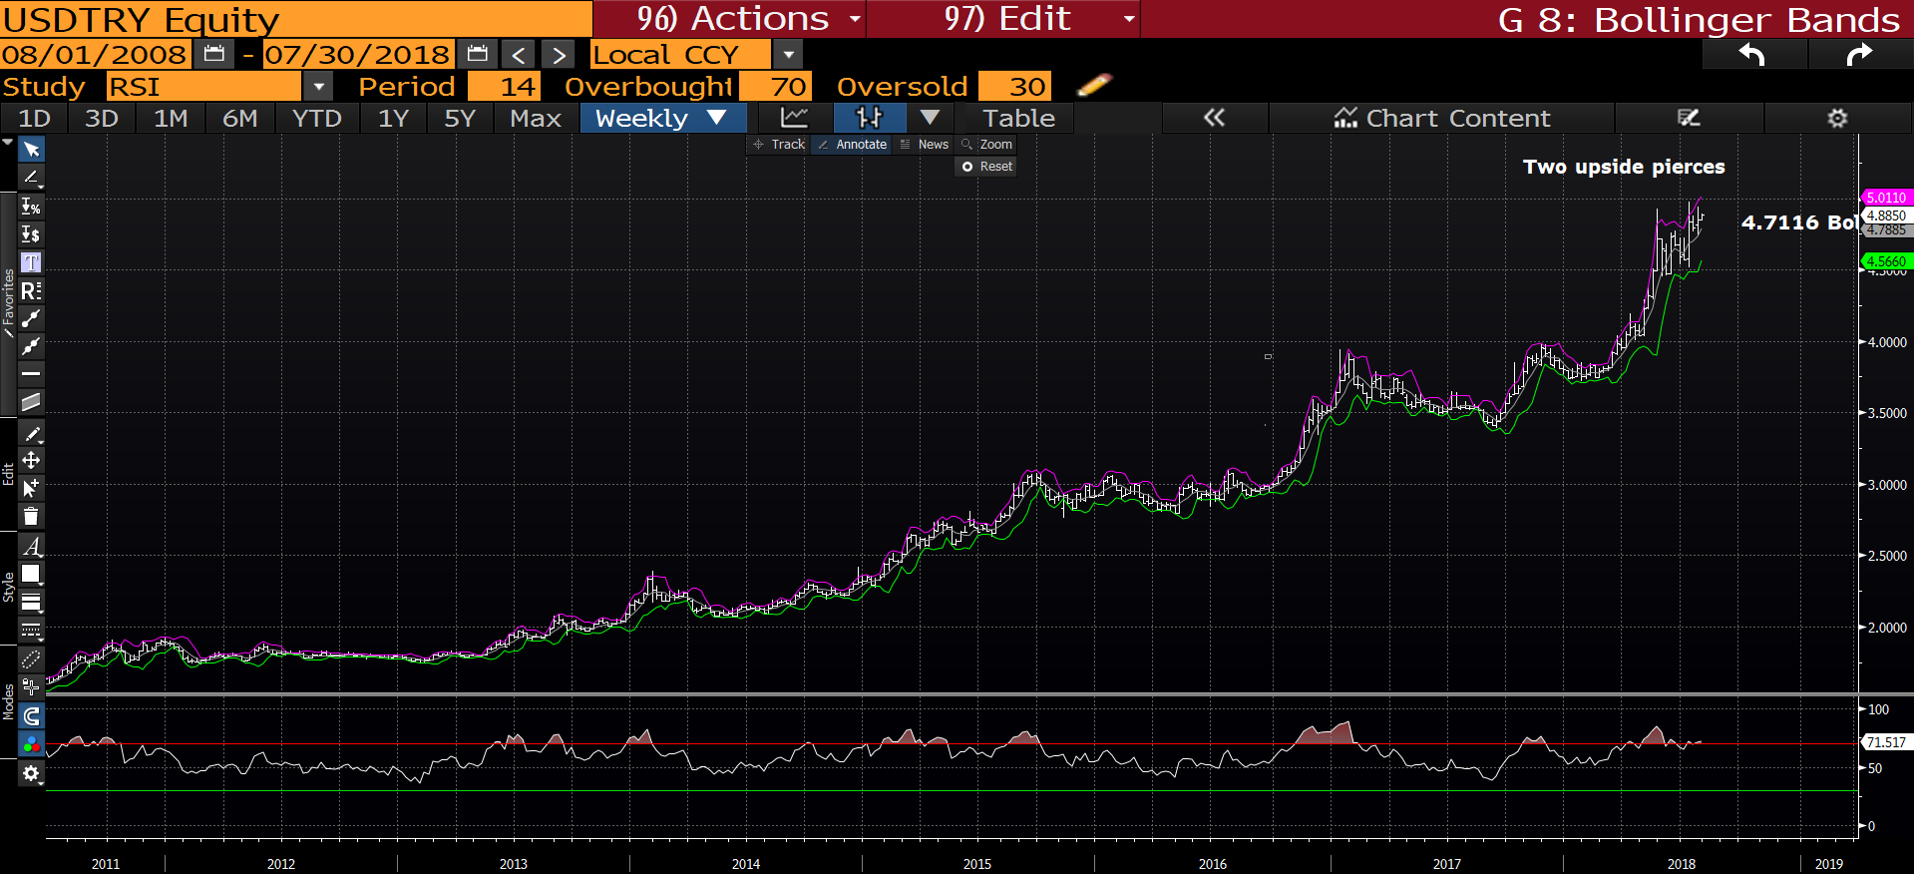
USD TRY weekly : We now have TWO upside pierces so the TOP should now be in, sub 4.7116 bollinger average will help a lot.

Slide 24
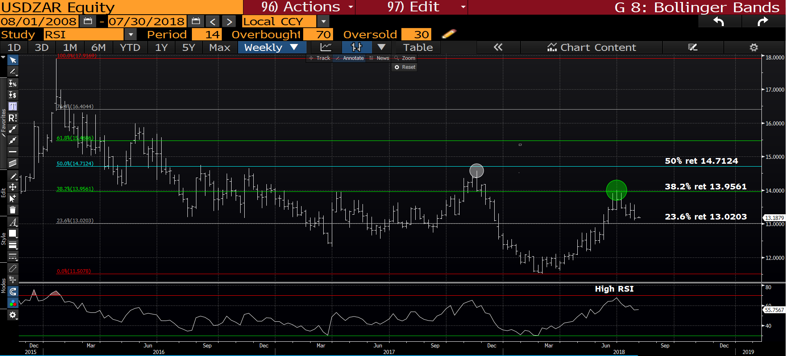
USD ZAR daily : We are grinding lower and sub 23.6% ret 13.0203 will trigger major stops and confirm FAILURE.

Slide 25
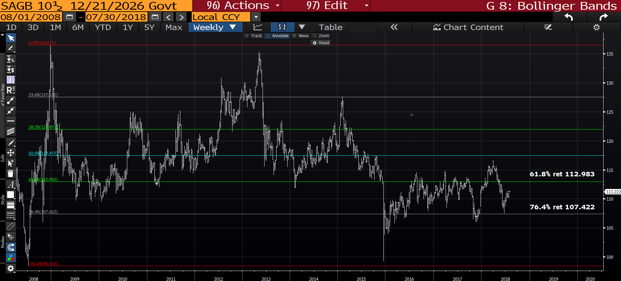
SAGB 26’s weekly : We are recovering slowly and targeting the 61.8% ret 112.983.

