Slide 1
BONDS and EURO UPDATE : Bonds ALSO had a KEY day yesterday “kick starting” the next BIG yield DROP! Add to that HUGE short positioning in US 10yrs and we are POISED for an EXPLOSIVE MOVE!
** There are some VERY SIMPLE charts that are creating NEAR PERFECT formations for MUCH lower yields. **
As LABOURED previously the “writing is on the wall” ALREADY relating to direction, ALL warnings signs emanate from MONTHLY and QUARTERLY charts, that won’t change.
The new month means many upside pierces are now ETCHED in history and some are now sub multi year MOVING AVERAGES.
Chart 3 US 30yr yield, DOES HISTORY REPEAT ITSELF, IF so yields are one way for a long while.

Slide 2
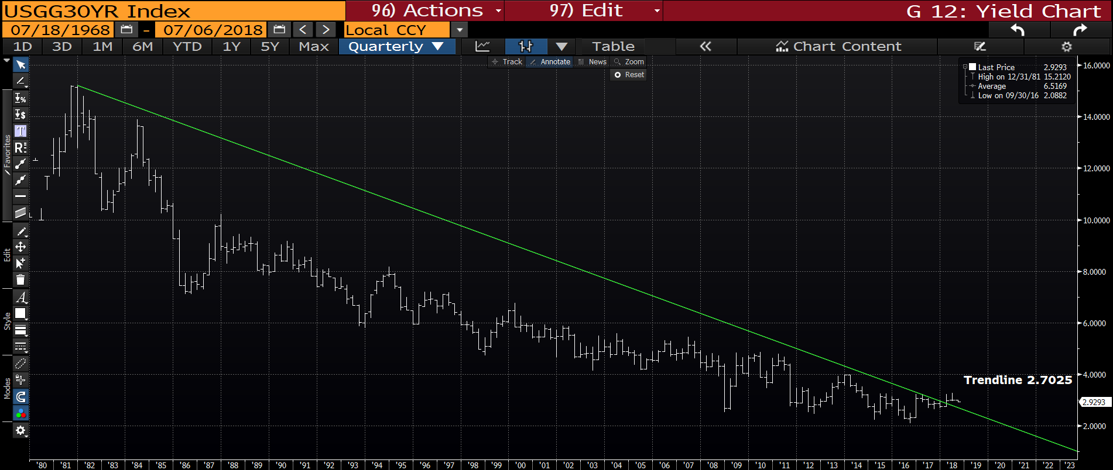
US 30yr yield quarterly : We have already breached last months low and looks like we will FALL AWAY as this month progresses. The trend line is much closer now at 2.7025.

Slide 3
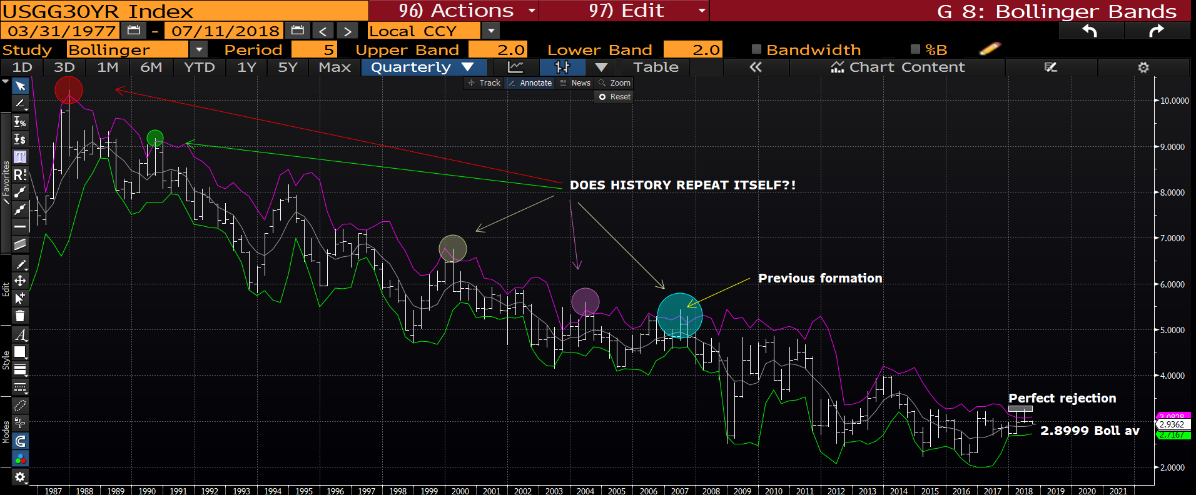
US 30yr yield quarterly : HISTORY IS ABOUT TO REPEAT ITSELF? ON ALL previous occasions yields have dropped and especially associated with DOUBLE UPSIDE PIERCES, as NOW! Any move sub the bollinger average 2.8999 will be negative and initiate a trend LOWER.

Slide 4
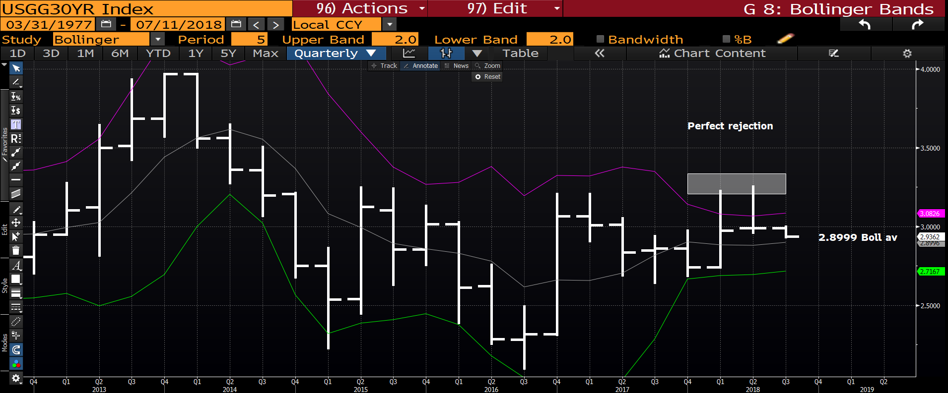
US 30yr yield quarterly : This “blow up” highlights 2 VERY nasty upside rejections and a breach of the 2.8999 bollinger average will help. The pierces will not go away so any yield bounce will be “window dressing” before the DROP. I would still FADE any POP to 3.09 the bollinger top.

Slide 5
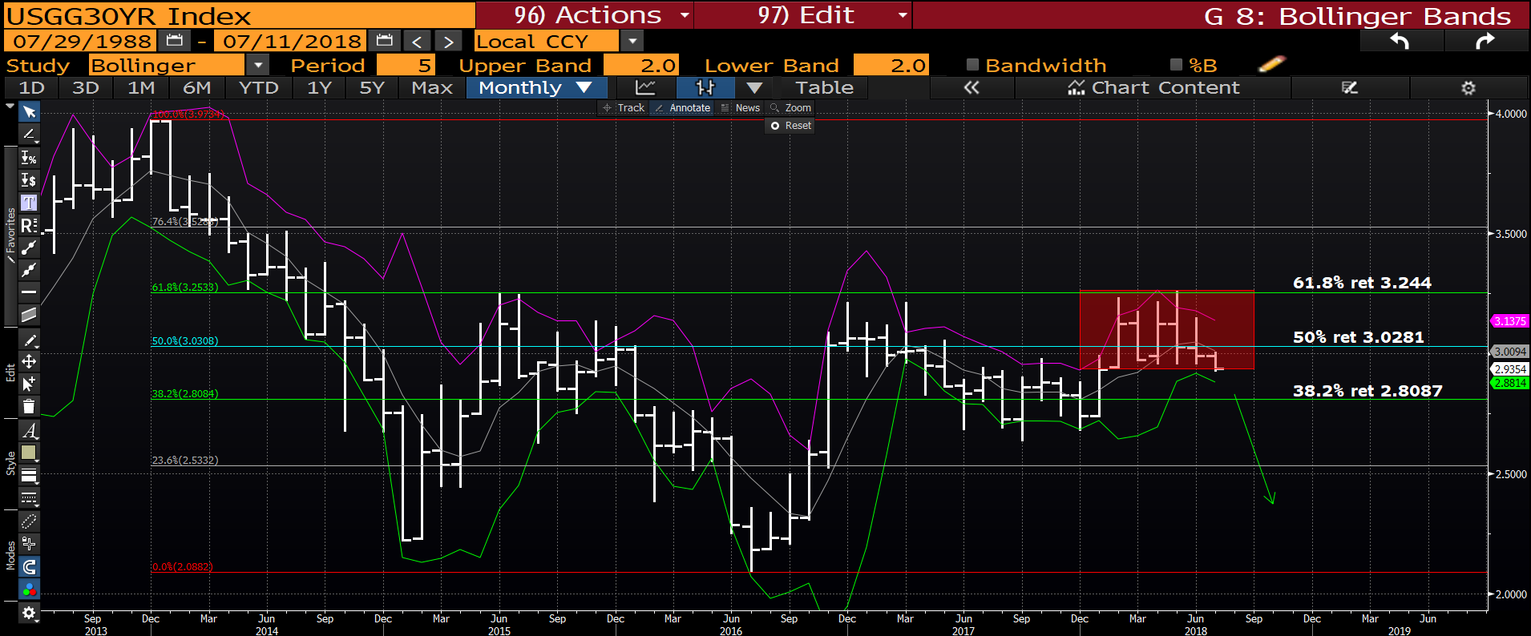
US 30yr yield monthly : We HAVE breached the 5 month RANGE and are well on the way to much lower yields. THIS WILL ONLY BE THE START! Sub 2.8087 seems an EASY and DISTINCT prospect.

Slide 6
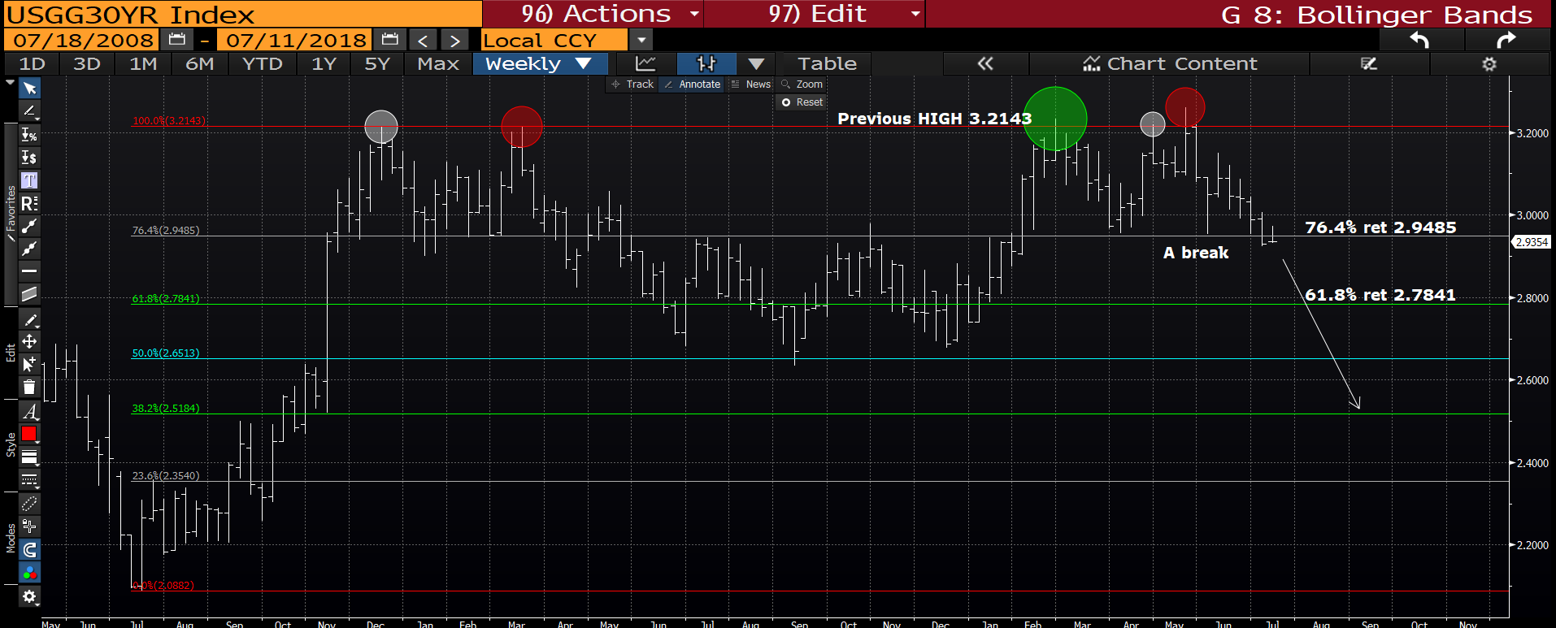
US 30yr yield weekly : Ideally we close the week sub the 76.4% ret 2.9485 so any subsequent breach will be a significant statement.

Slide 7
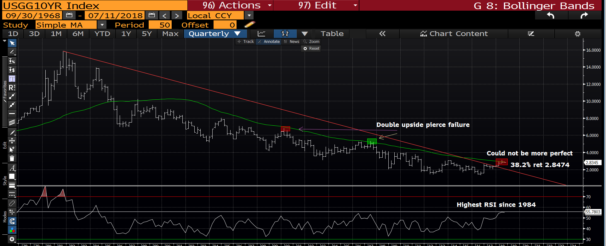
US 10yr yield quarterly : The RSI dating back to 1984 is not going to go away, thus the BIAS still remains for lower yields. Another PERFECT YIELD FAILURE is forming! We are now sub the moving average 2.8474 poised to head much lower.

Slide 8
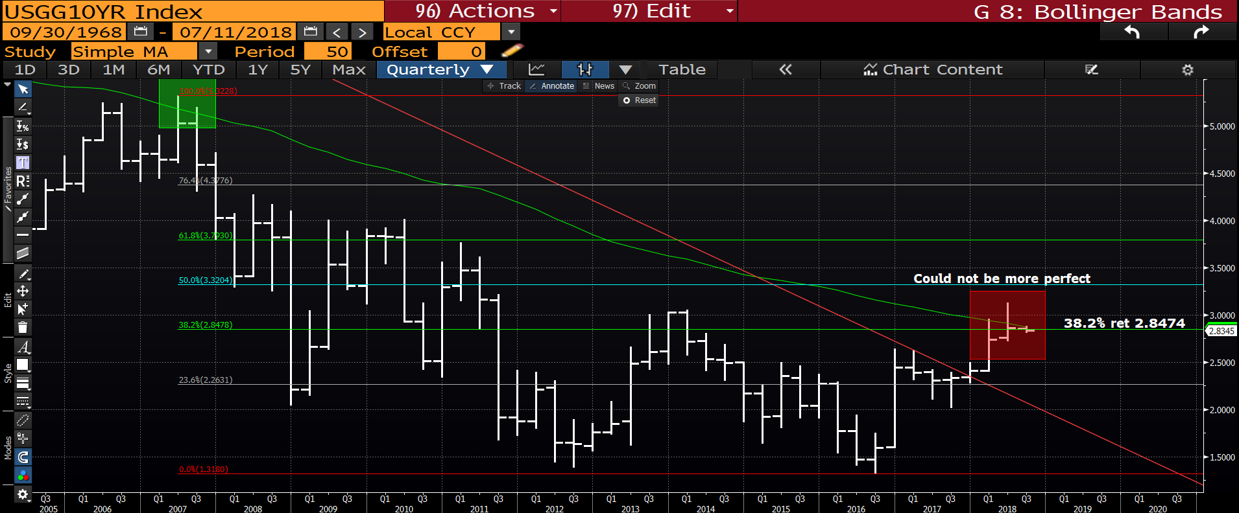
US 10yr yield quarterly : This is going to become the PERFECT failure? This is poised to be the PERFECT failure at the 2.8474 38.2% ret. Another chart where if HISTORY REPEATS ITSELF, yields will be significantly lower.

Slide 9
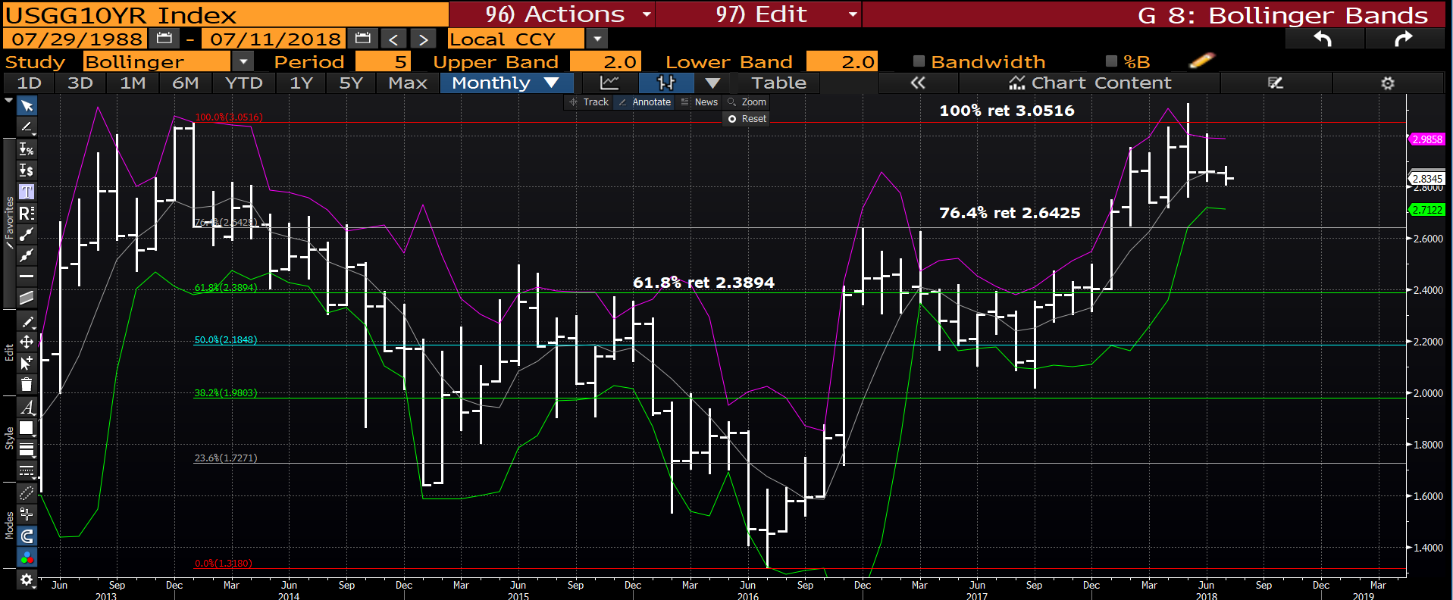
US 10yr monthly : We have made a new low on last month BUT unlike the US 30yr it doesn’t carry the same enormity of breach.

Slide 10
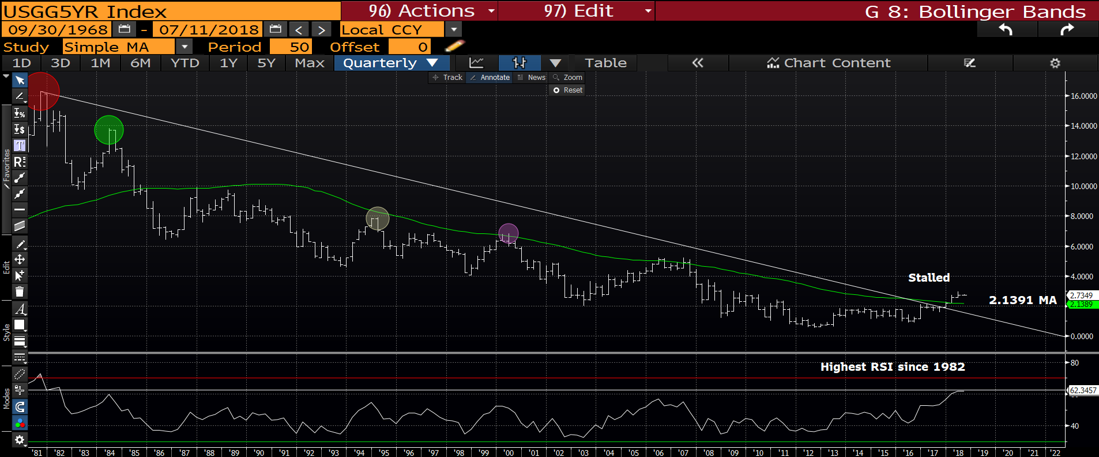
US 5yr quarterly : To many, this remains a positive chart i.e. above the moving average and trendline BUT the RSI will not diminish given it is of 1982 proportions. Also once we fail the moving average 2.1391, there are numerous example of what has happened before.

Slide 11
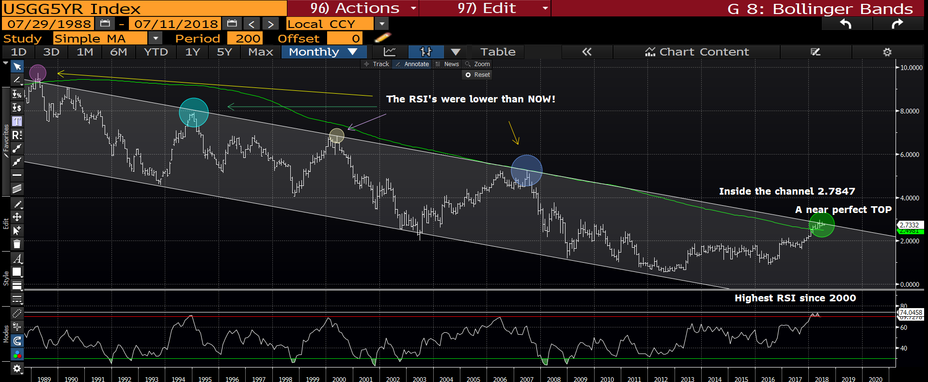
US 5yr monthly : A MAJOR statement as we are now back in the LONGTERM trend channel (2.7847), the RSI has A LOT of unwind potential. Key break would be SUB the MOVING AVERAGE 2.4982.

Slide 12
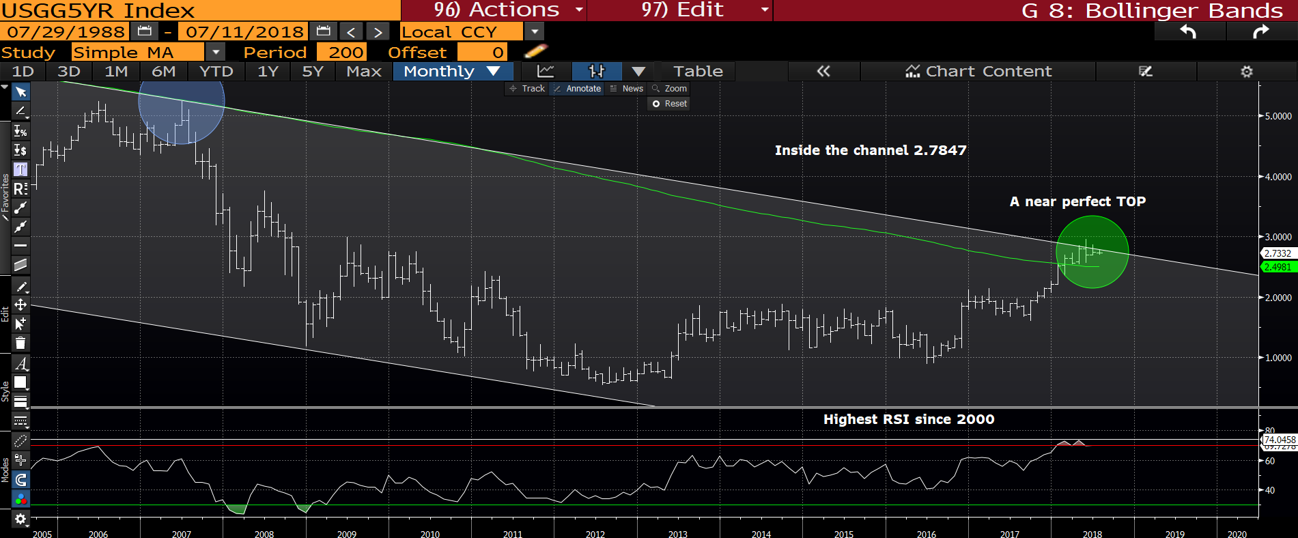
US 5yr monthly : Another perfect formation looming, we have stalled against the trend channel with significant room to head lower. Sub the moving average 2.4891 will help.

Slide 13
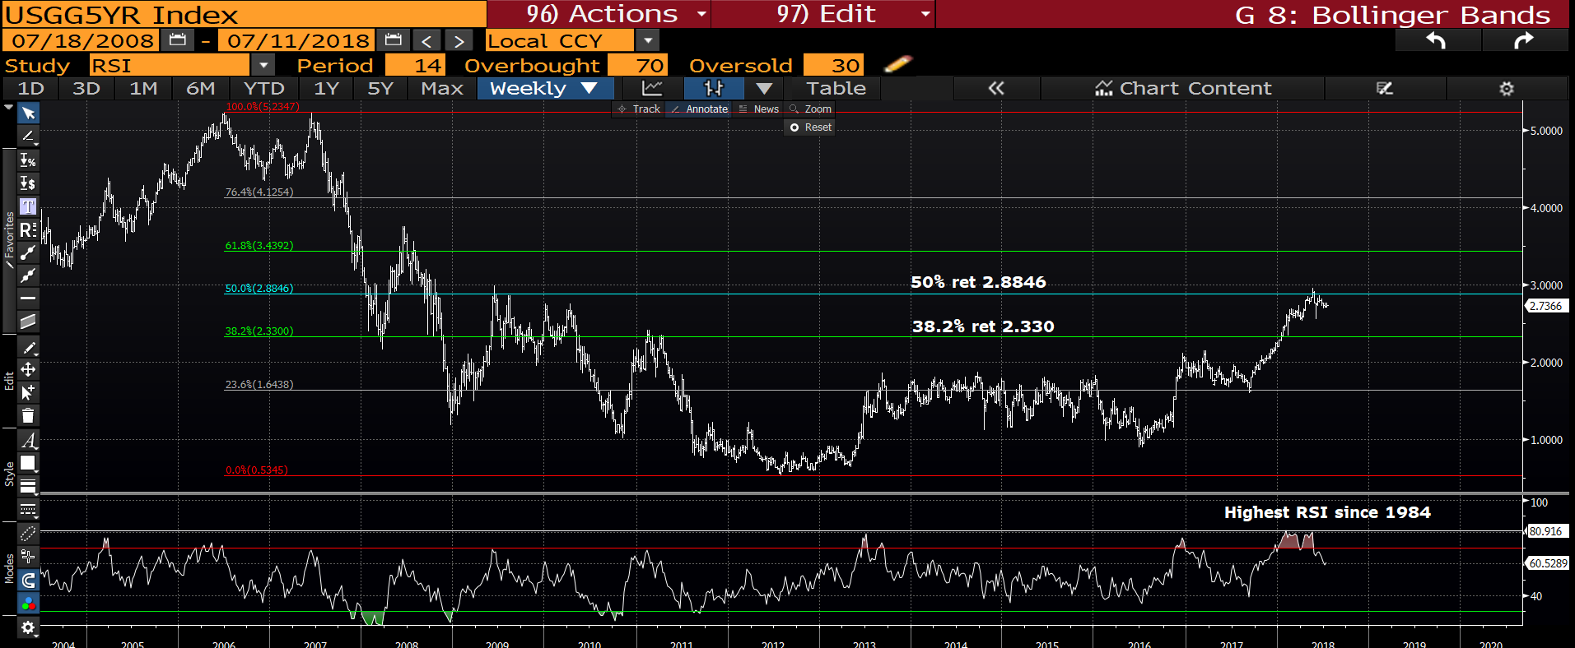
US 5yr weekly : We have failed the 50% ret 2.8846, targeting the 38.2% ret 2.330. The RSI at 1984 levels!

Slide 14
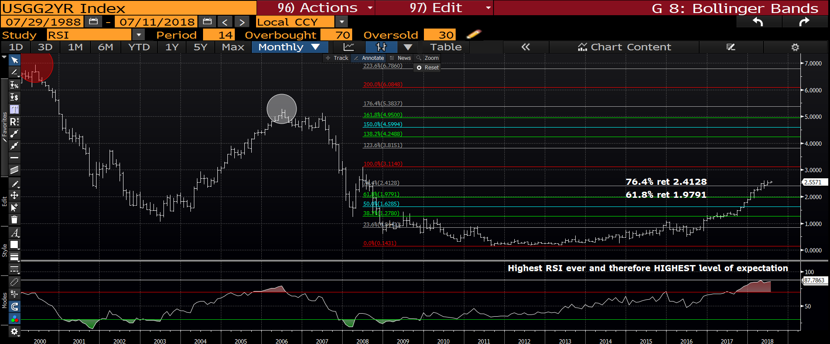
US 2yr monthly : The RSI speaks for itself and we look close to STALLING, sub the 76.4% ret 2.4128 is KEY.

Slide 15
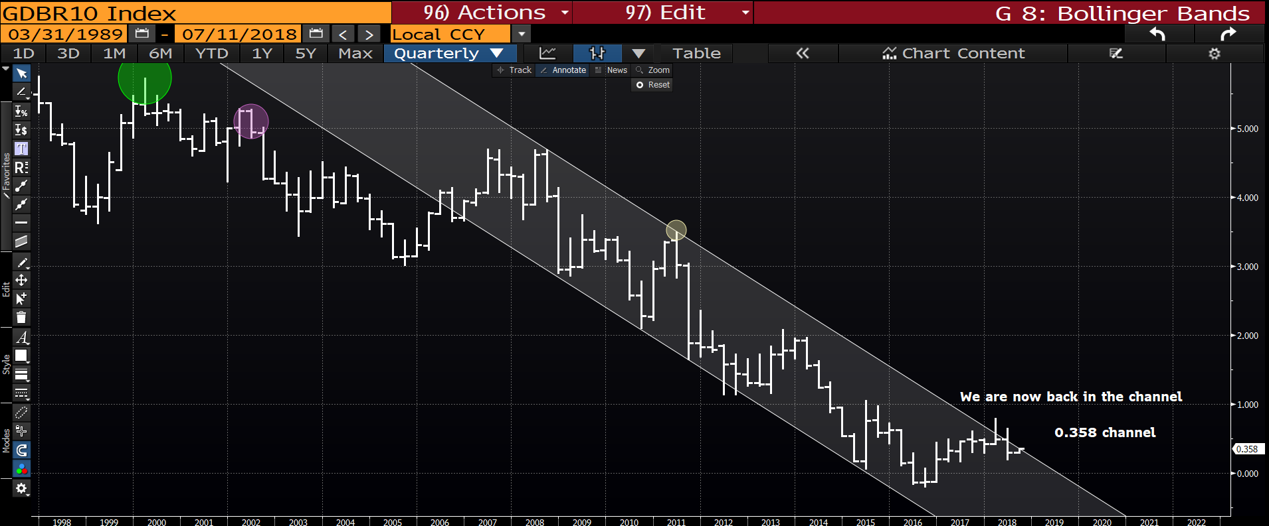
Generic German 10yr quarterly : We now have 2 SOLID UPSIDE PIRECES that are etched in history, this will form an explosive bearish tone for yields. Whilst teasing the multi year channel this is forming a very nice-tidy chart. COULD it be as simple as this?!

Slide 16
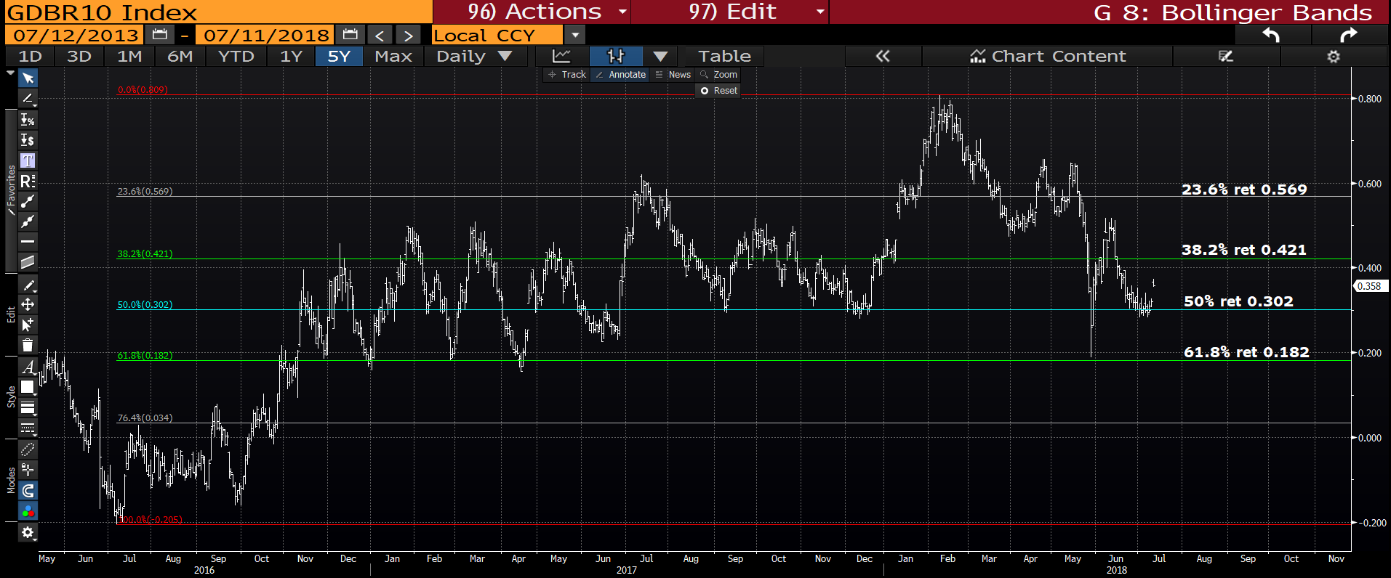
Generic German yield daily : We are teasing the 50.0% ret 0.302 and targeting the 61.8% ret 0.182. A breach of the 61.8% ret 0.182 will trigger major stops.

Slide 17
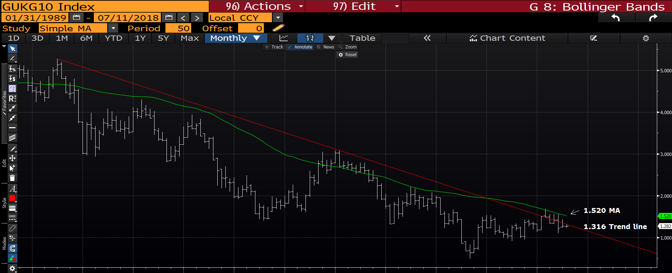
UK 10yr monthly : We are now back below the 2008 trendline 1.316 and should head lower in yield. A KEY level to fade on any bounce! ANOTHER TIDY chart.

Slide 18
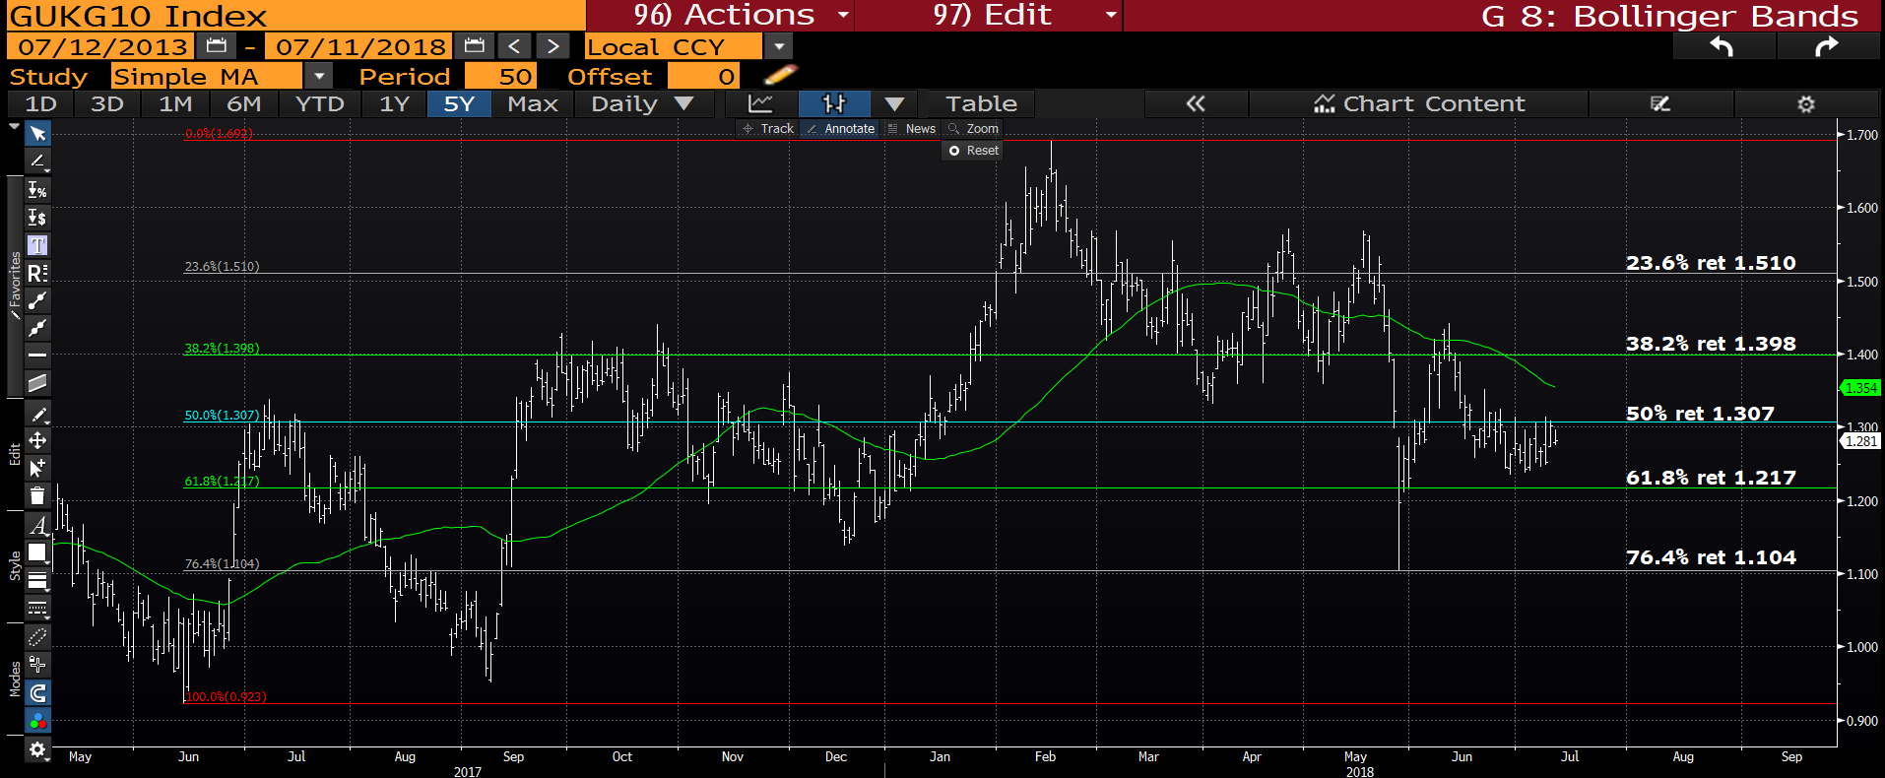
UK 10yr yield daily : We have key resistance at the 50% ret 1.307, sub the 61.8% ret 1.217 will be key.

Slide 19
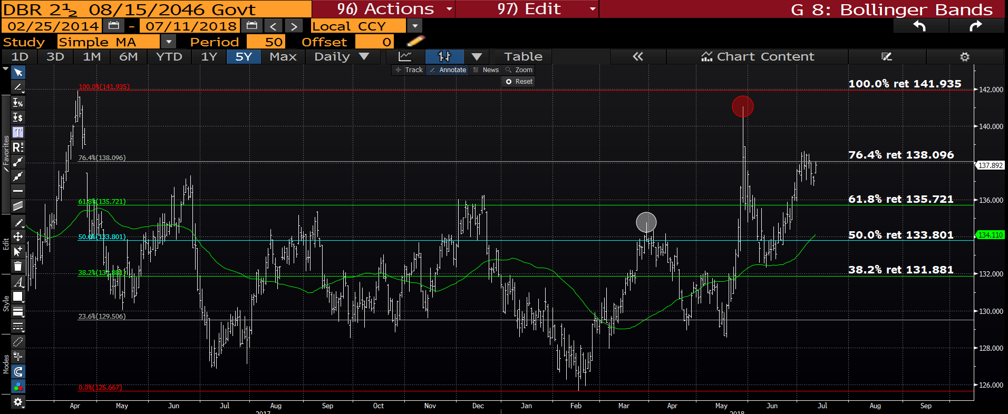
DBR 46 daily : We look VERY close to making a new high and certainly a breach of the 76.4% ret 138.096 will go a long way to helping.

Slide 20
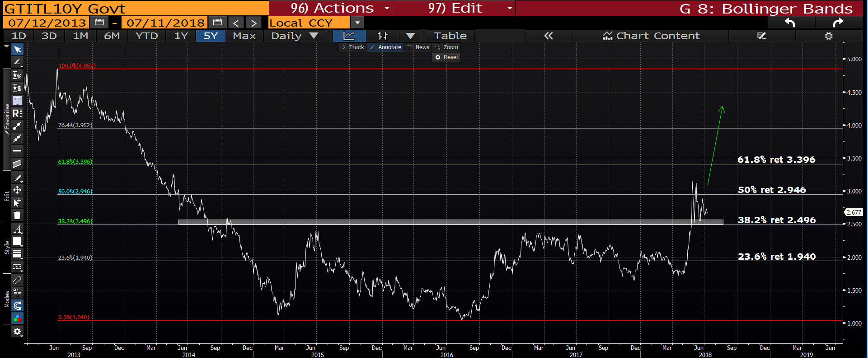
Italian generic 10yr daily : We have held the 38.2% ret 2.496 but the chart leaves the door wide open for much higher yields. I think liquidity will add to the yield rally.

Slide 21
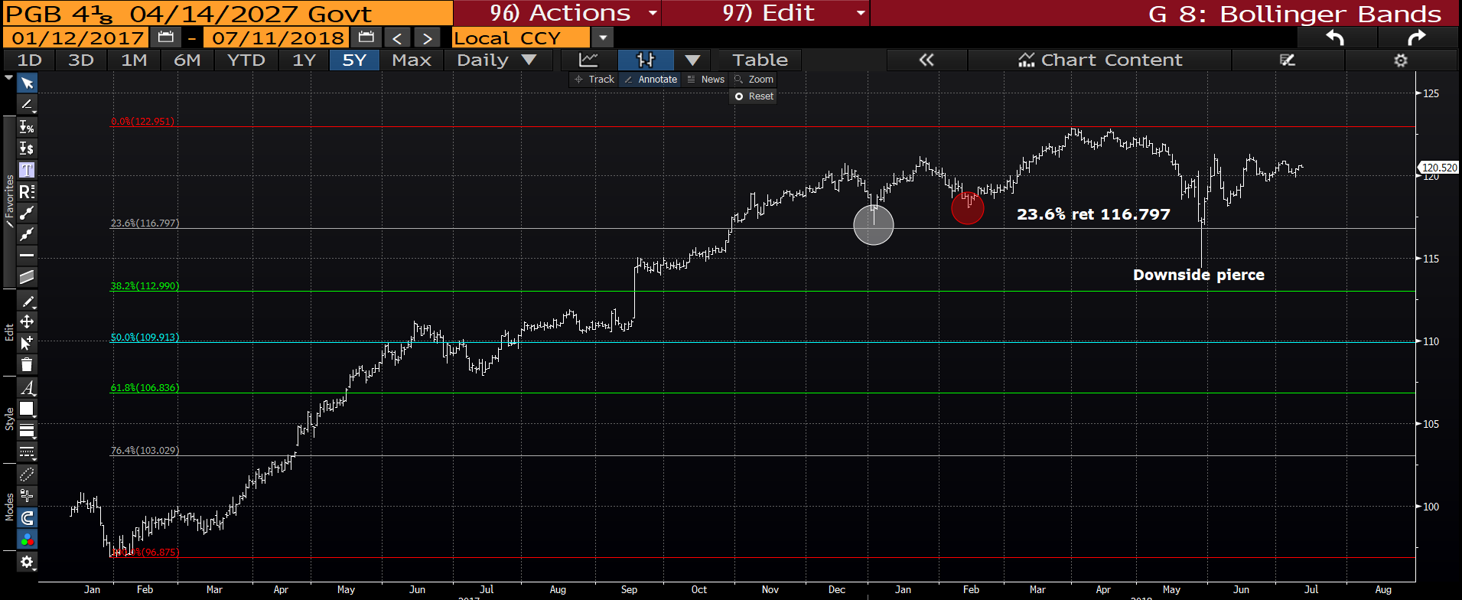
Portugal 27’s : For the first time in a long while PGB is a worry but the RSI is neutral, hence not included.

Slide 22
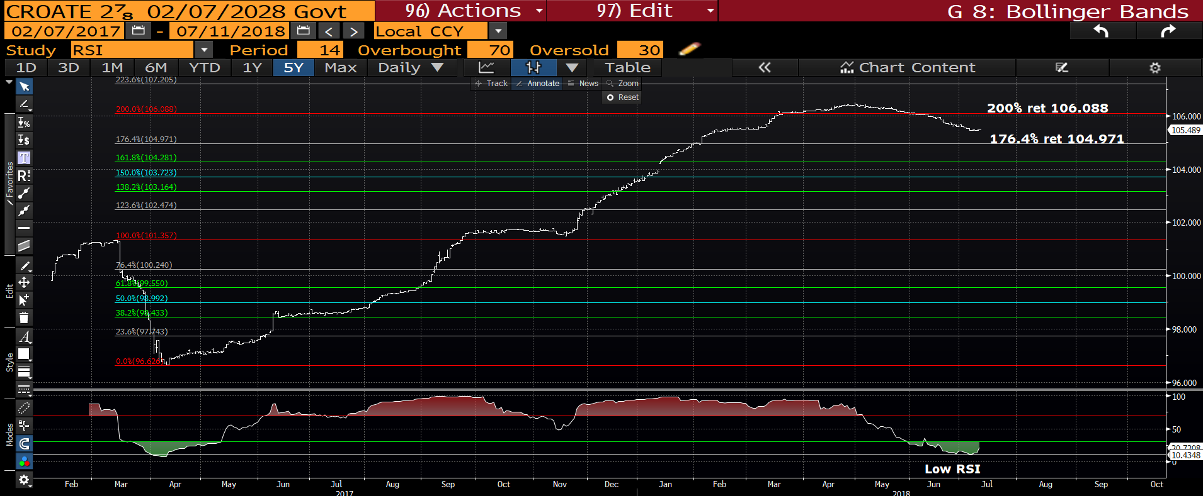
**Croatia 28’ daily : The RSI is now VERY low but we have dipped below the 200% ret 106.088. We should hold here given the RSI.

Slide 23
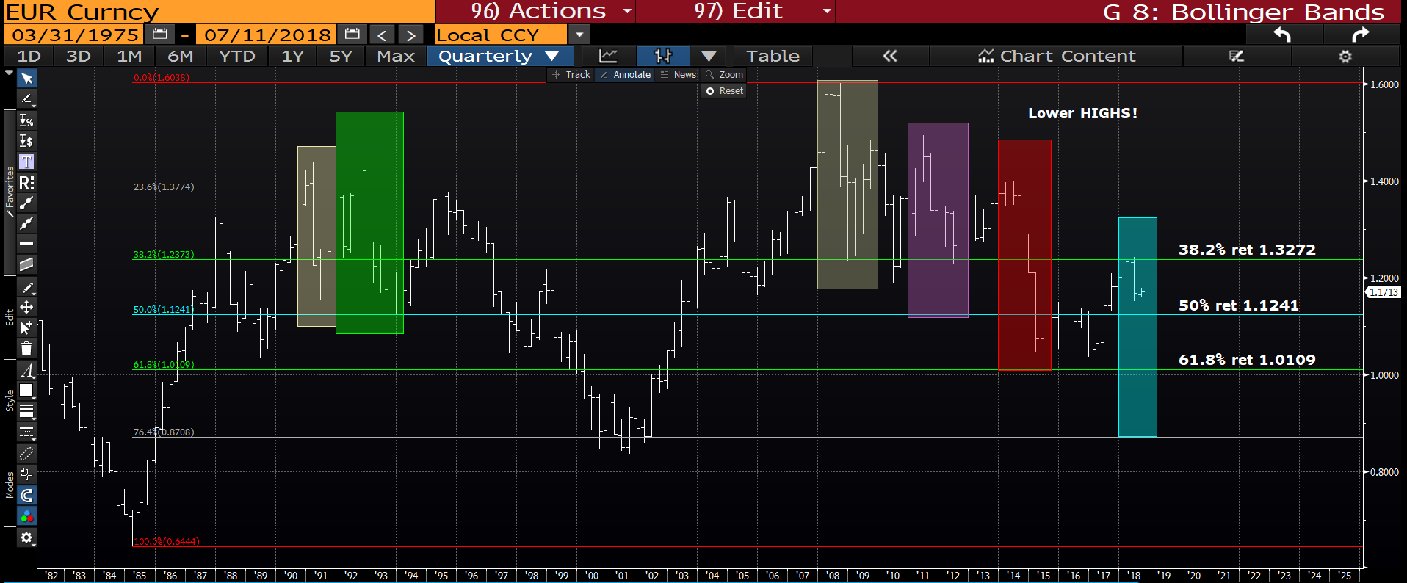
EUR USD quarterly : We have opened at the close of the last quarter, hopefully we can just head lower directly from here, in a similar fashion to last quarter. The initial target may be the 50% ret 1.1241 thereafter it could be the 61.8% ret 1.0109.

Slide 24
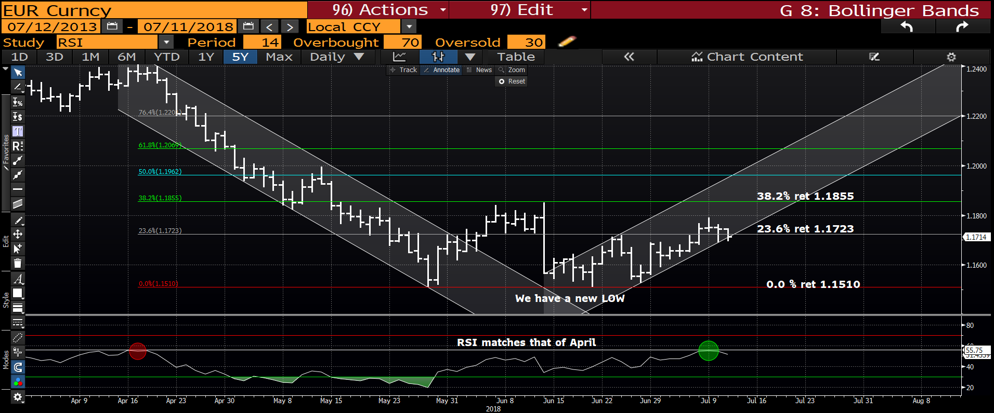
EUR USD daily : A KEY DAY TO FAIL. If we can close sub the 23.6% ret 1.1723 then this will kick start a greater move lower and put us back ON TREND.

Slide 25


